Slide 1
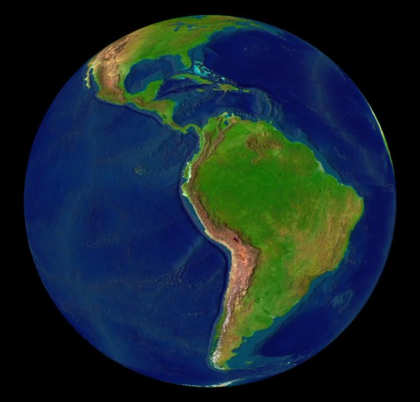
6th gr Latin America
Ch 1

Slide 2
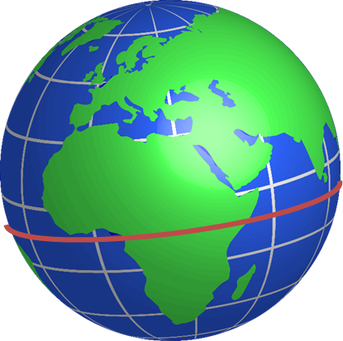
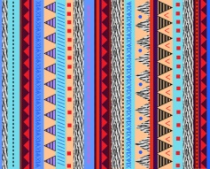
What factors affect climate in Latin America?
Elevation, the Equator, and wind patterns

Slide 3
A narrow strip of land that connects Mexico to South America. It is boarded by water on two sides is called an…….?
Isthmus

Slide 4
Located along the west coast of South America, they are the 2nd largest mountains in the world.
Andes Mountains

Slide 5
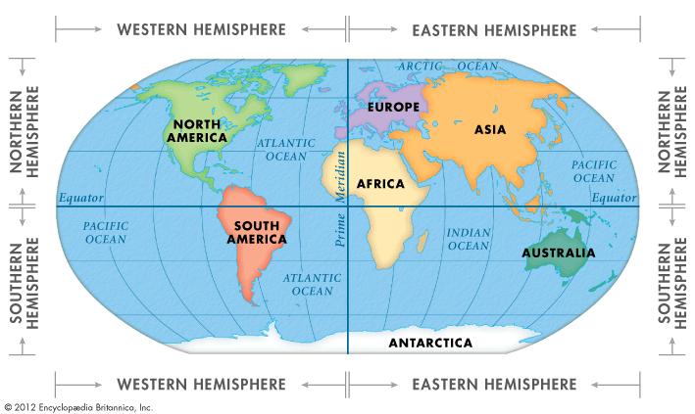
Where is Latin America located?
Western Hemisphere South of the United States

Slide 6
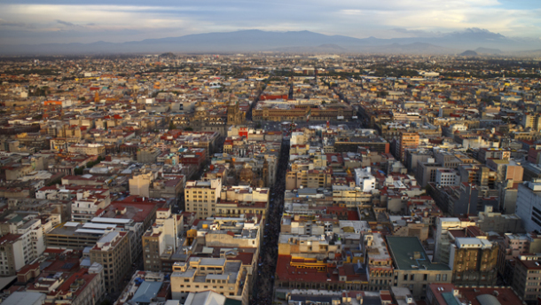
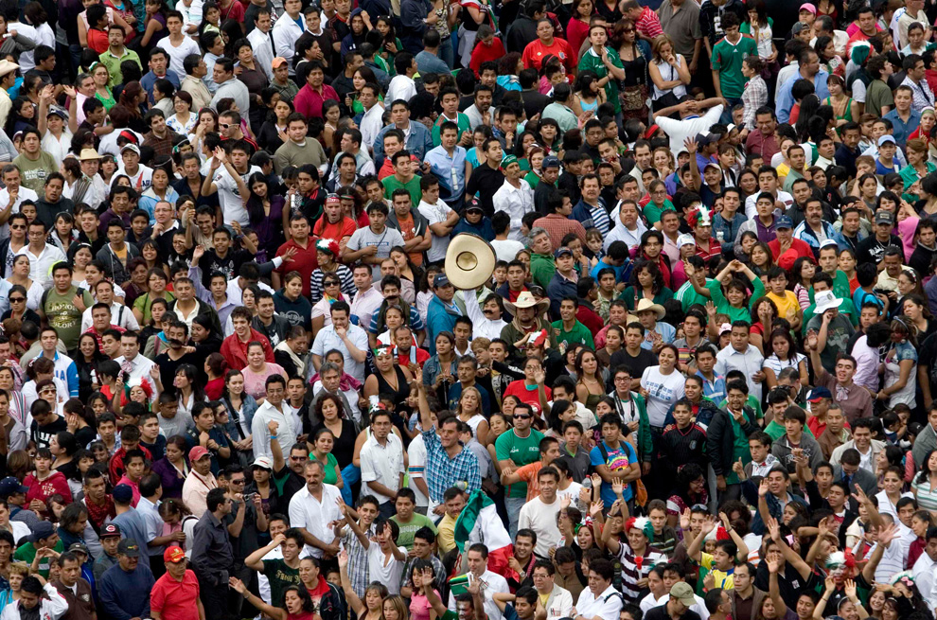
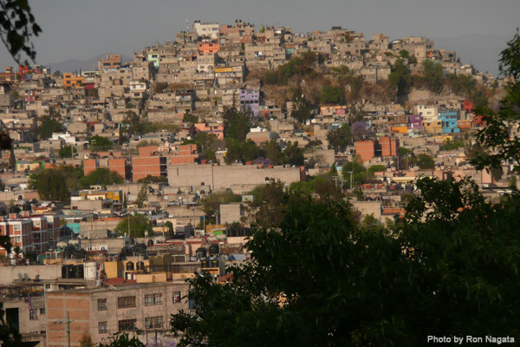
Why is mexico’s central plateau important to the region?
Most of the country’s people live there.

Slide 7
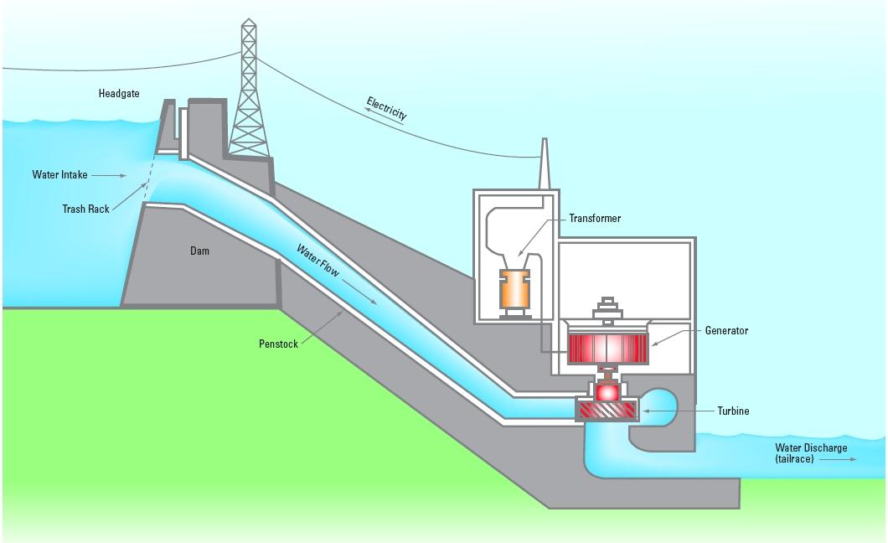
One of the uses of rivers in Central America is to produce what?
Hydroelectricity

Slide 8
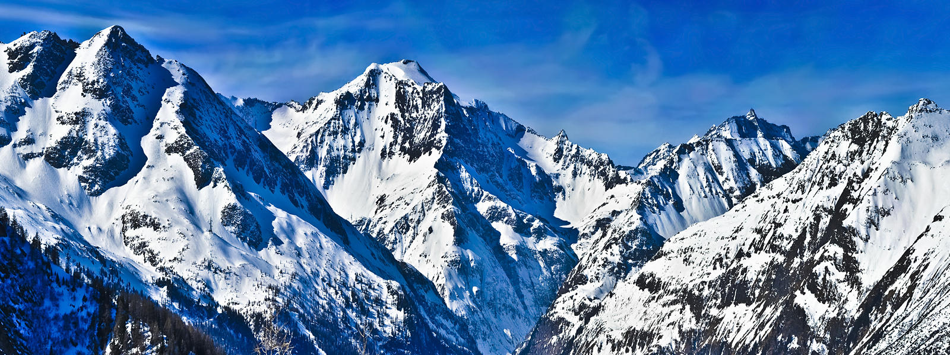
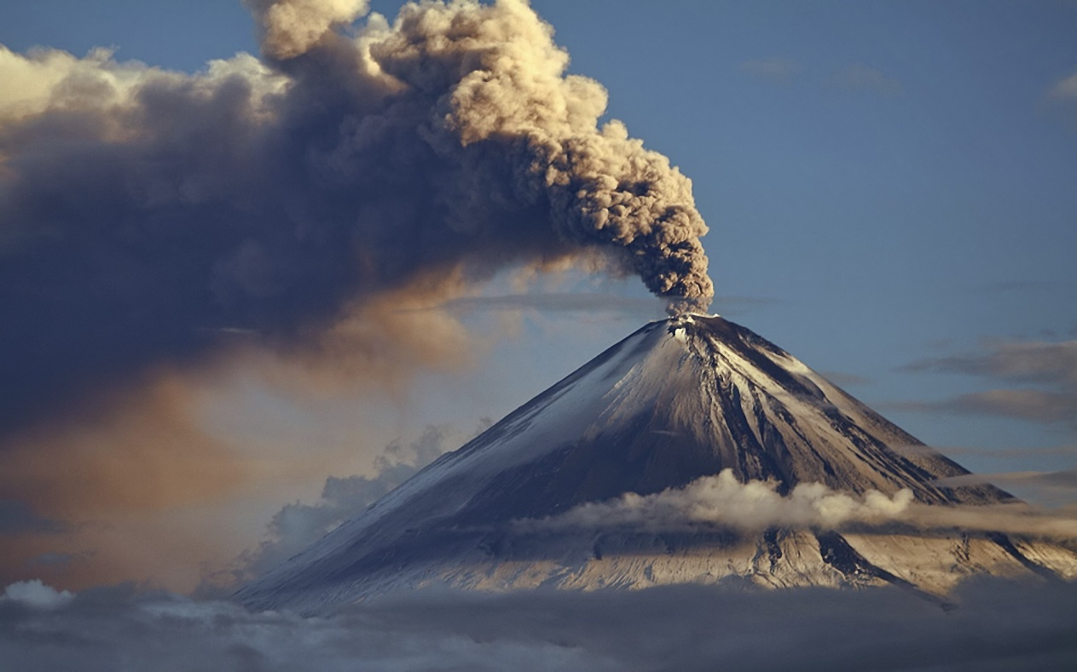
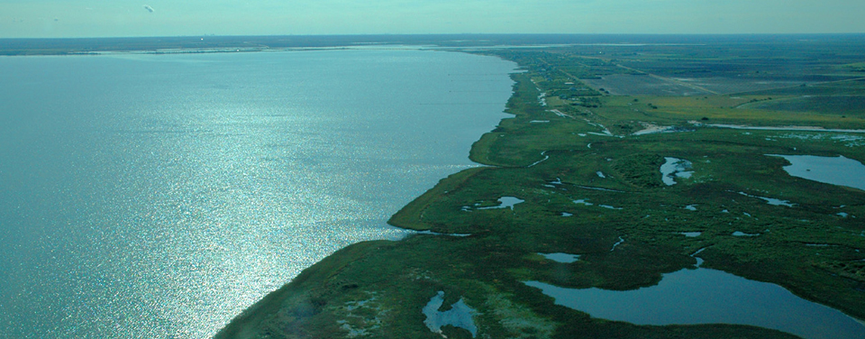
Central America has multiple landforms, they are……?
Mountains, Volcanoes, and Coastal Plains

Slide 9
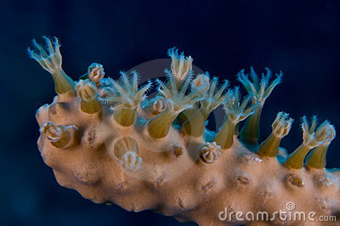
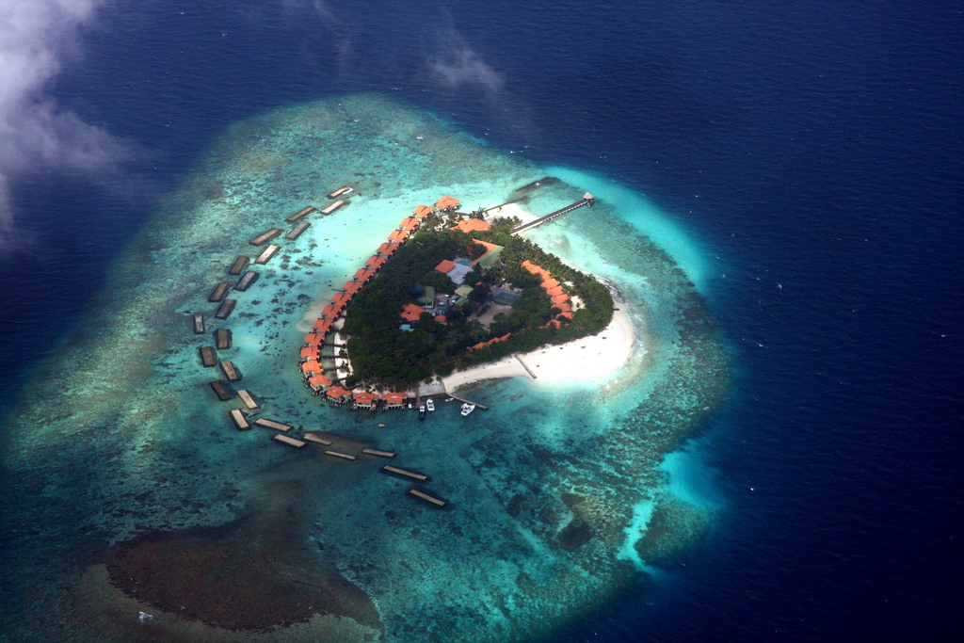
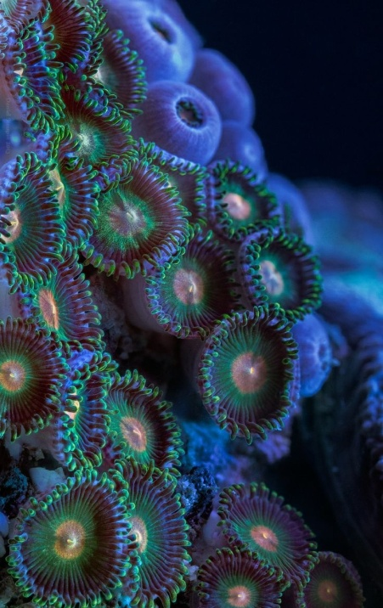
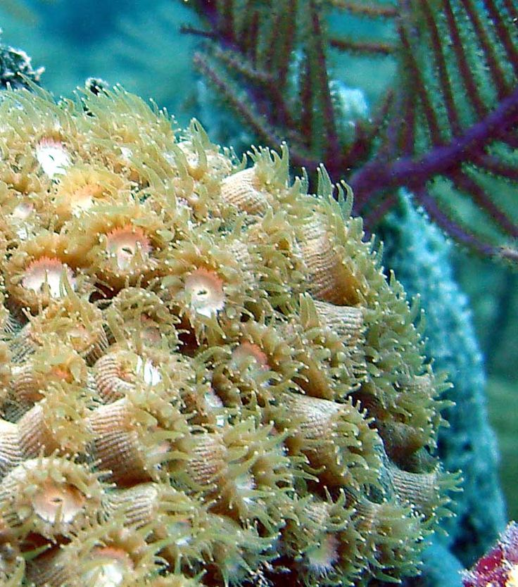
Some Caribbean islands are coral islands formed from what?
The skeletons of tiny sea animals

Slide 10
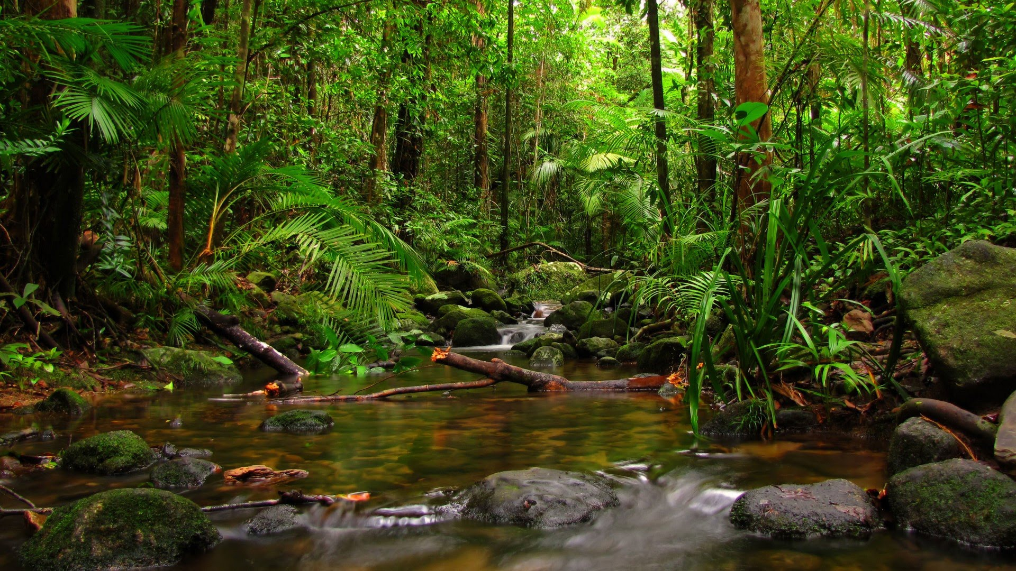
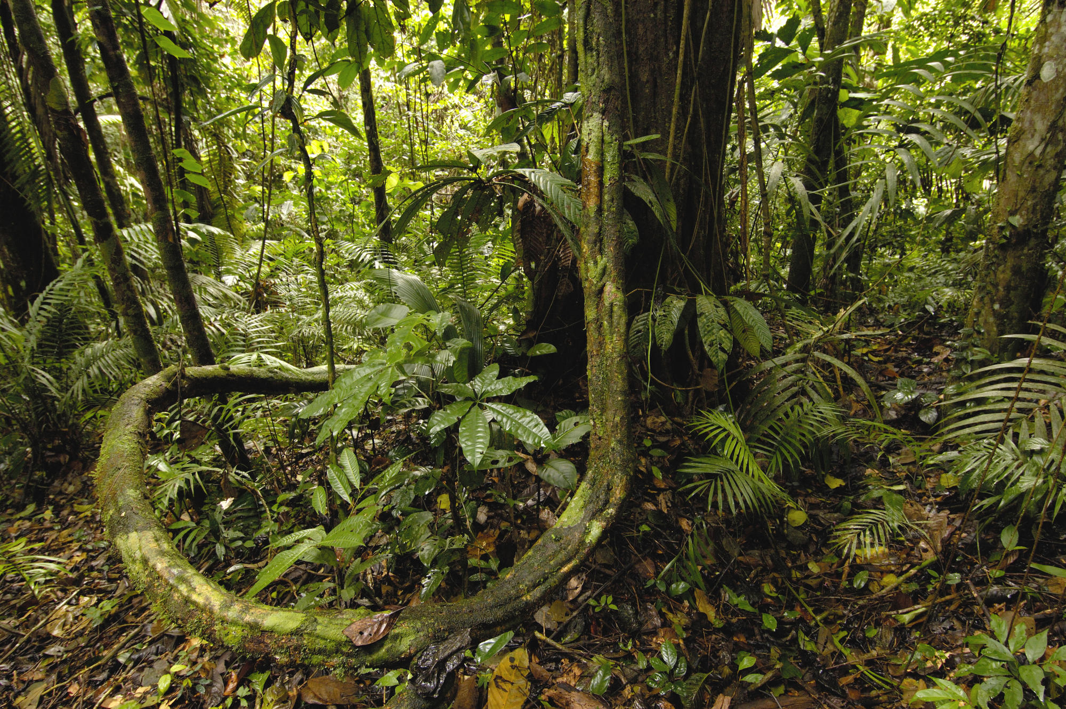
What is the Amazon River Basin home to?
The largest tropical rain forest in the world

Slide 11
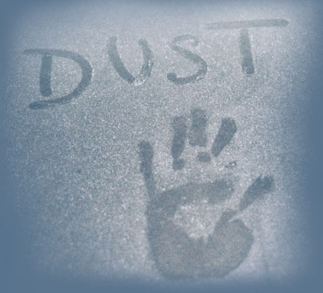
To reduce their reliance on one natural resource or crop, many Latin American countries have begun to do what?
Build up their industries & Diversify

Slide 12
The drop in oil prices in the 1980’s probably helped to convince Venezuela to do what?
Promote investment in other industries & Diversify

Slide 13
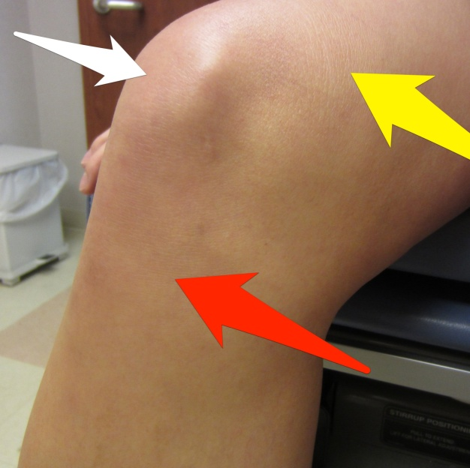
A warming of the ocean water along the western coast of South America is called an……?
El NIÑO

Slide 14
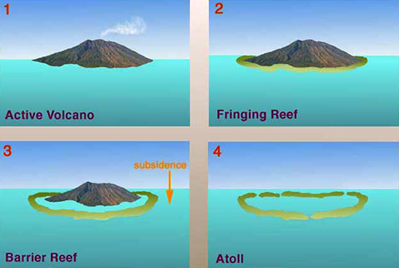
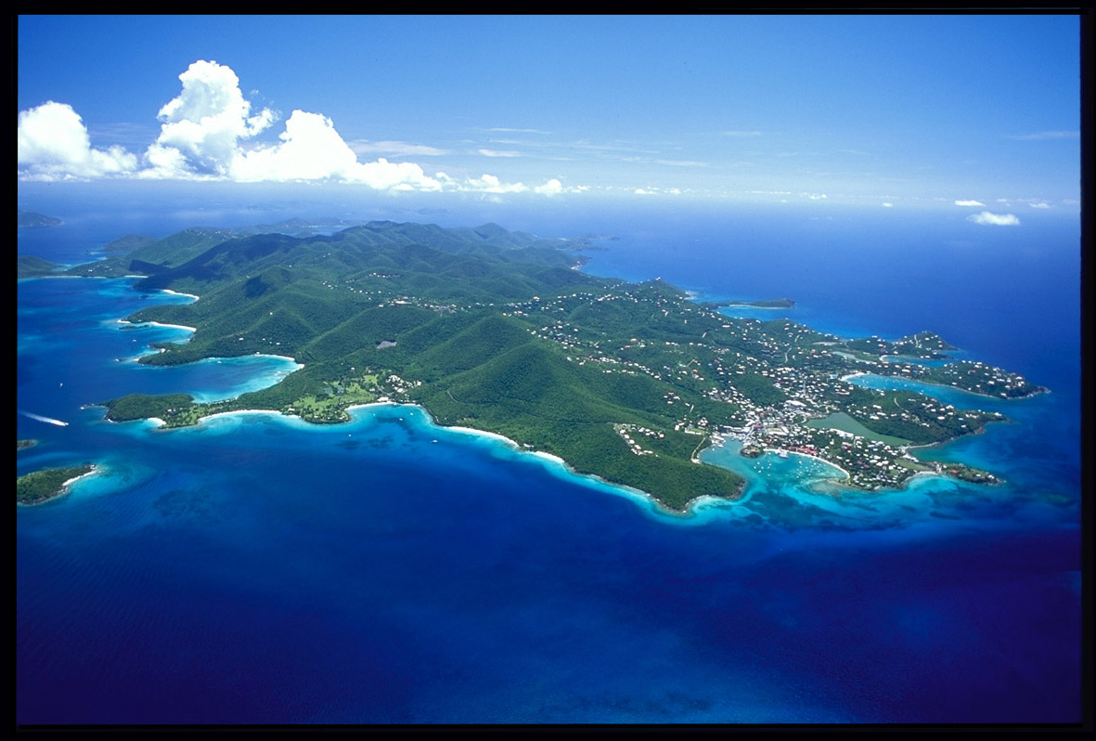
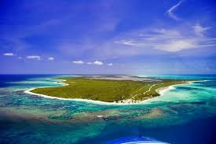
How are some Caribbean islands formed?
Tops of under water volcanic mountains Coral Reefs

