Slide 1
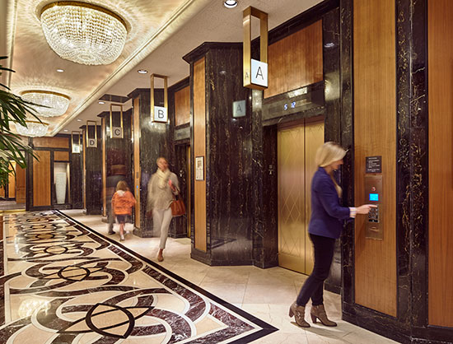
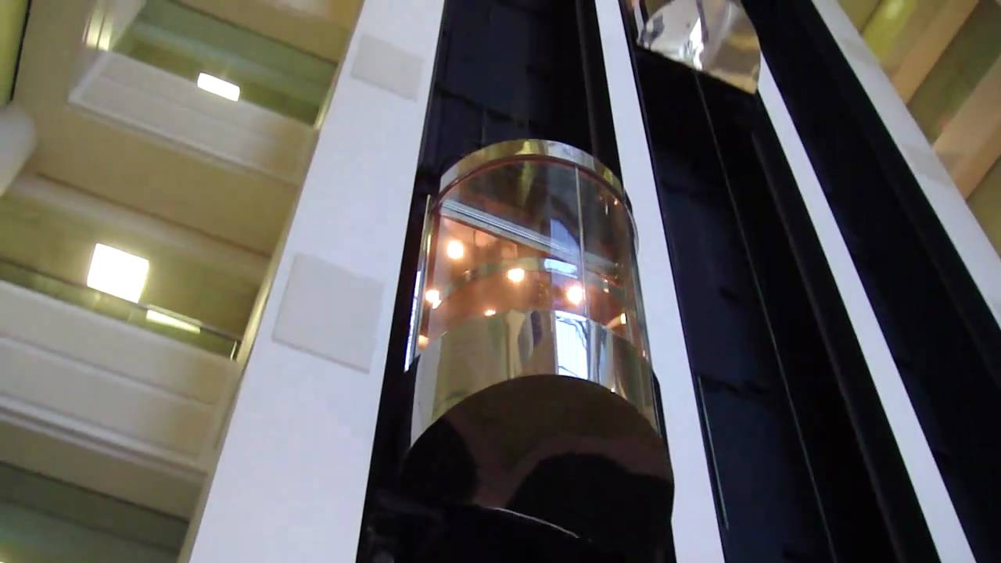
Height of land above sea level is …..?
Elevation

Slide 2
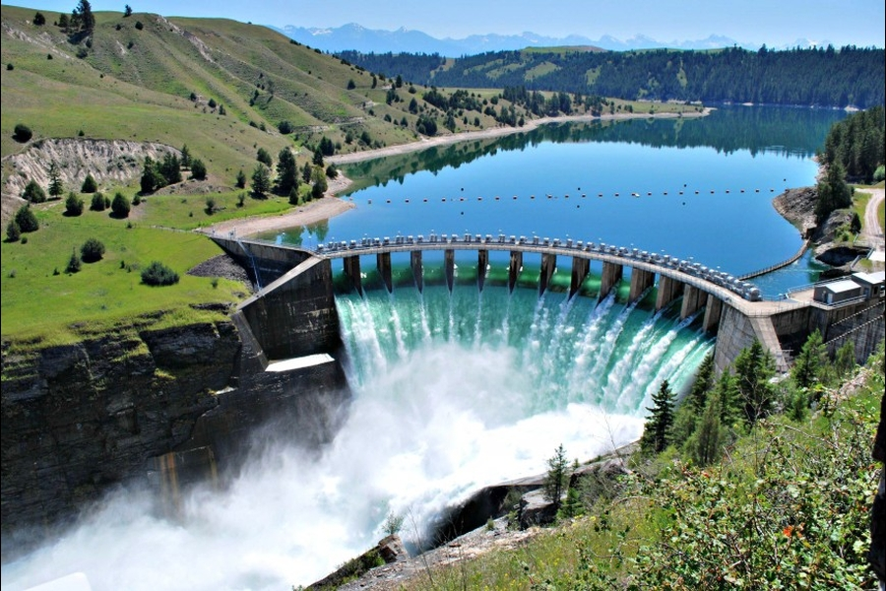
Electric power produced by rushing water is called….?
Hydroelectricity

Slide 3
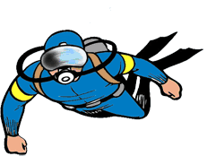
To add variety means to…..?
Diversify

Slide 4
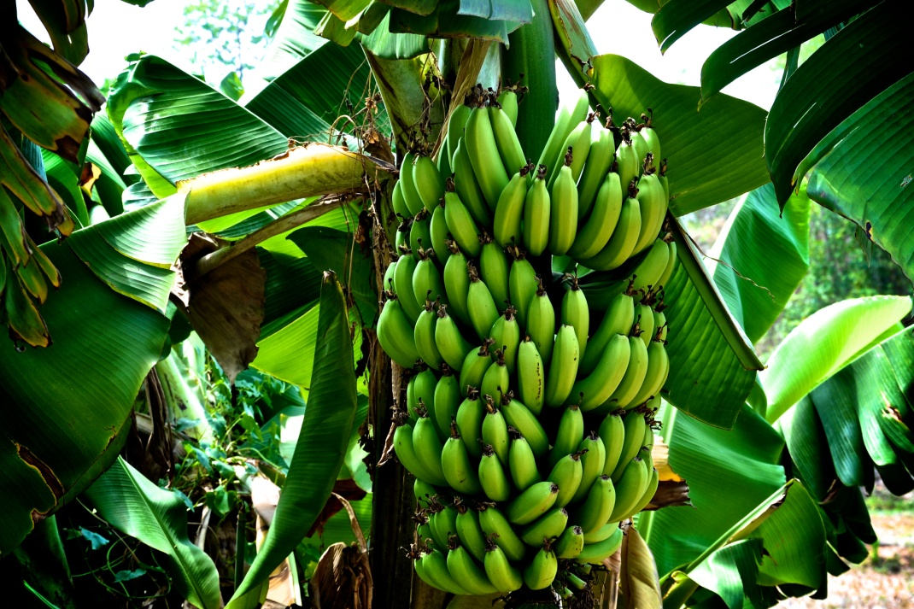
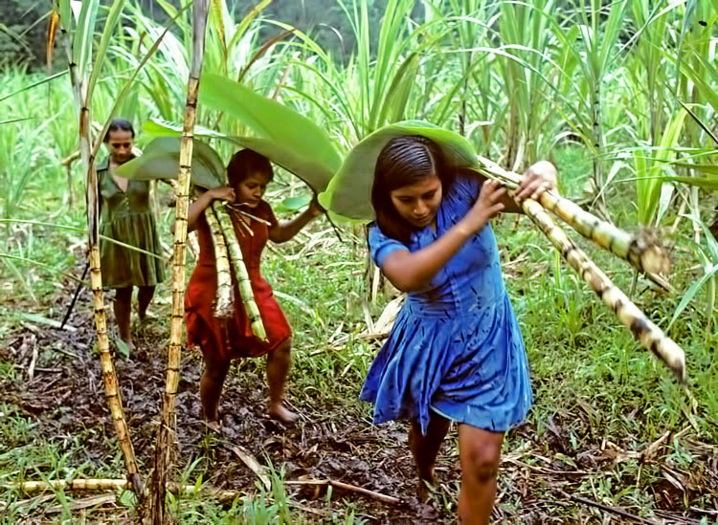
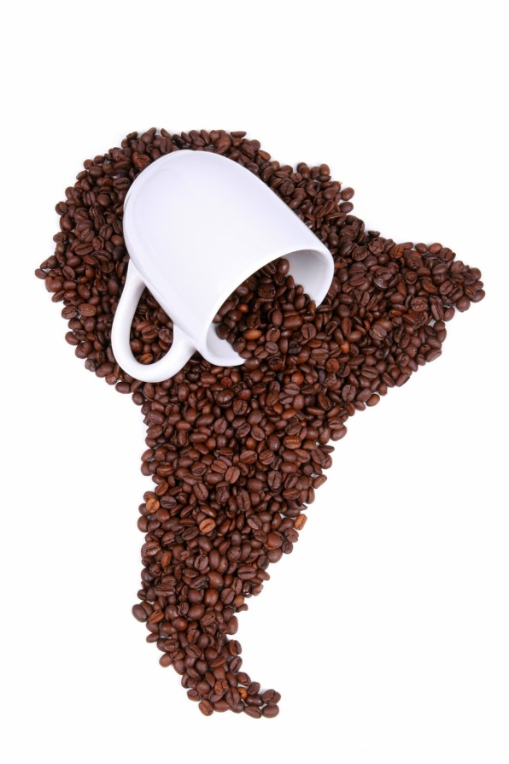
The tropical wet and dry climate of the Caribbean is good for farming what types of crops?
Bananas, sugarcane, and coffee

Slide 5
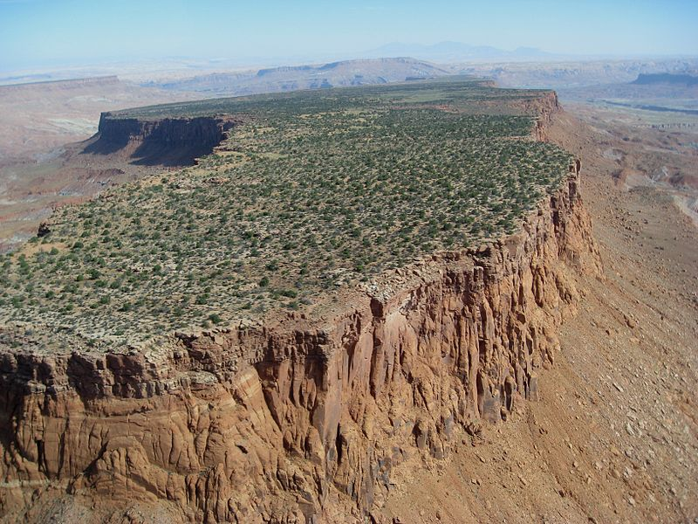
Large, raised land that is flat and level is called a…?
Plateau

Slide 6
When the price of copper goes down, how does that affect the economy in Chile?
Oh, Cheer up Chile?
Dang!!!
I can’t bare it!
I can only have one.
The economy suffers because Chile relies on a one-resource economy.

Slide 7
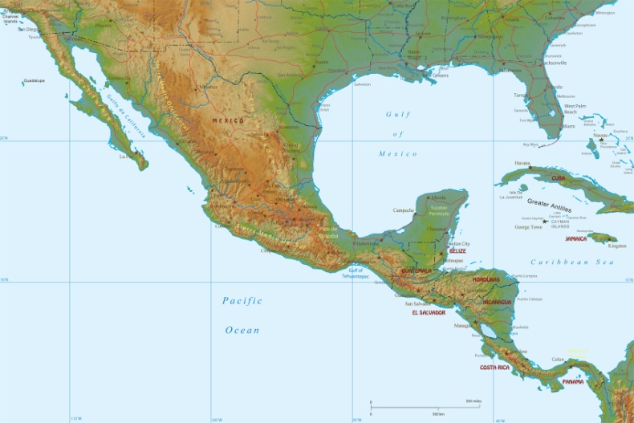
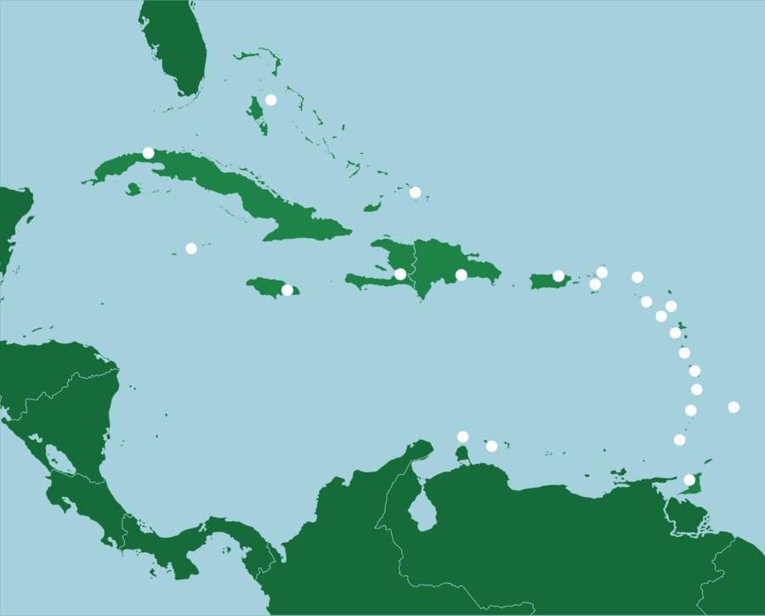
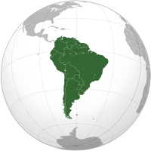
What are the regions of Latin America?
Mexico and Central America (Middle America), The Caribbean, South America

Slide 8
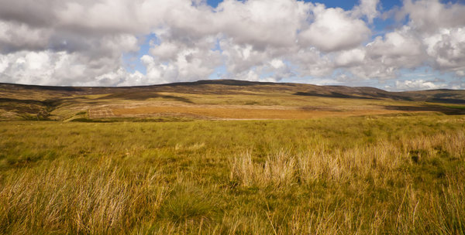
The grasslands of South America are called…….?
Pampas

Slide 9
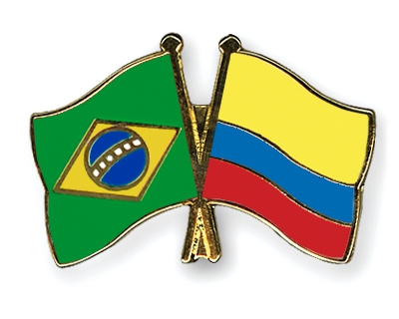
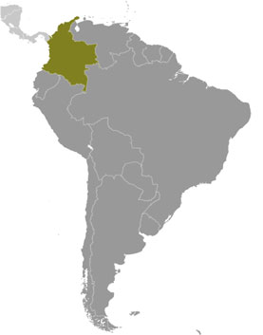
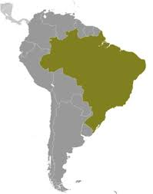
Two South American countries that produce coffee as a key crops are…?
Brazil and Columbia

Slide 10
What is the long mountain chain that runs along the west coast of South America?
Andes Mountains

Slide 11
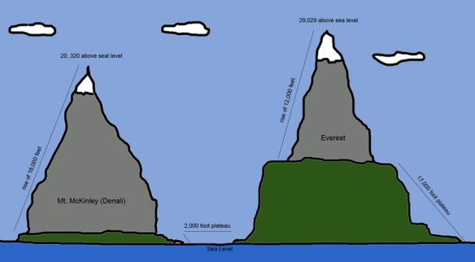
What primarily influences crops grown on farms in the Andes Mountains?
Elevation – only a few crops can grow at high altitude

Slide 12
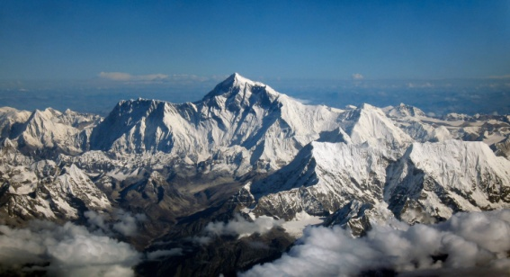
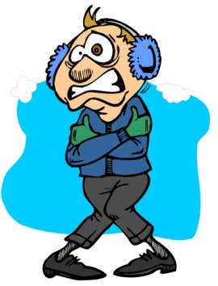
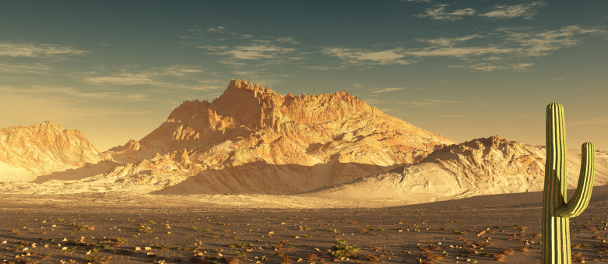
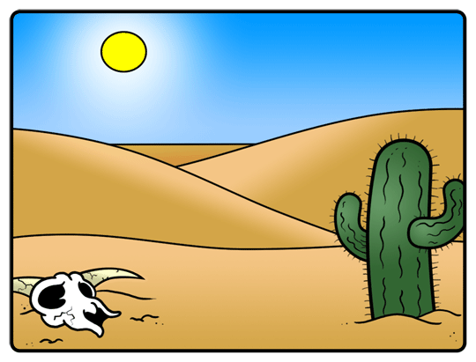
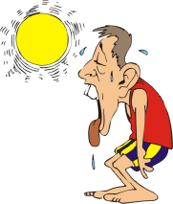
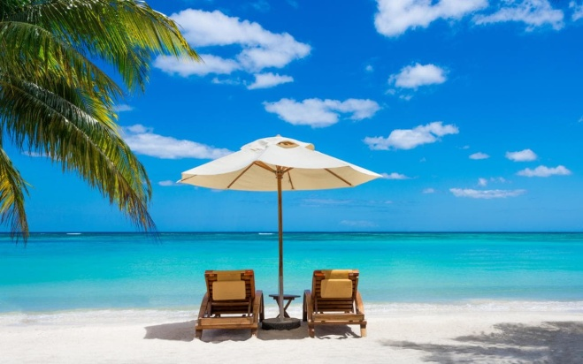
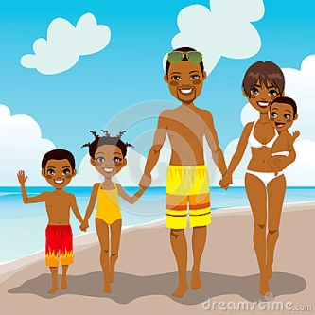
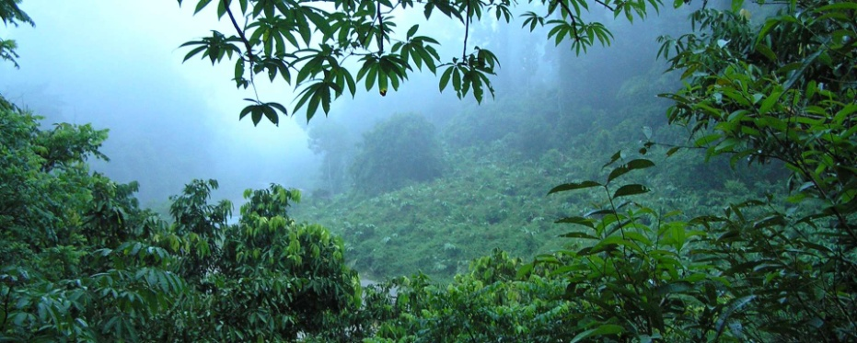
How does the climate in Latin America differ from place to place?
Elevation from the Andes Mountains makes parts very cold.
Caribbean is usually sunny and warm
Deserts in Latin America are the hottest and driest in the world.
Rainforest in the Amazon Basin is very wet and hot.

Slide 13
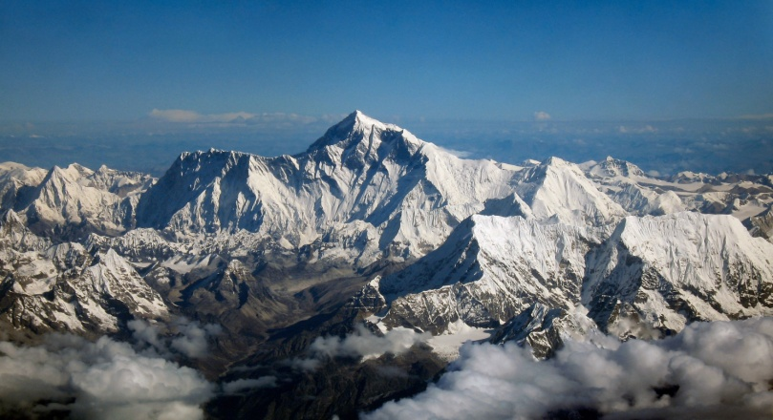
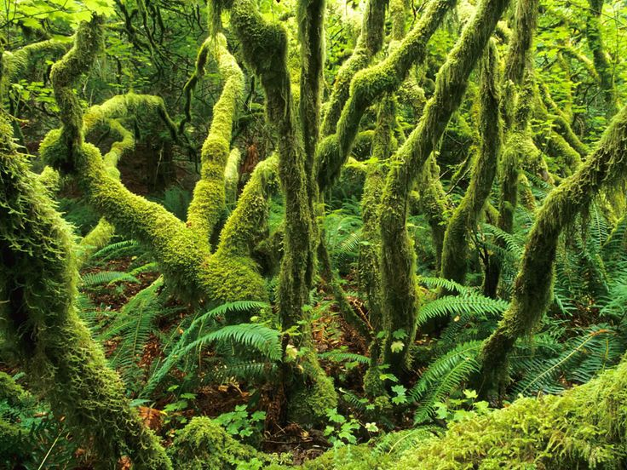
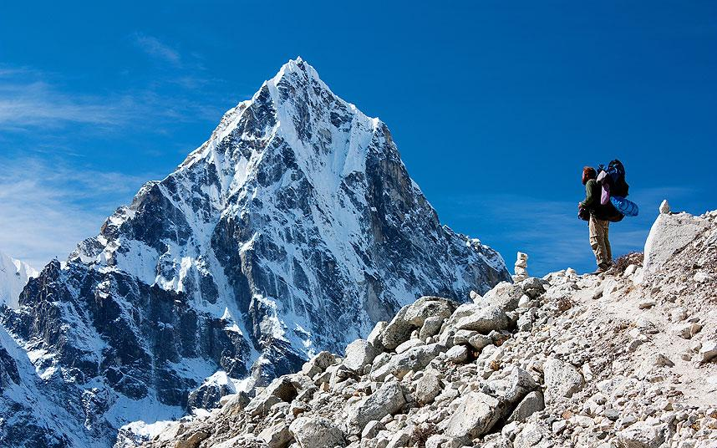
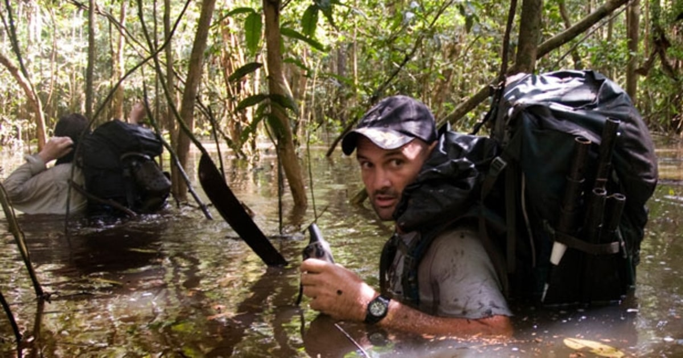
Trade and travel among the regions of South America have been affected by what?
It’s been affected by location. It’s difficult to travel over the high mountains and into the dense rain forests.

Slide 14
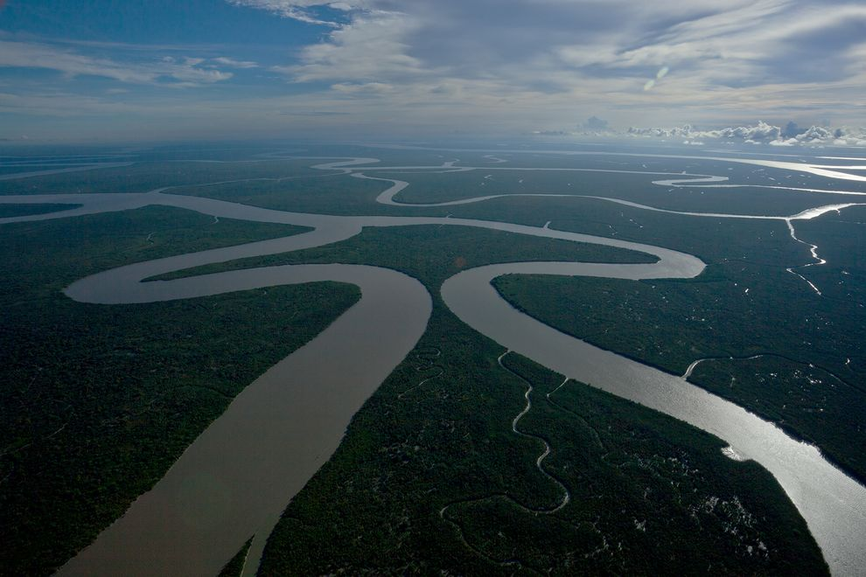
A River or stream that flows into a larger river is called a …?
Tributary

