Slide 1
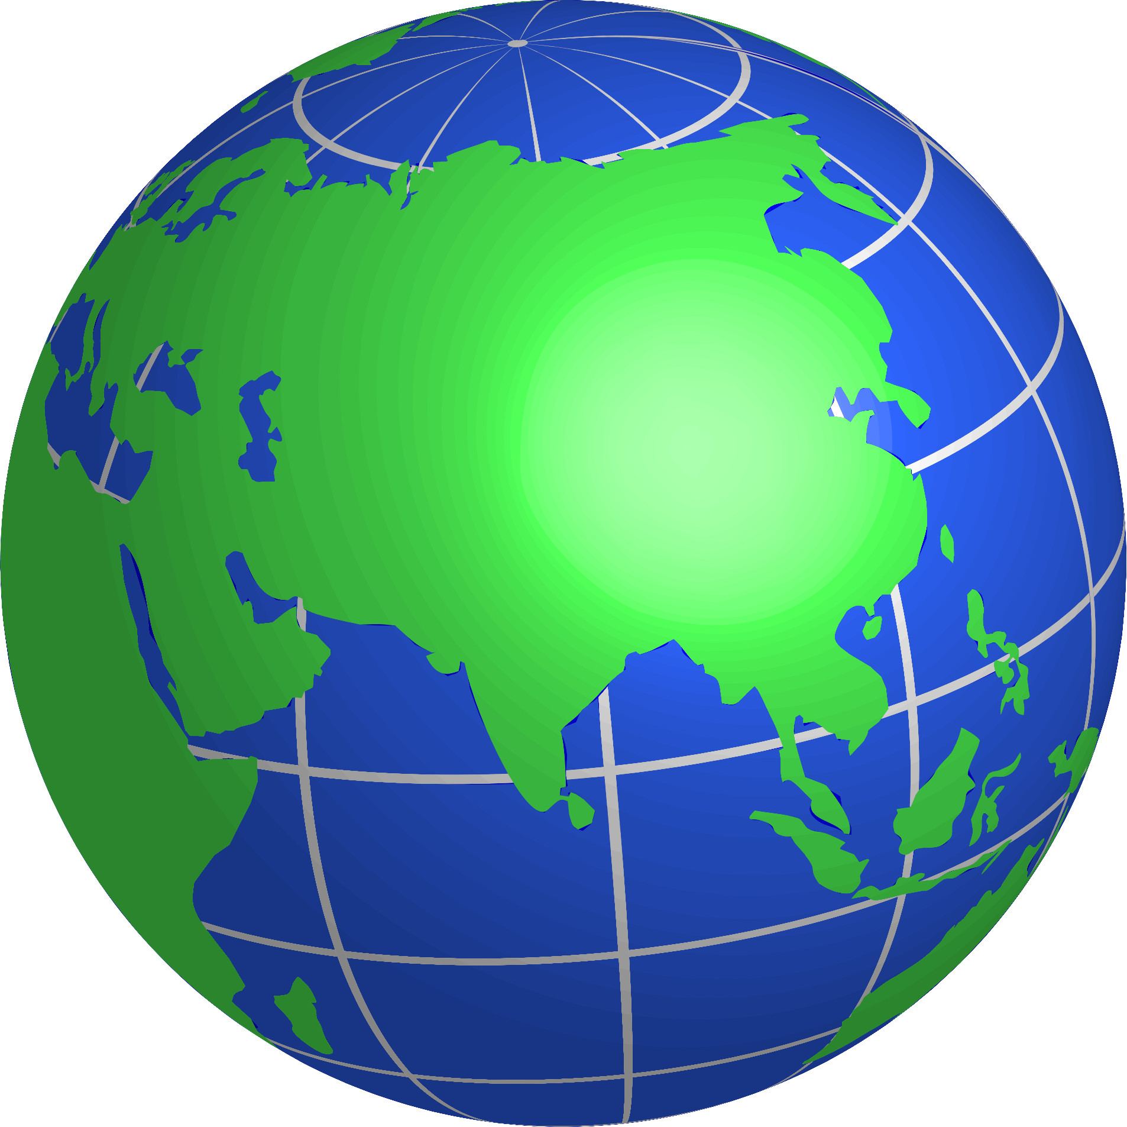
The
PACIFIC
ASIA
and
Ch. 1 to 4

Slide 2
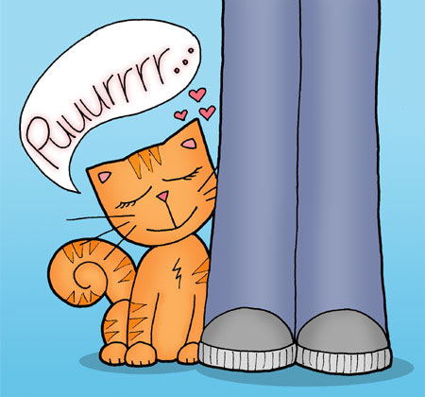
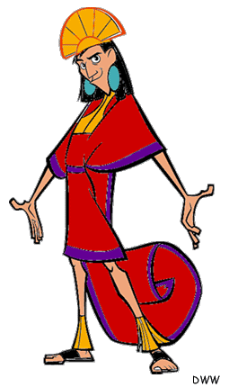
Starting in ancient times, China was governed by a(n) ____, or ruler.
Emperor

Slide 3
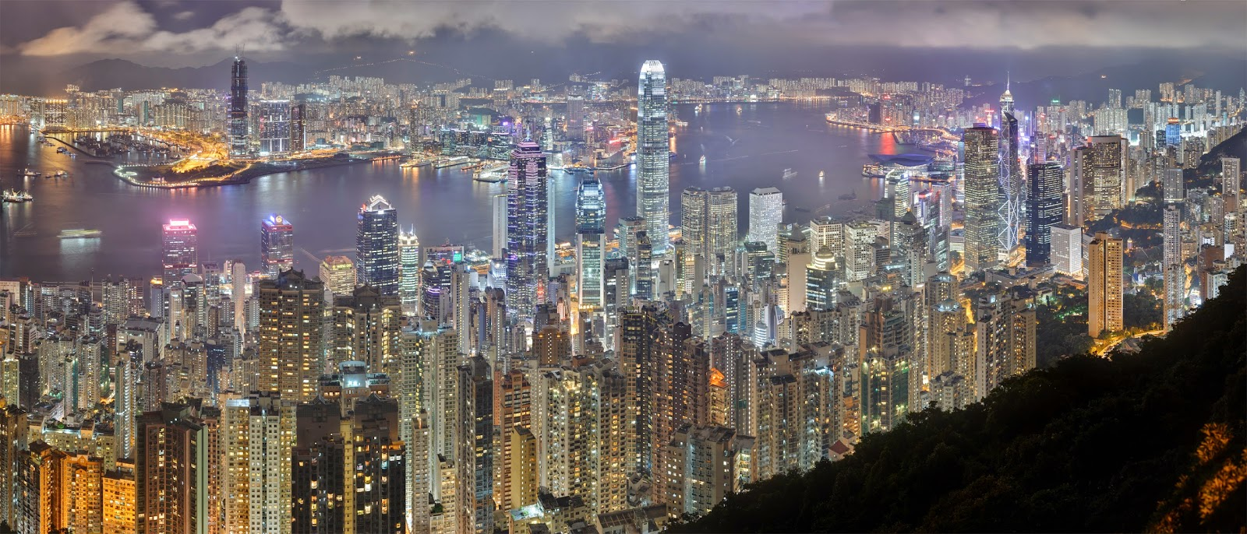
A country with many industries and a well-developed economy is referred to as a ….?
Developed country

Slide 4
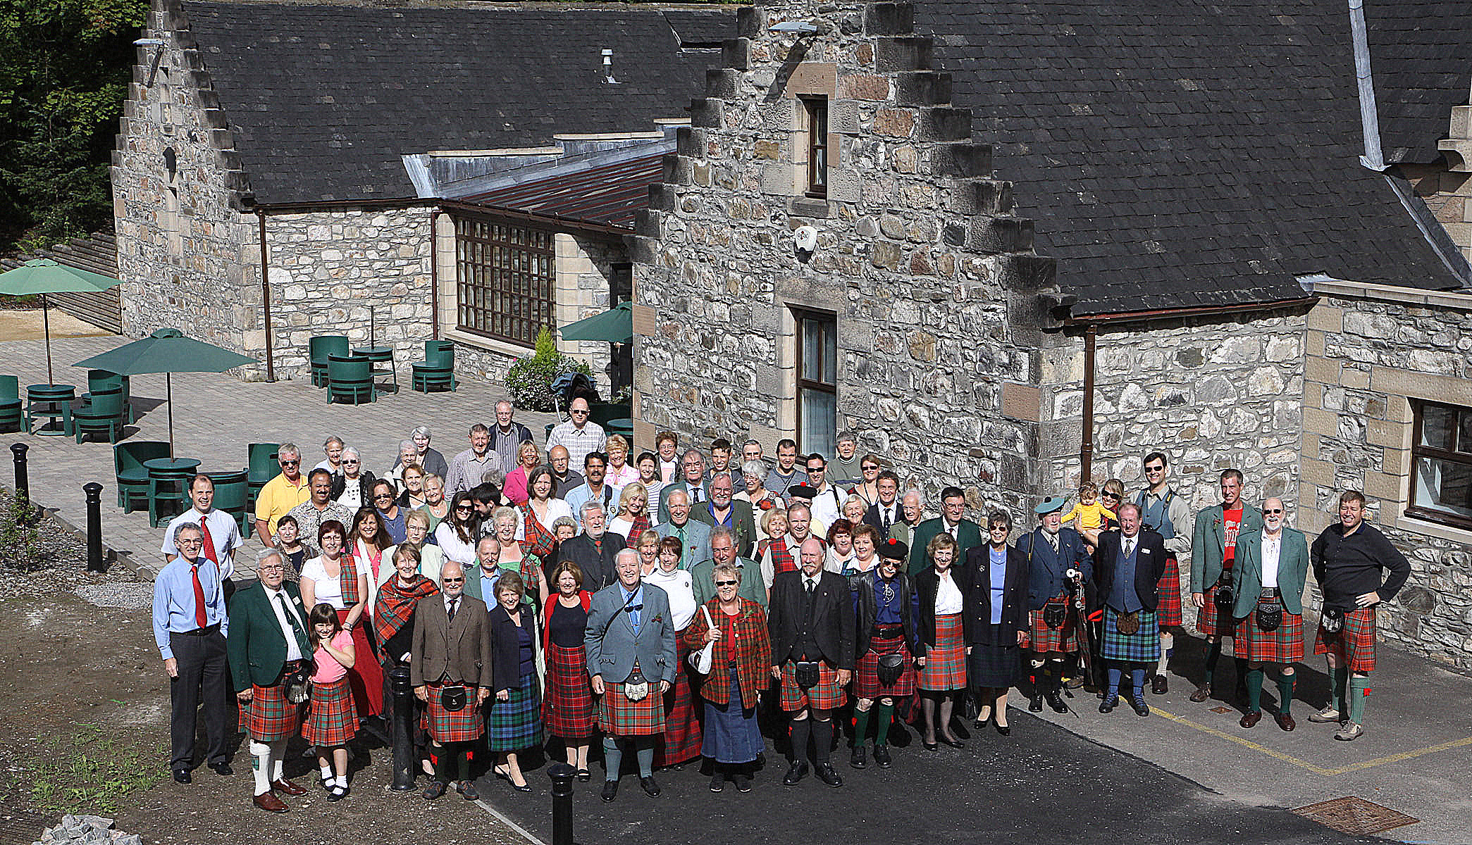
A ____ is a group of families with a common ancestor.
Clan

Slide 5
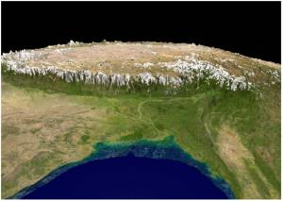
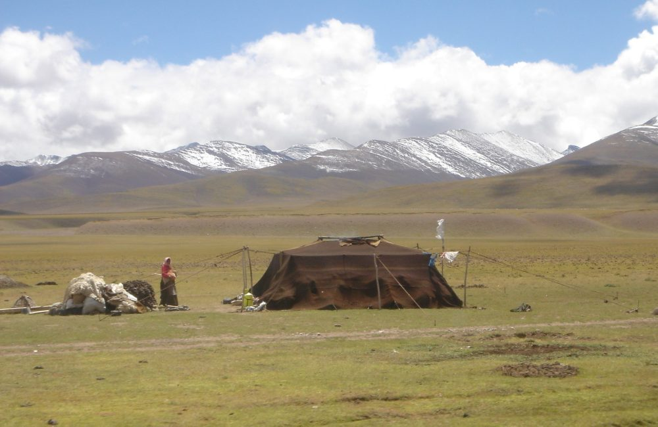
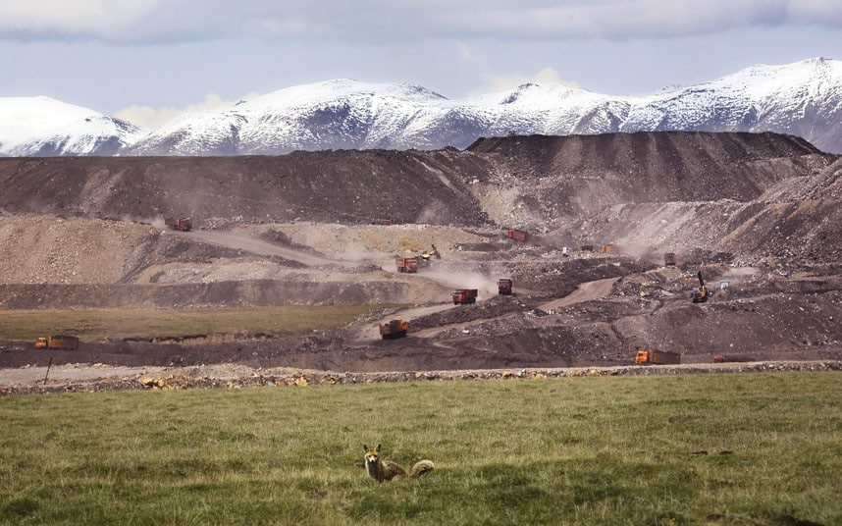
A raised area of mostly level land is called a ….?
Plateau

Slide 6
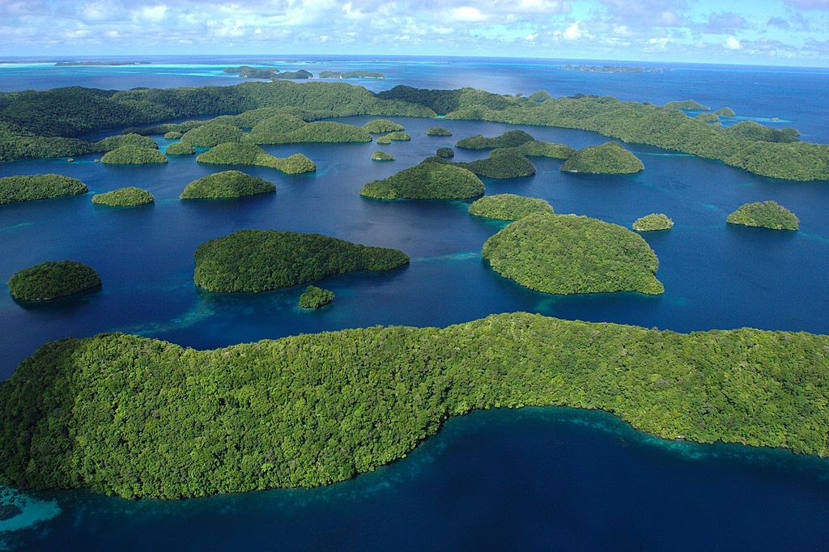
A group of islands is an….?
archipelago

Slide 7
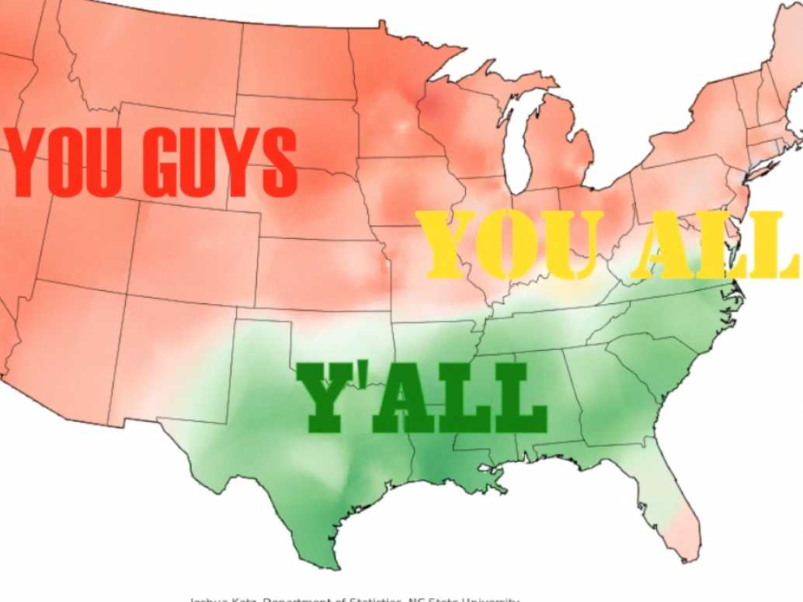
A ____ is a regional variation of a language.
Dialect

Slide 8
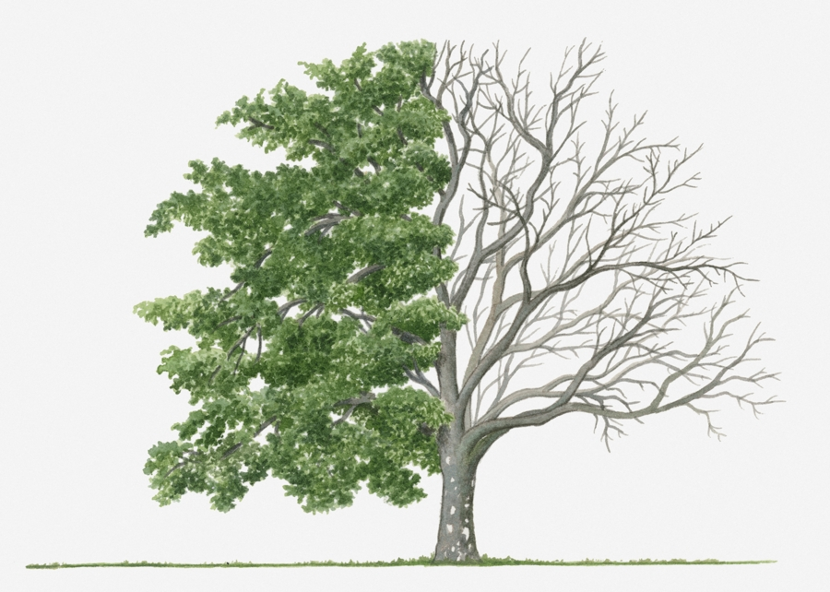
What type of tree sheds leaves seasonally?
Spring/Summer
Fall/Winter
Deciduous

Slide 9
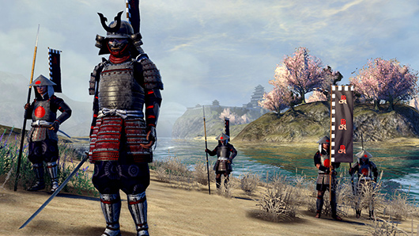
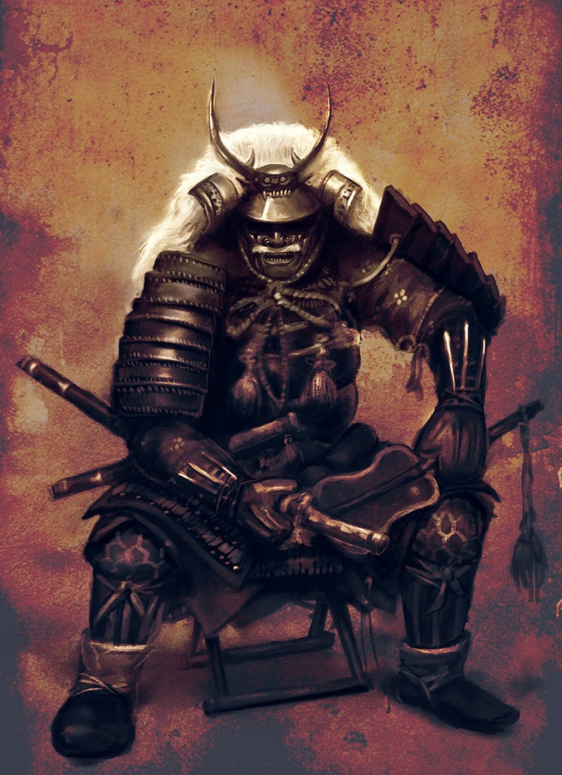
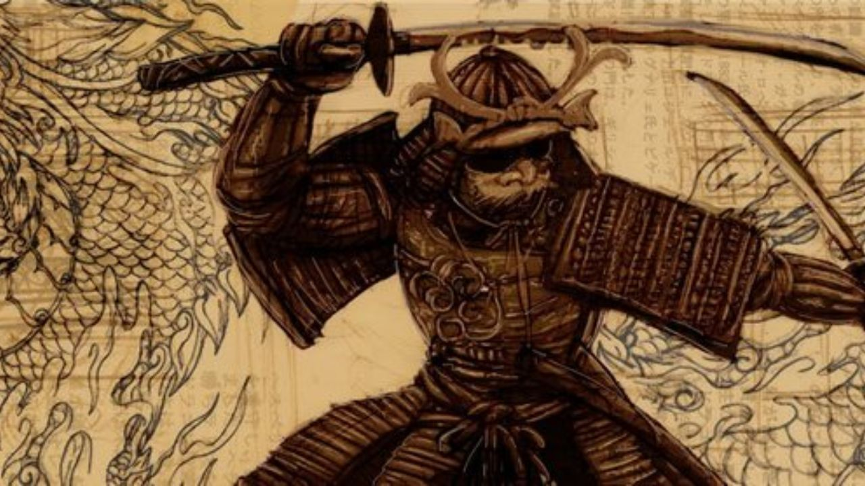
During much of Japan’s history, laws were made by whom?
Showguns

Slide 10
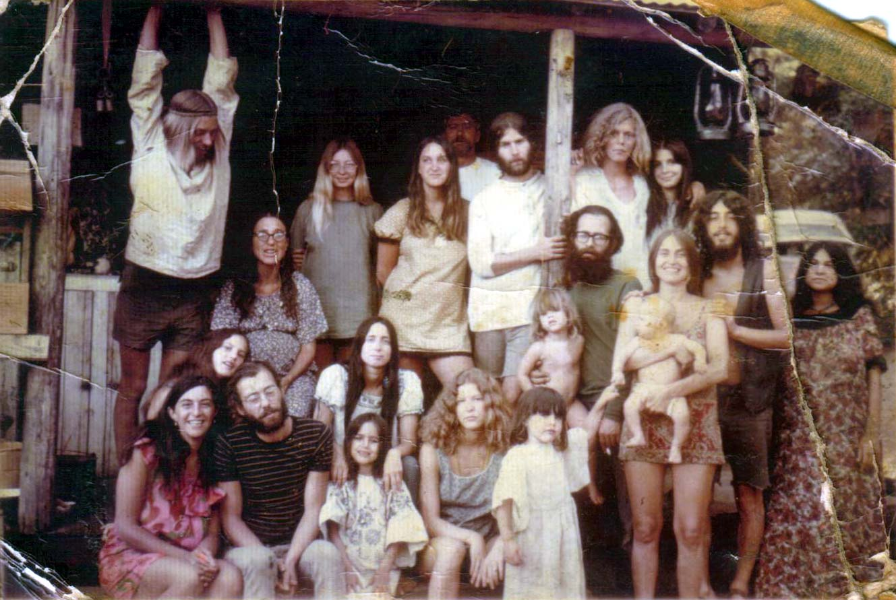
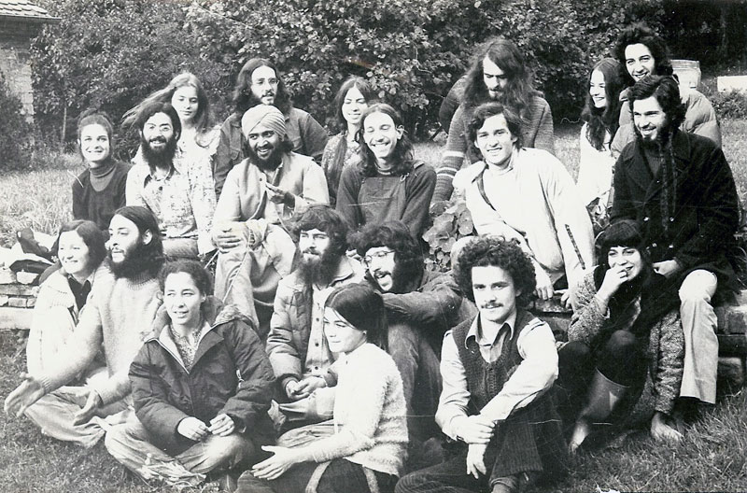
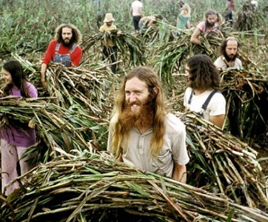
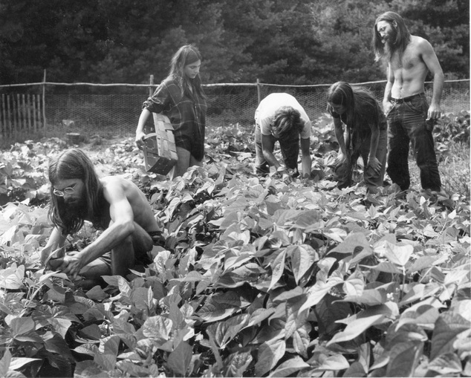
Community in which land is held in common and where members live and work together is a….?
Commune

Slide 11
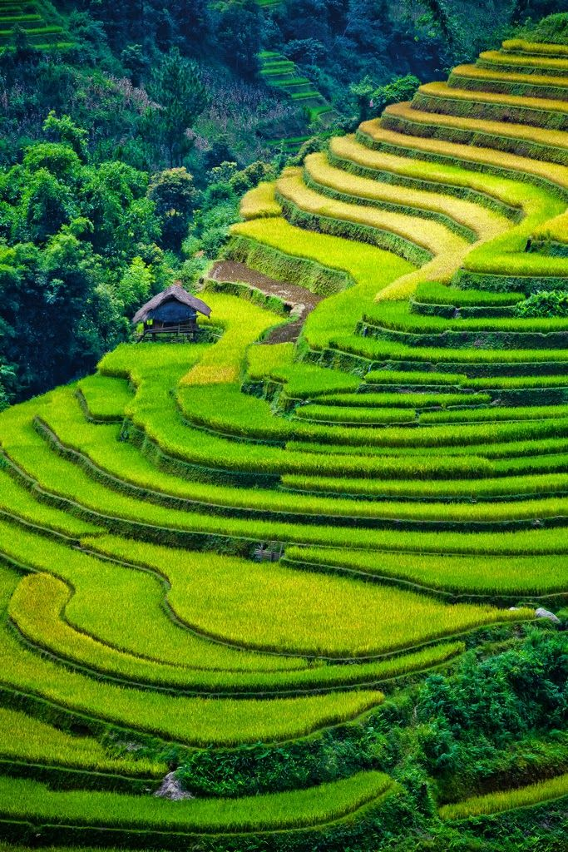
A horizontal ridge made in a hillside to create farmland is called a….?
Terrace

Slide 12
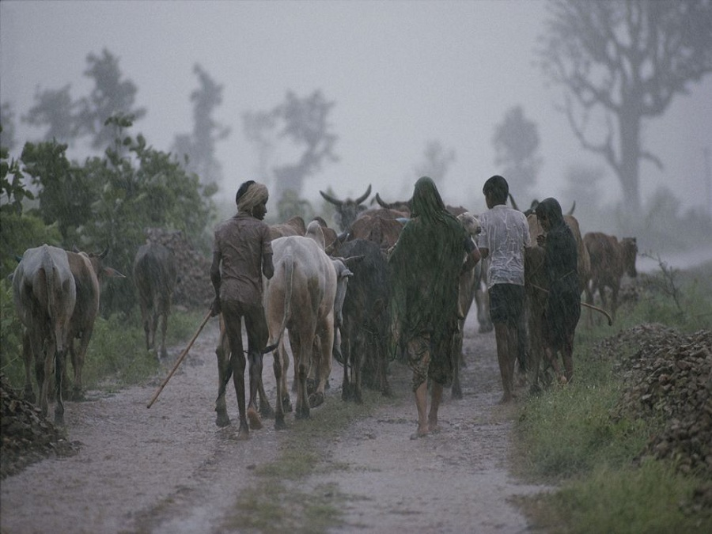
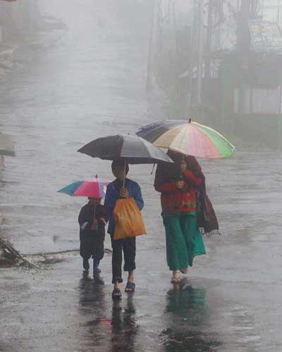
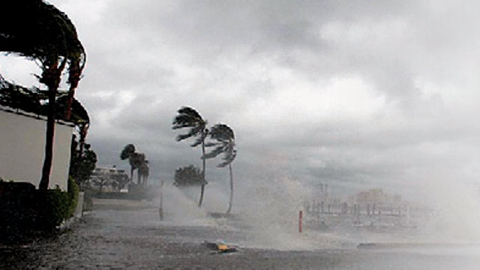
In East Asia, a ____ blows across the region at certain times of the year.
monsoon

Slide 13
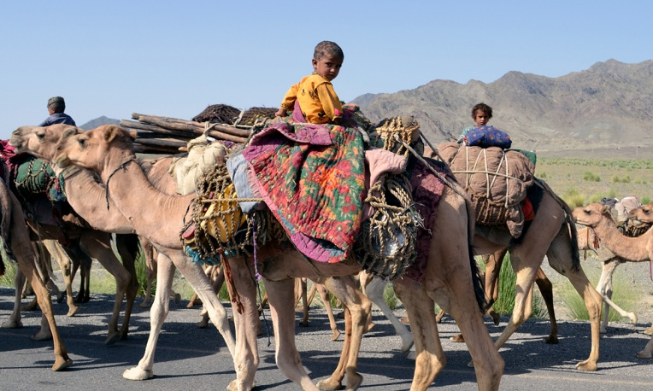
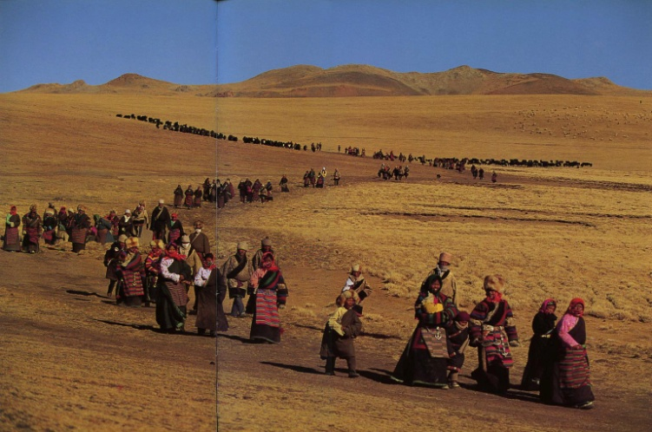
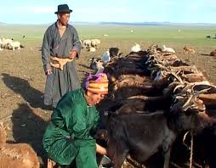
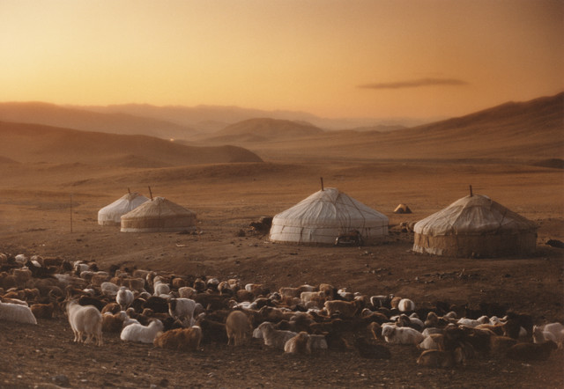
A person(s) who moves from place to place in search of water and grazing for animals is a….?
Nomad

Slide 14
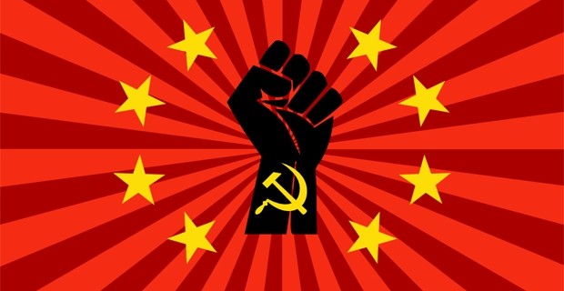
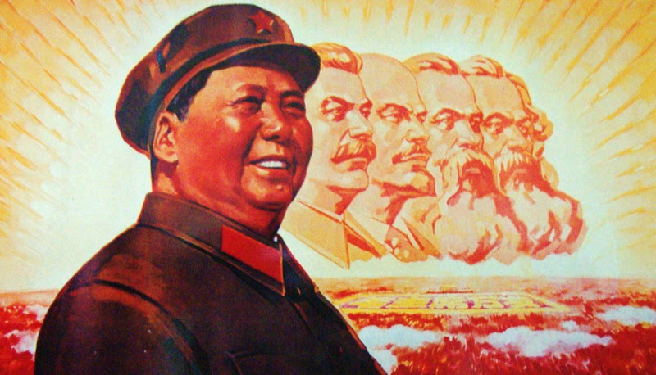
Under the ____ economic system, the government controls a country’s large industries, businesses, and land.
Communist

Slide 15
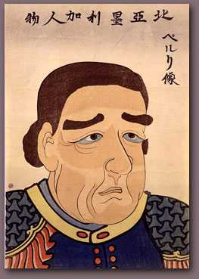
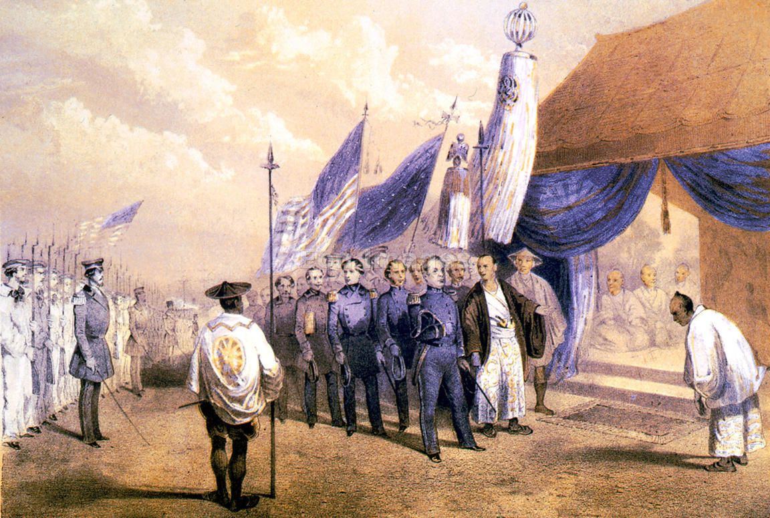
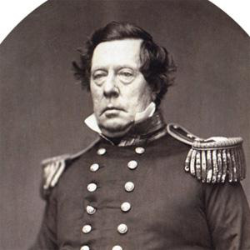
Why did Commodore Matthew Perry come to Japan in 1853?
to force the country to grant trading rights to the U.S.

Slide 16
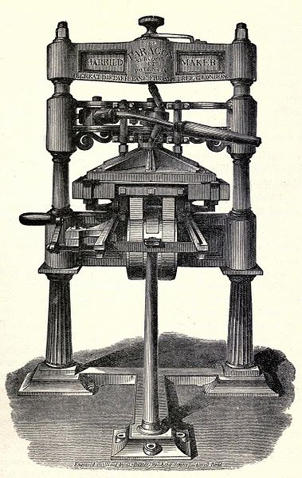
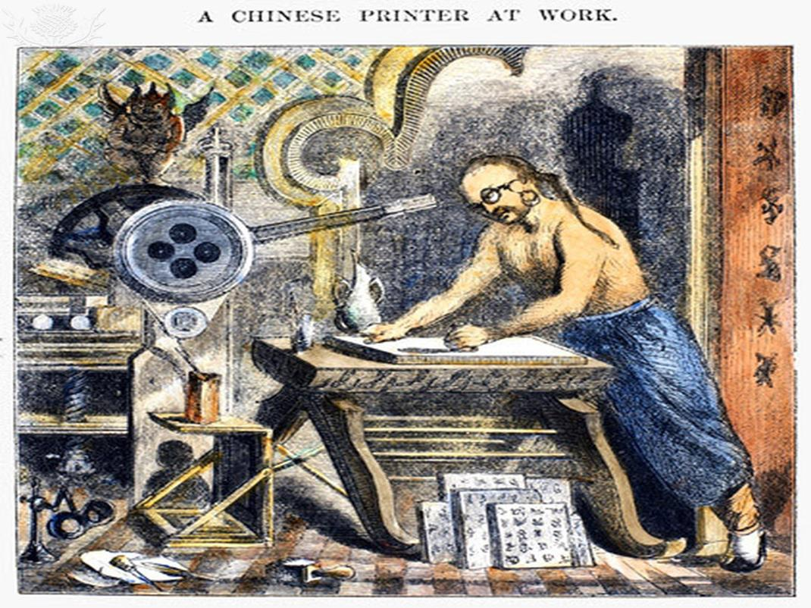
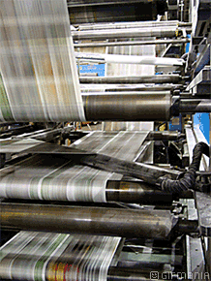
Some of ancient China’s most important inventions were paper, gunpowder, and ….?
The Printing Press.

