Slide 1
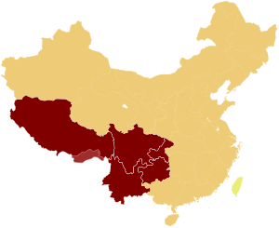
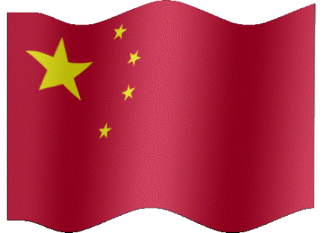
In which parts of the country do most of China’s 55 different minority groups live?
southern and western China

Slide 2
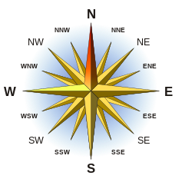
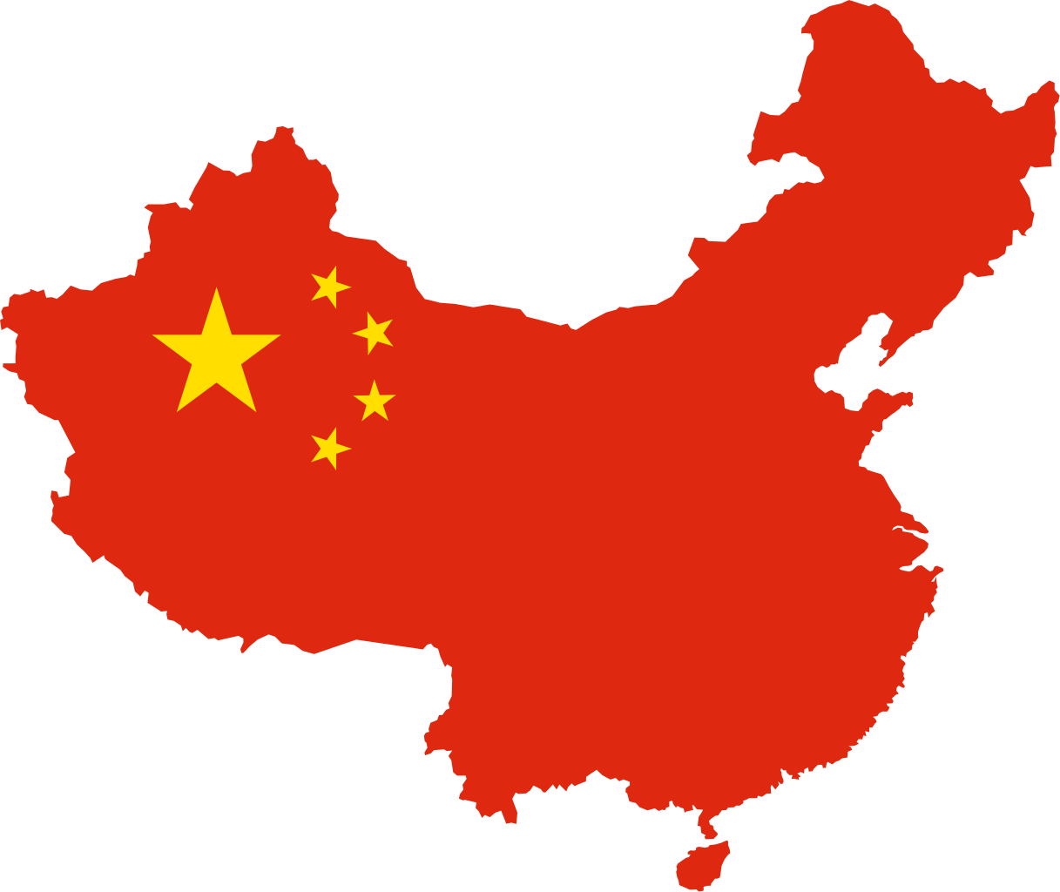
In which parts of the country do most of China’s 55 different minority groups live?
southern and western China

Slide 3
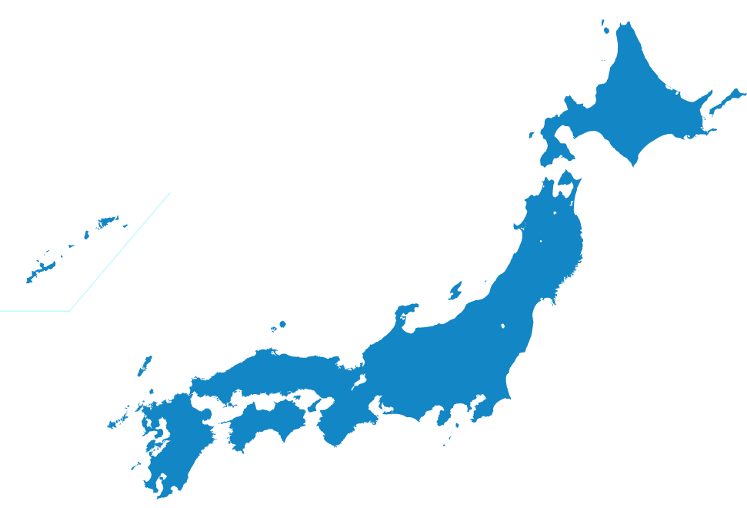
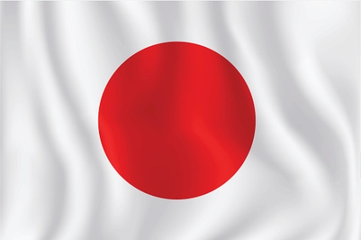
Why did Japanese leaders keep their country isolated from the outside world for many hundreds of years?
to keep the country united

Slide 4
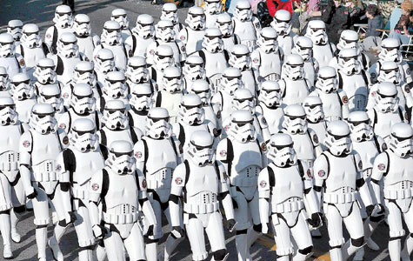
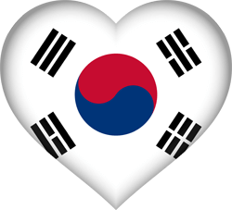
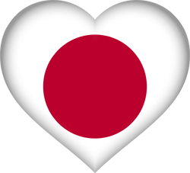
Which statement best describes the populations of the Koreas and Japan?
Koreans
Japanese
The populations of both countries are homogeneous.

Slide 5
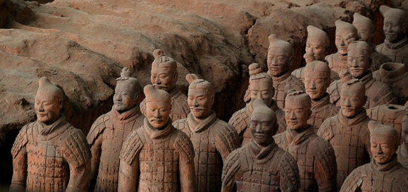
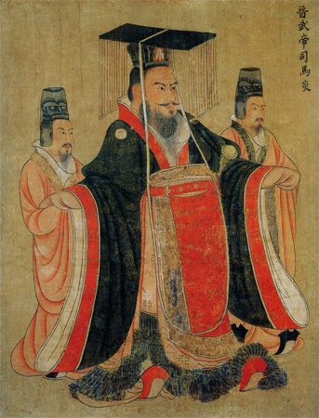
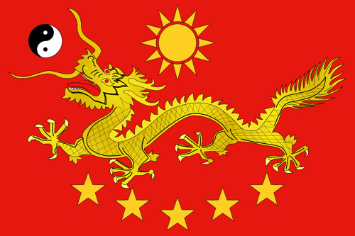
Most people in China can trace their ancestry to which ethnic group?
The Han

Slide 6
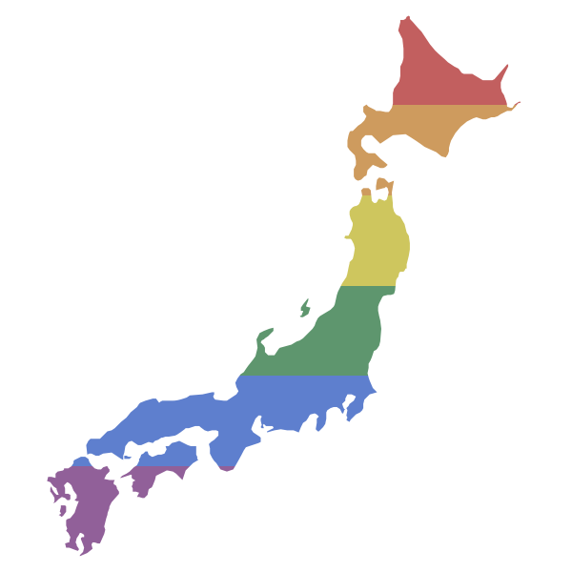
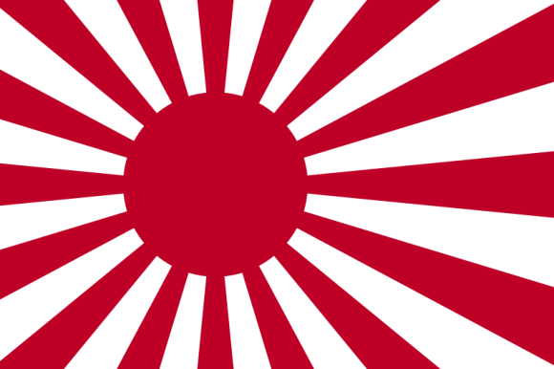
What is the most modern of the East Asian countries?
Japan

Slide 7
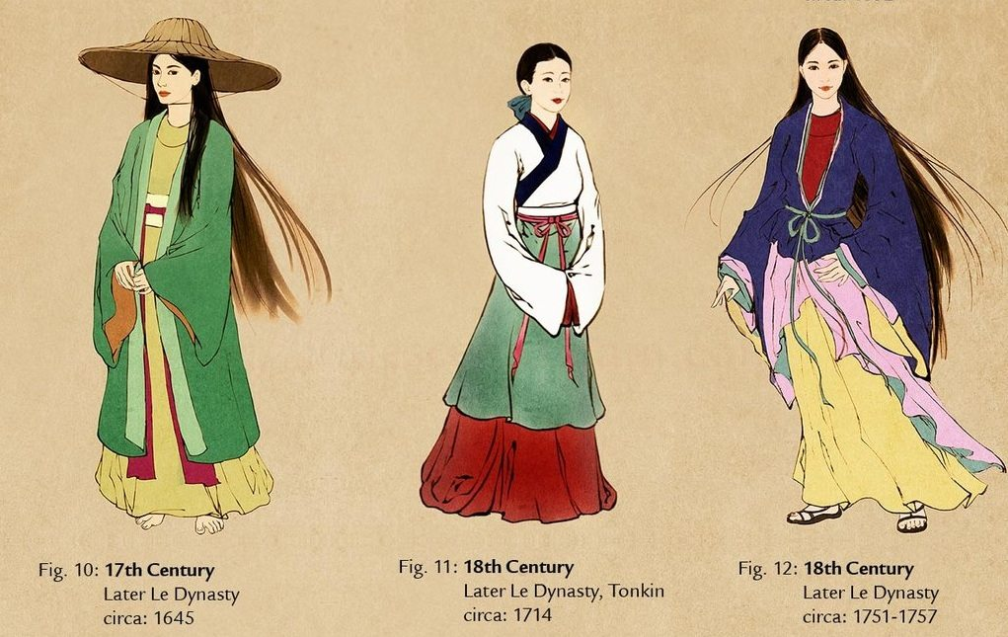
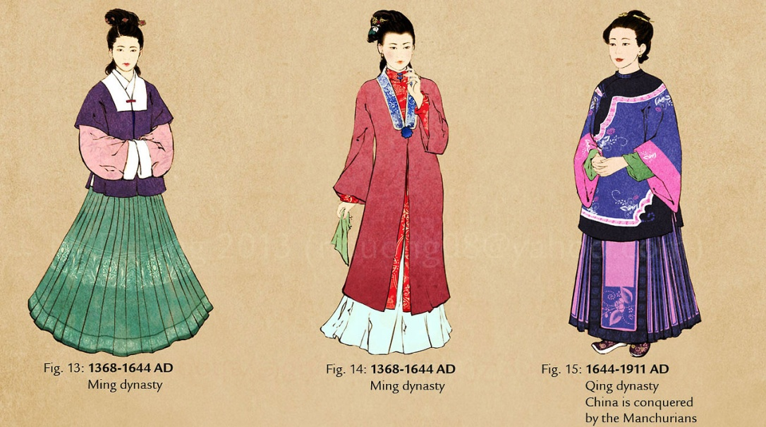
How is Chinese history described?
Dynasties

Slide 8
What event sparked the Korean War in 1950?
North Korea invaded South Korea.

Slide 9
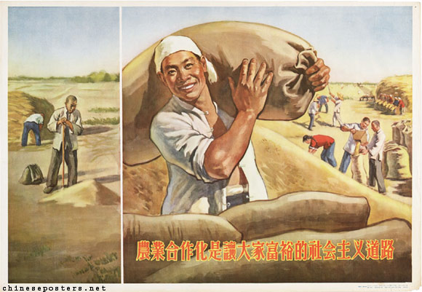
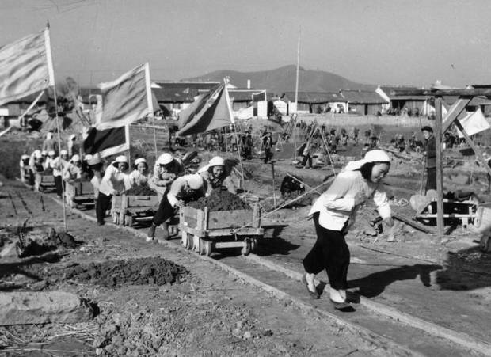
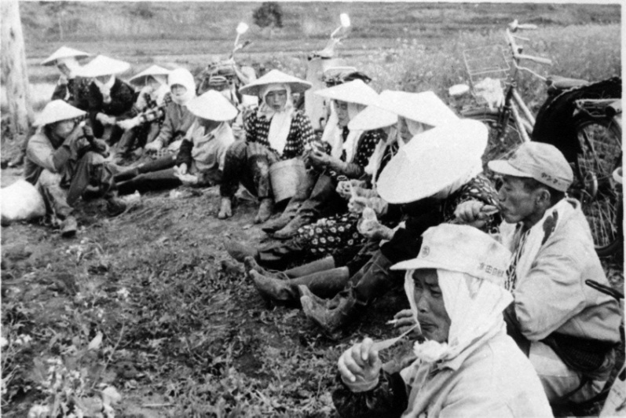
When the communist government came to power in China in 1949, what major changes did it make in the Chinese way of life?
The gov’t created farm communes.

Slide 10
What two cities does the Silk Road connect?
Antioch and Chang’an

Slide 11
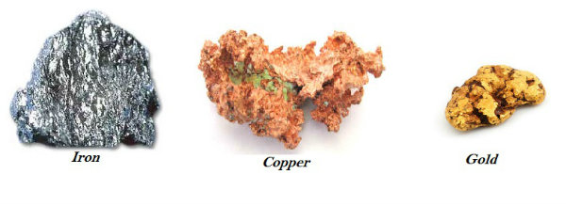
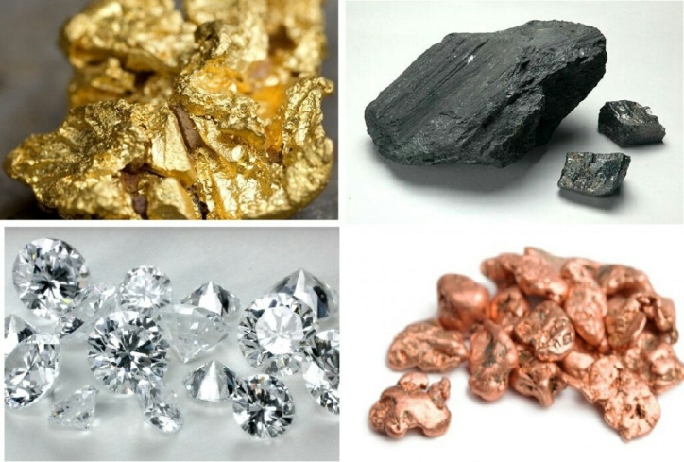
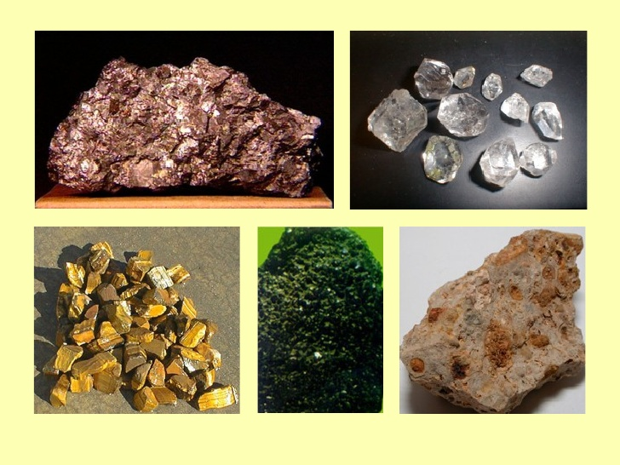
Although both Japan and South Korea are developed countries, both nations have few of these, what are they?
Mineral Resources.

Slide 12
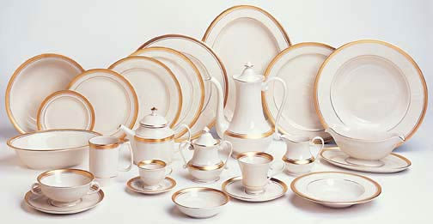
Which country takes up most of the territory of East Asia?
Fine China

Slide 13
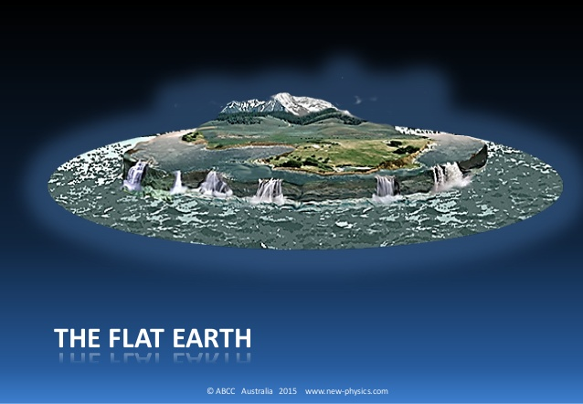
Two thirds of China’s land is made up of high mountains and what other land form/s?
Plateaus

Slide 14
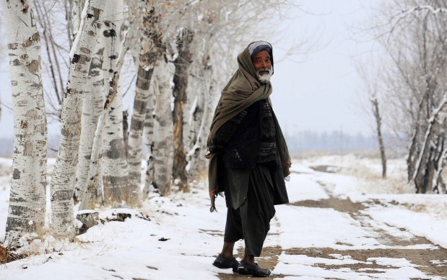
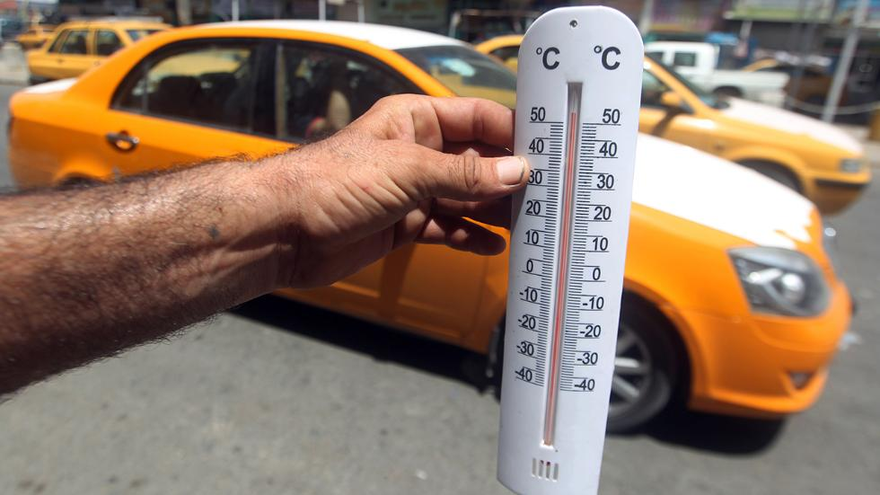
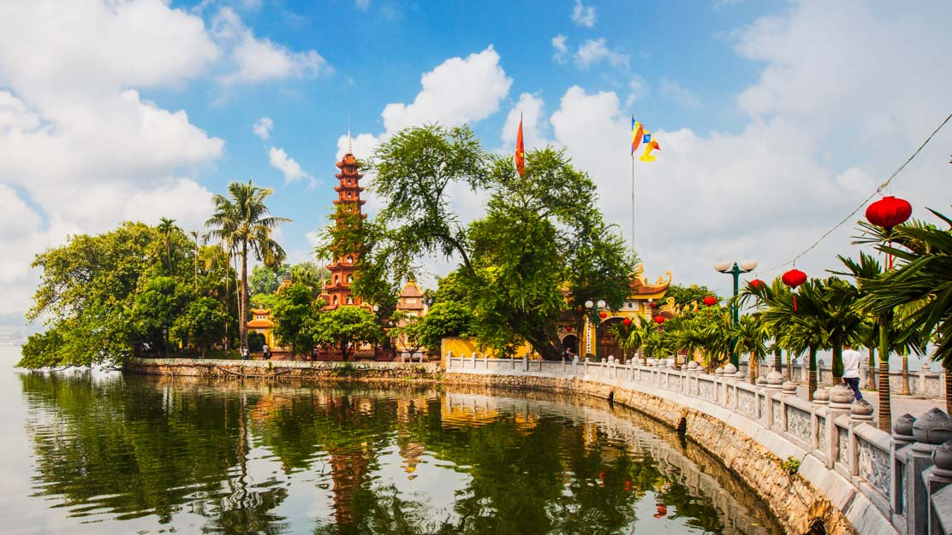
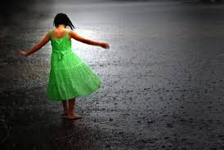
The climate of East Asia is best described as?
Varied

Slide 15
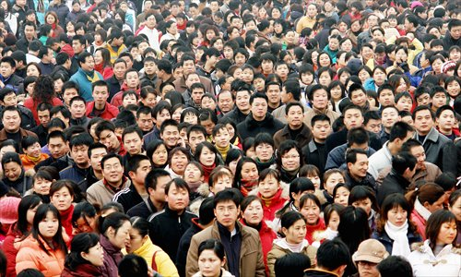
Why must the countries of East Asia farm all the available land?
In order to feed the area’s large population.

Slide 16
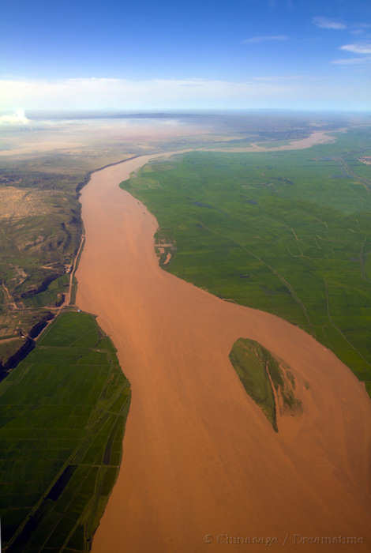
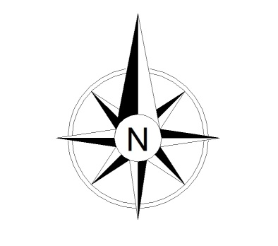
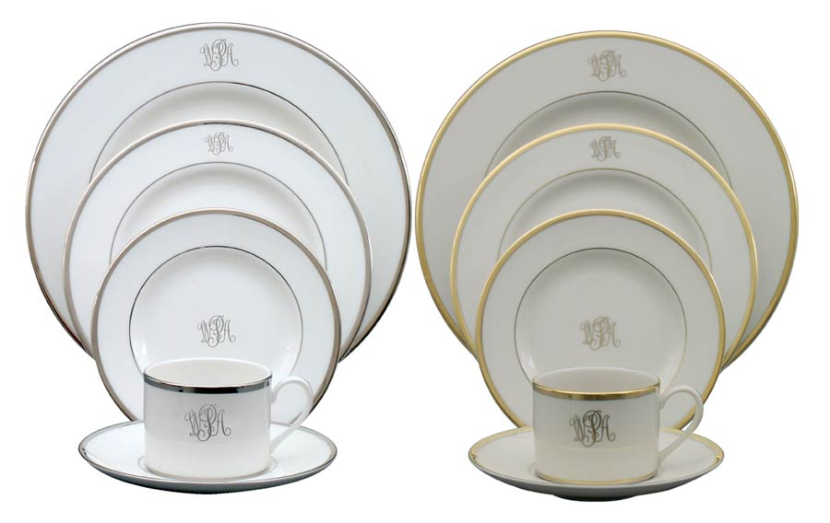
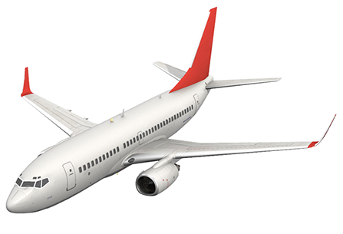
The Huang River runs through a fertile region of East Asia called…?
The North China Plain.

Slide 17
The Korean peninsula extends south into what body of water?
The Yellow Sea

Slide 18
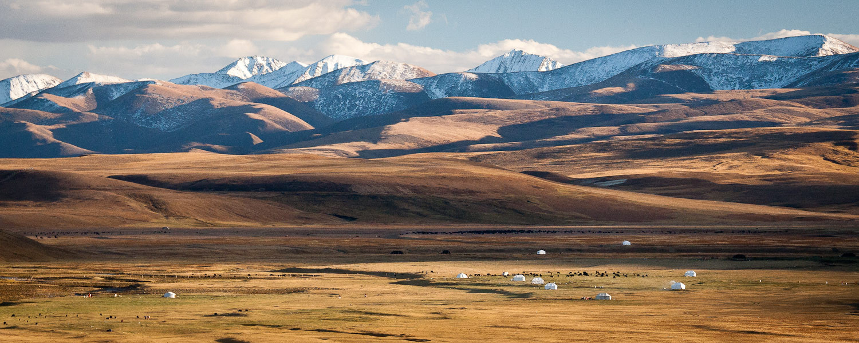
Unlike the other countries of East Asia, China and Mongolia have wide plains and what other land form/s?
Plateaus

