Slide 1
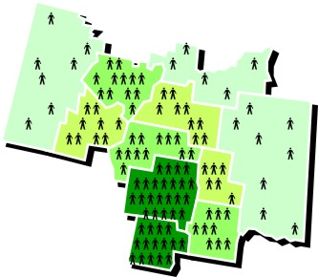
The average number of people living in a square mile is….?
Population density

Slide 2
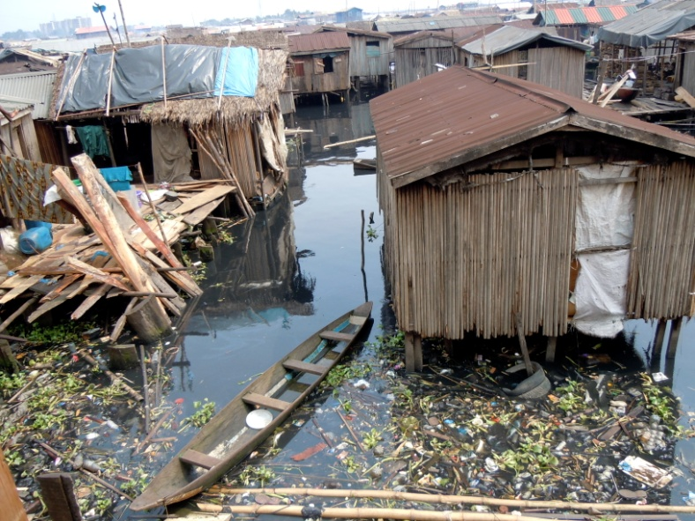
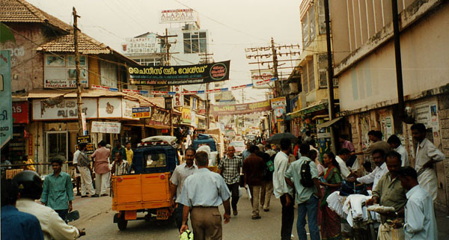
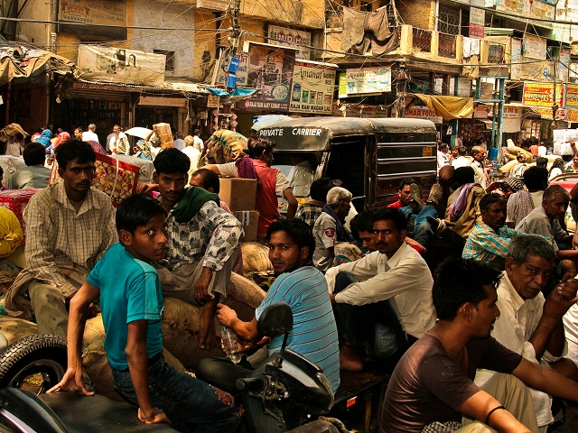
A nation that has low industrial production and little modern technology is a….?
developing
country

Slide 3
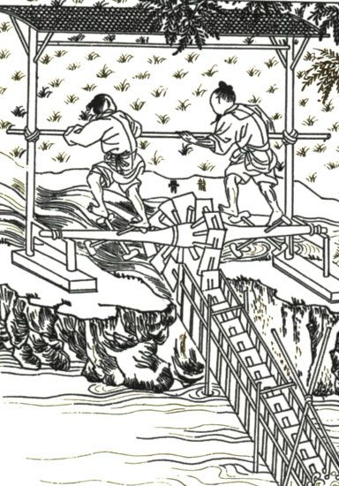
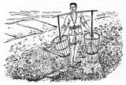
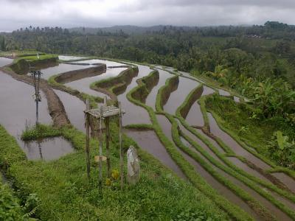
Three important contributions made by ancient Chinese engineers were digging canals, building dams, and …….?
setting up irrigation systems.

Slide 4
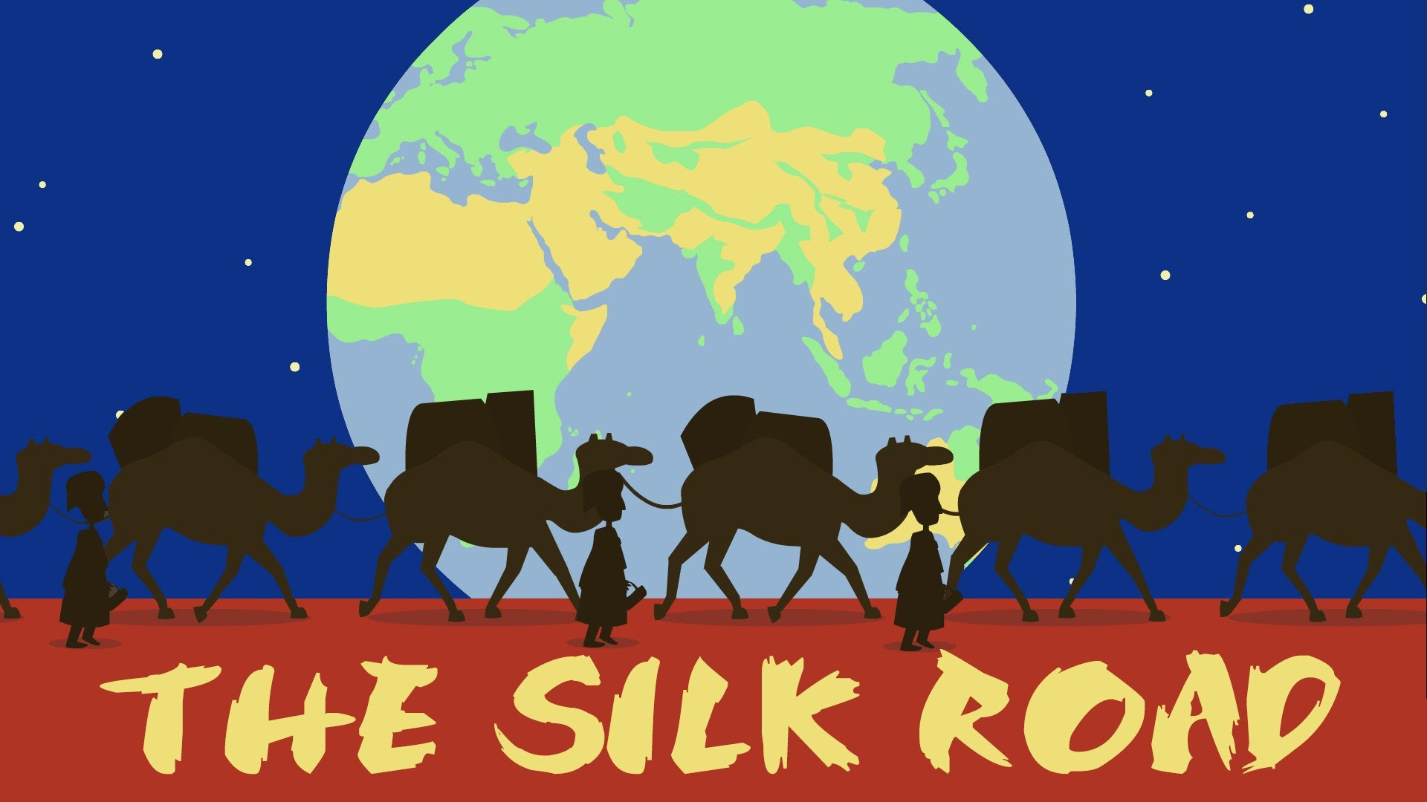
What are two major landforms or bodies of water that the Silk Road passes?
Possible answers include the Euphrates River, the Tigris River, the Caspian Sea, the Pamir Mountains, the Takla Makan Desert, and the Huang River.

Slide 5
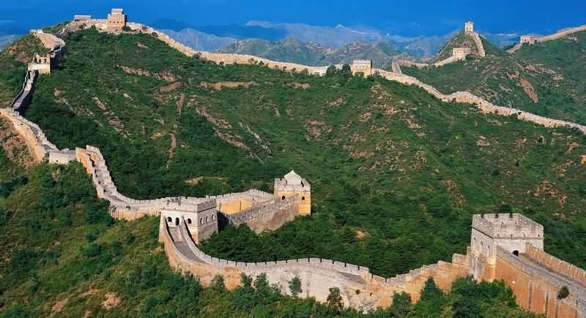
Near which city does the Silk Road meet the Great Wall of China?
Anxi

Slide 6
To get to the Tigris River from the Pamir Mountains, in what direction would you travel?
East –er Bunny

Slide 7
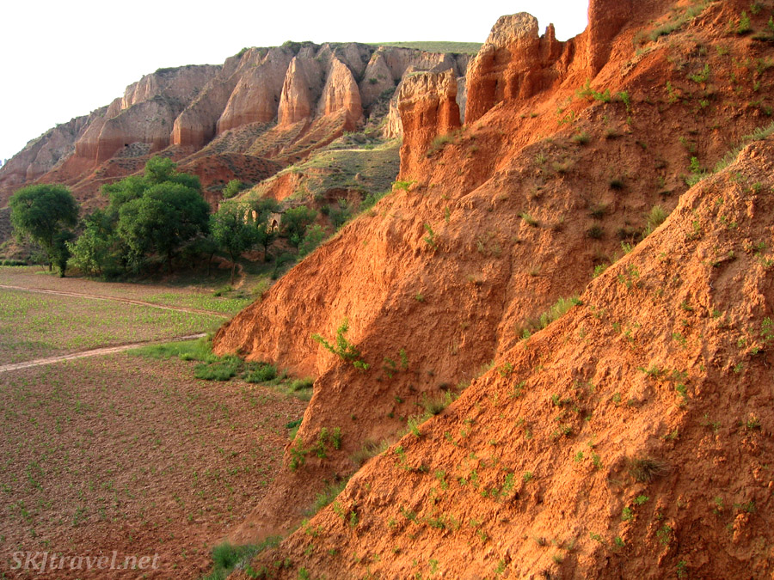
The North China Plain, one of the most fertile regions of China, is covered with deposits of what?
More or….
Loess

Slide 8
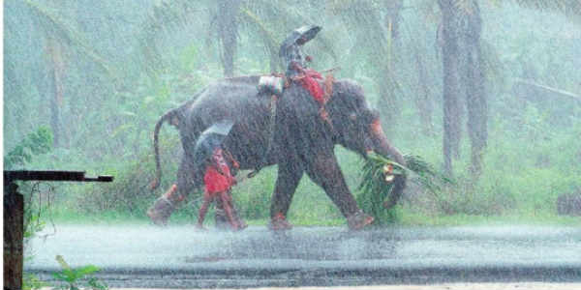
Which of the following is a strong influence on the climates of East Asia?
Monsoon

Slide 9
How have South Korea’s limited mineral resources influenced its economy?
It must import iron, crude oil, and chemicals.

Slide 10
Why is bamboo grown so widely in East Asia?
It is a strong plant that can survive dry spells.

Slide 11
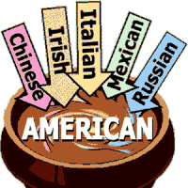
The spreading of ideas or practices from one culture to other cultures is….?
Cultural Diffusion

Slide 12
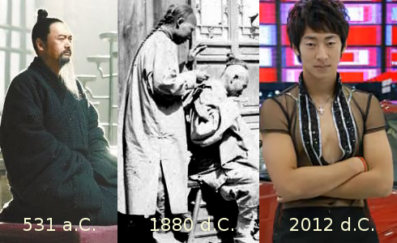
A series of rulers from the same family is called a ….?
Dynasty

Slide 13
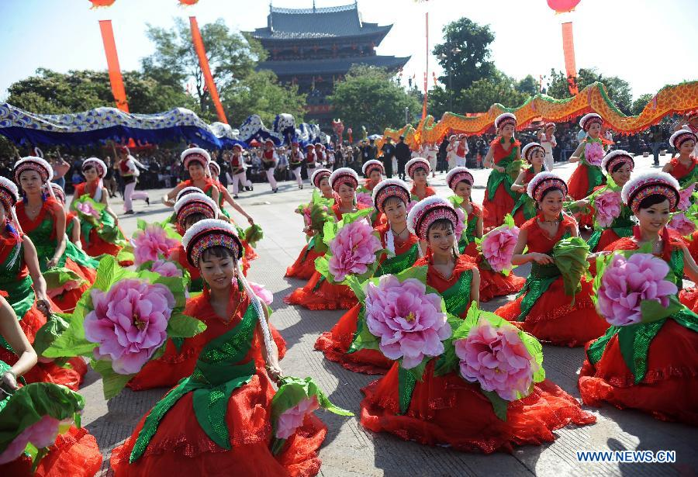
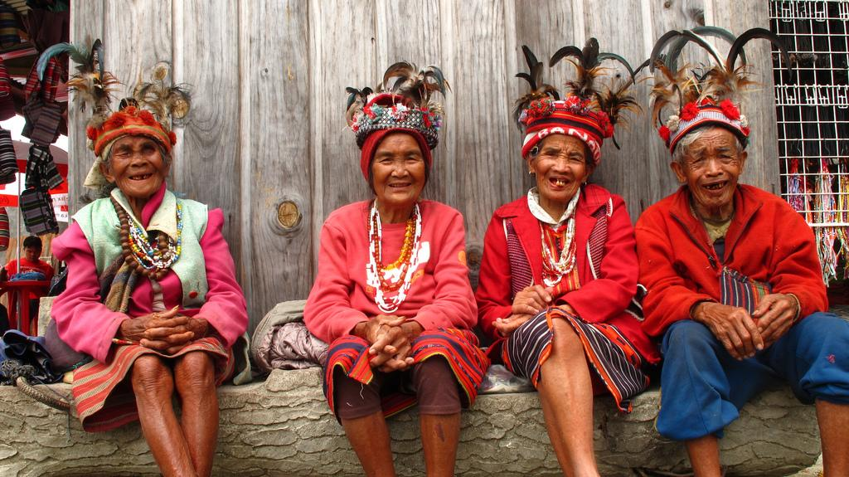
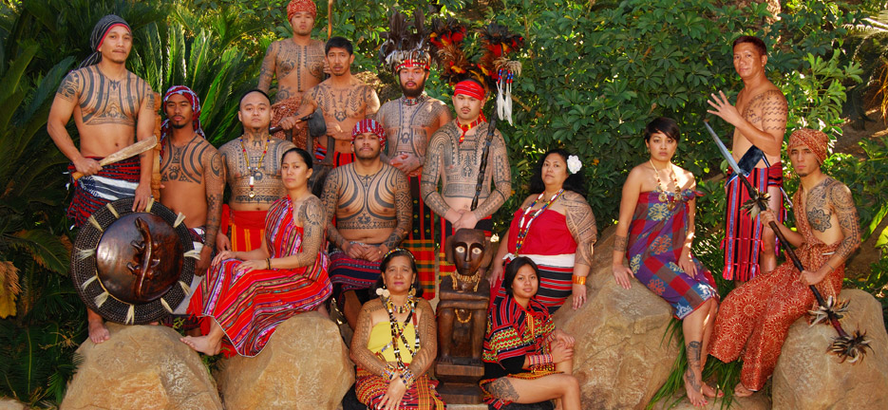
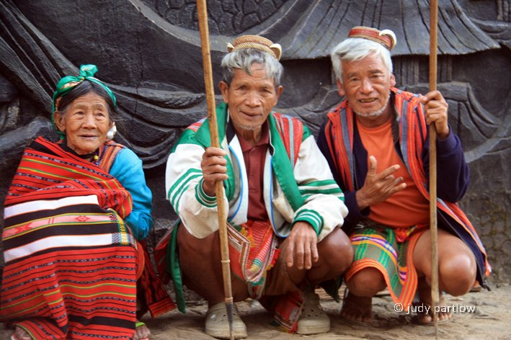
A group of people who share such characteristics as language, religion, and ancestry are said to be an….?
Ethnic group

Slide 14
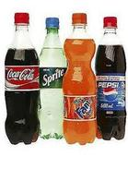
If something is said to be identical or similar, it’s referred to as……..?
Homogeneous

Slide 15
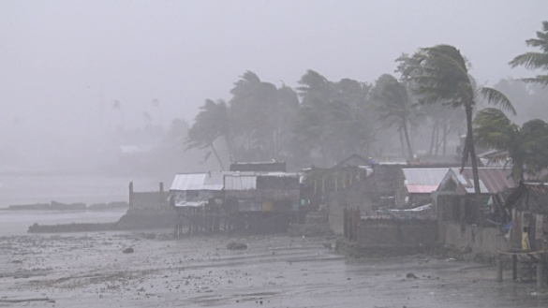
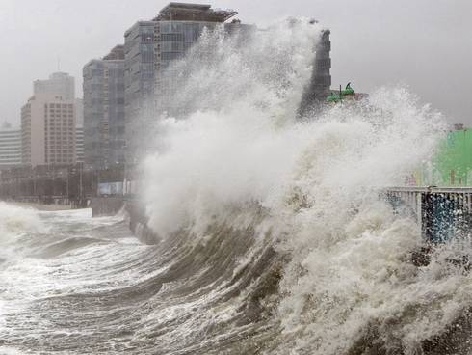
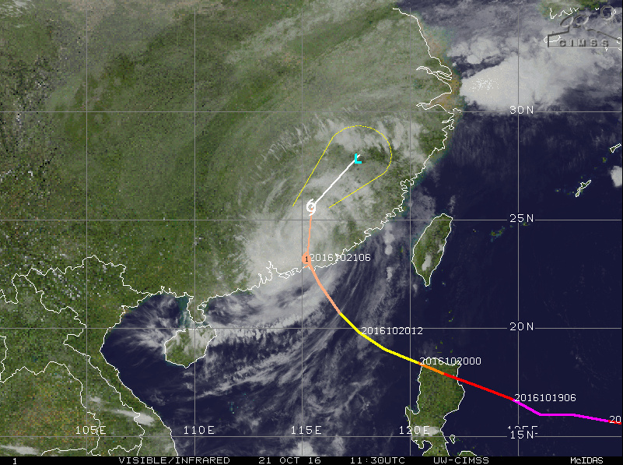
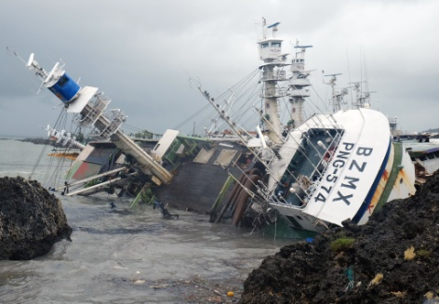
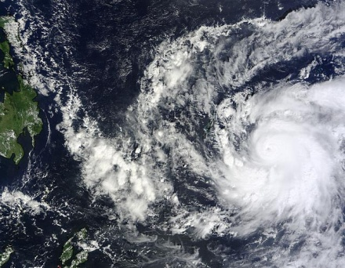
A violent storm that develops over the Pacific Ocean is called a…….?
Typhoon

Slide 16
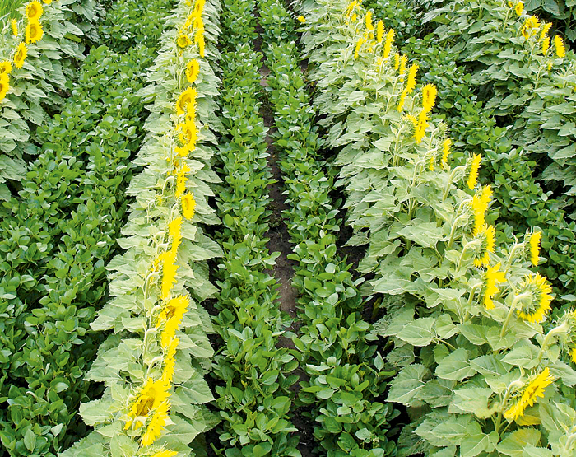
Growing two or more crops on the same land in the same season or at the same time is called…?
Double-cropping

