Slide 1
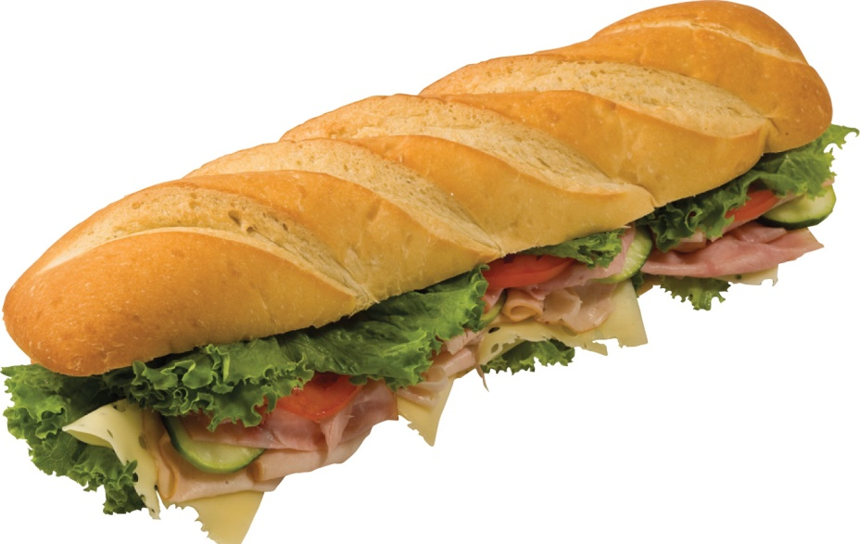
Money given by a government to assist a private company is called….?
Subsidy

Slide 2
Groups of students who carried out Mao Zedong’s policies during the Cultural Revolution were called the……?
…… rail
Red Guard

Slide 3
To add variety to is to….?
Diversify

Slide 4
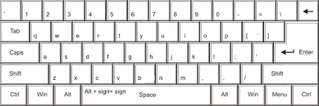
Under the ____ economic system, people can start private businesses and make a profit.
Free enterprise

Slide 5
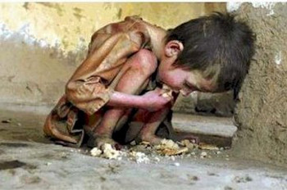
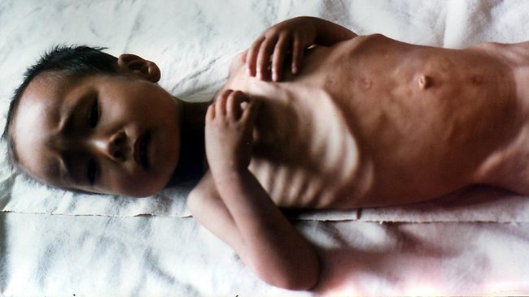
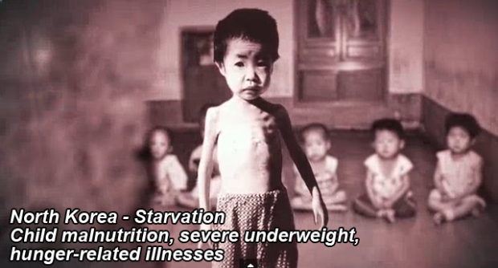
North Korea faced a huge food shortage, or ____, in 1995.
Famine

Slide 6
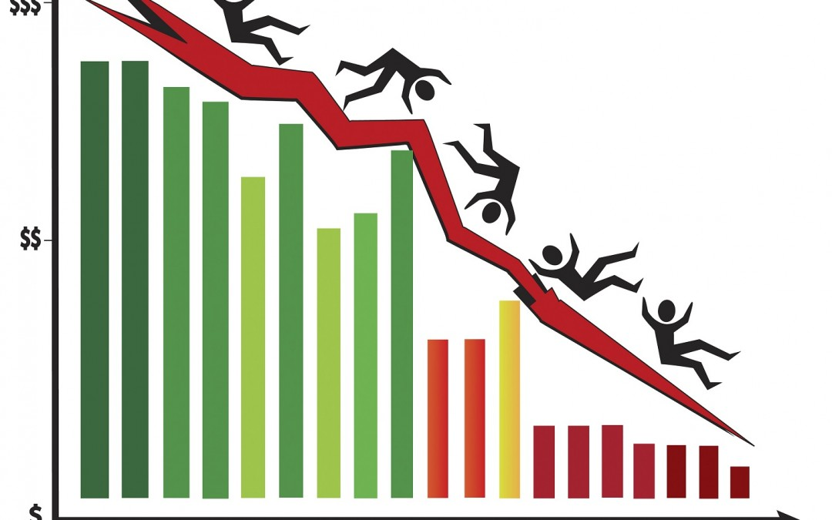
To overcome the ____, or shrinking economy, some Japanese companies began to lay off employees.
Recession

Slide 7
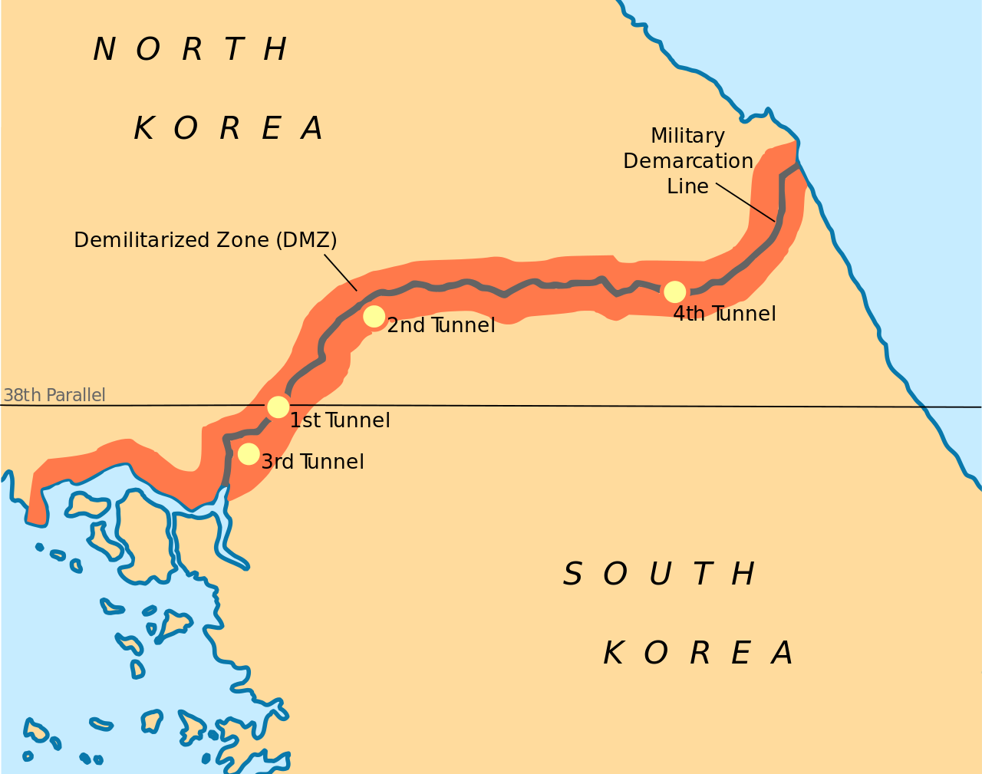
The border between the two Koreas runs through the ____, an area in which no weapons are allowed.
No Weapons Here Please!
Demilitarized zone

Slide 8
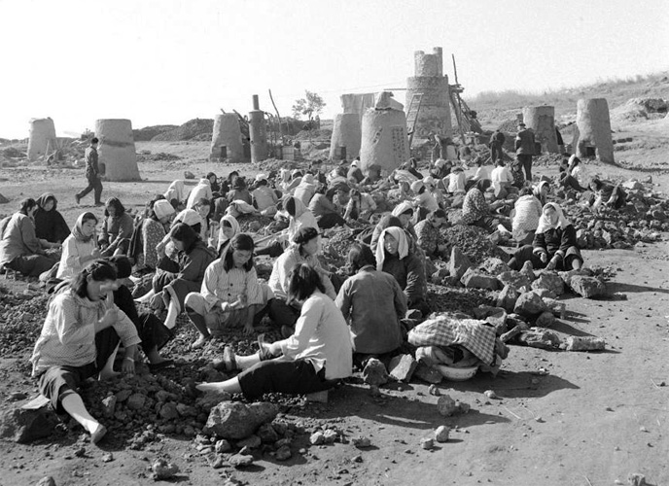
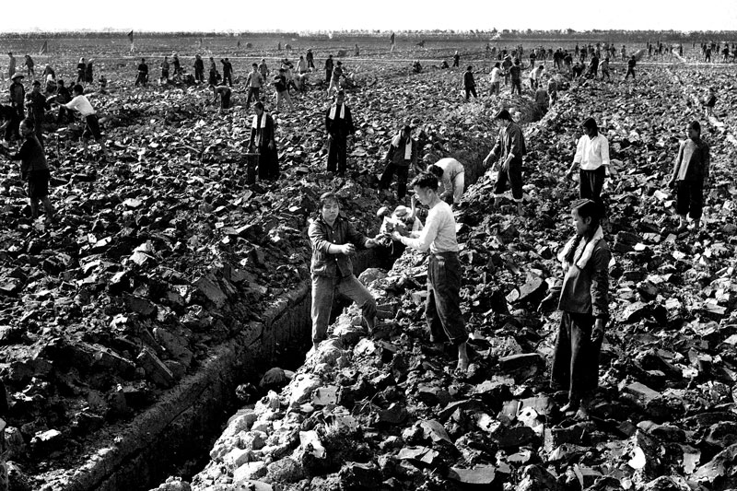
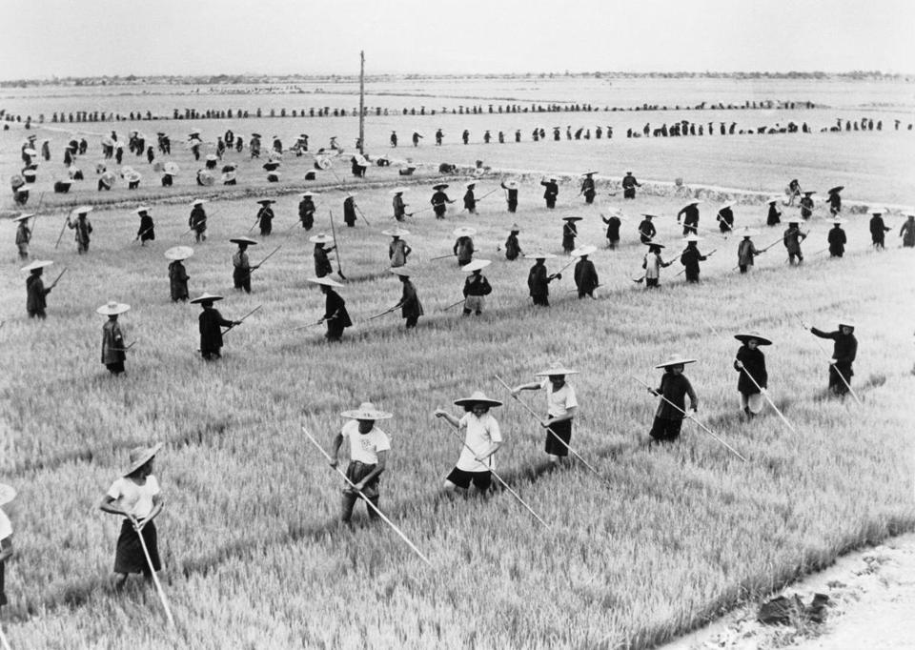
The “Great Leap Forward” was a ____, or extreme, program intended to increase output from farms and factories.
Radical

Slide 9
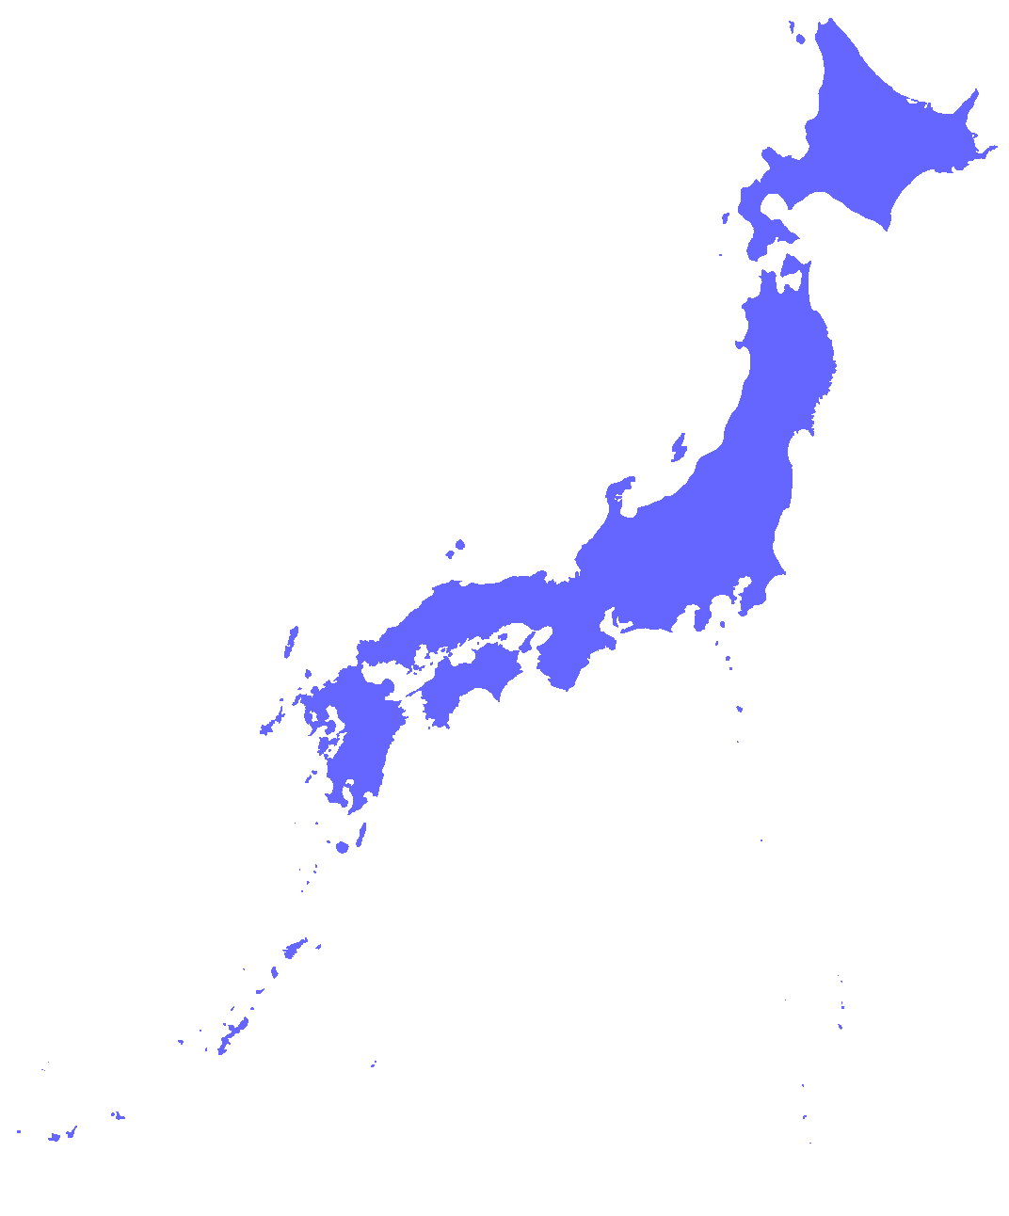
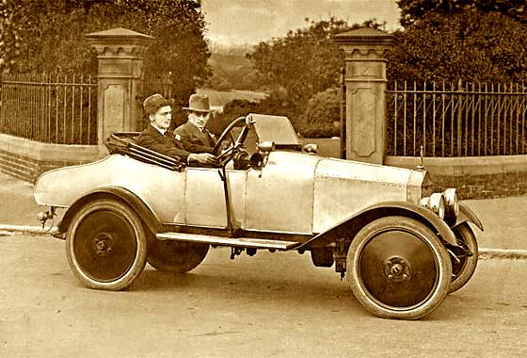
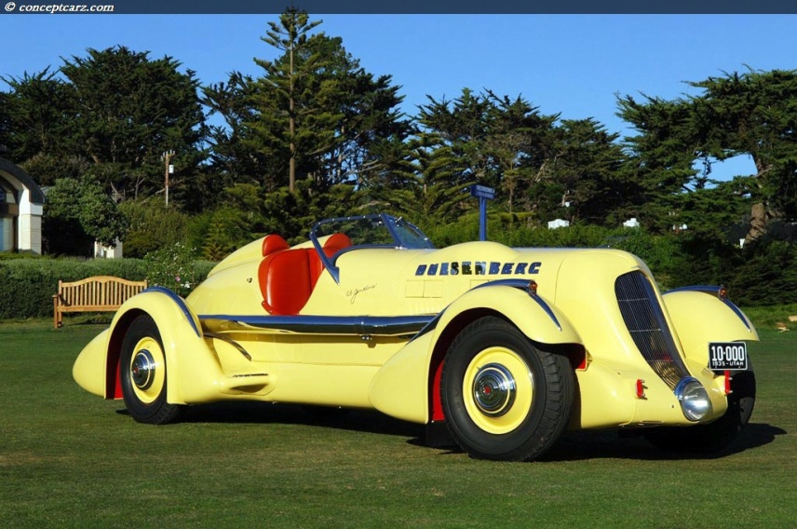
A main reason Japan became a prosperous industrial nation was its ability to do what?
Comes Out
Goes In
improve existing products.

Slide 10
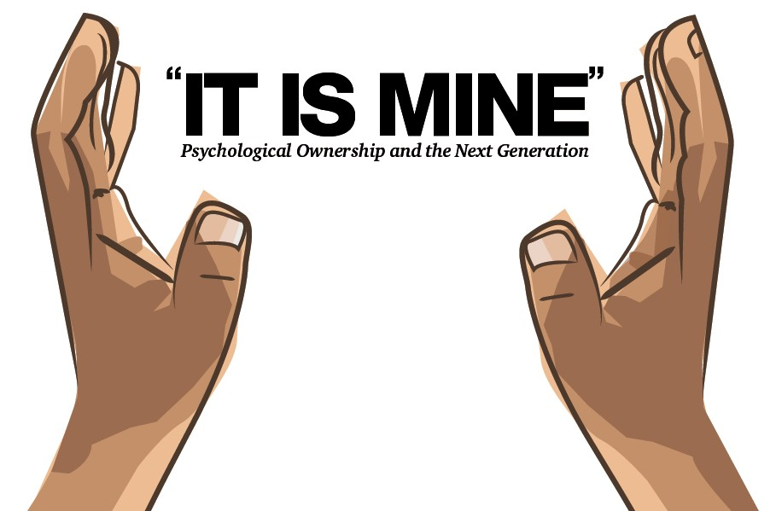
What is the economy of North Korea based on?
North Korean Gov’t
Government ownership.

Slide 11
Why does the demilitarized zone exist?
because no peace treaty was signed to end the Korean War

Slide 12
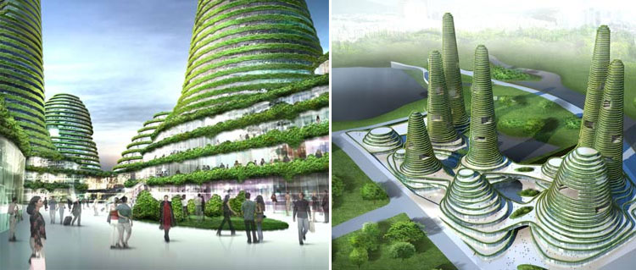
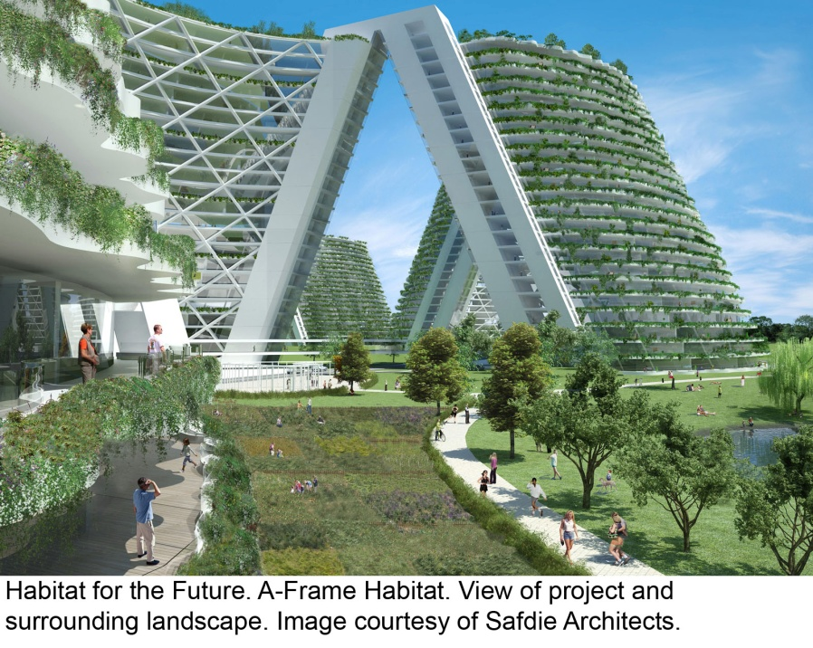
What was the aim of Mao Zedong’s Cultural Revolution policy?
To create a new society.

Slide 13
Where did the Chinese Nationalists establish the Republic of China?
Taiwan

Slide 14
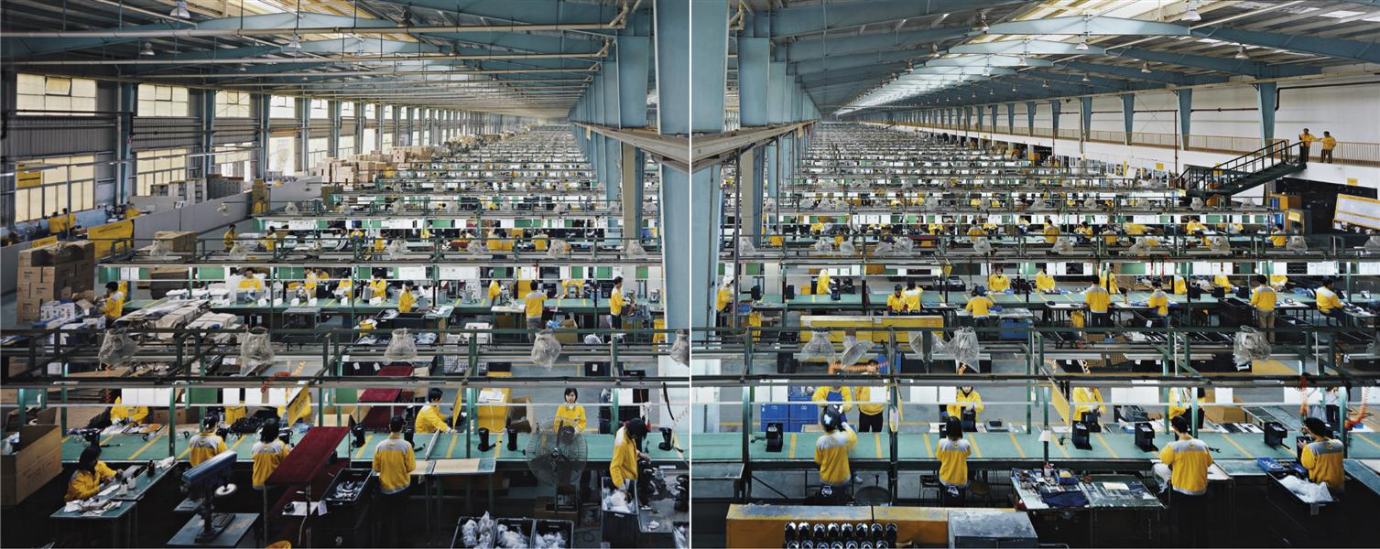
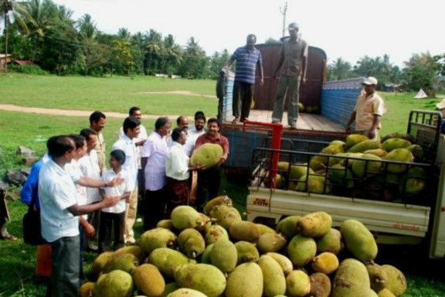
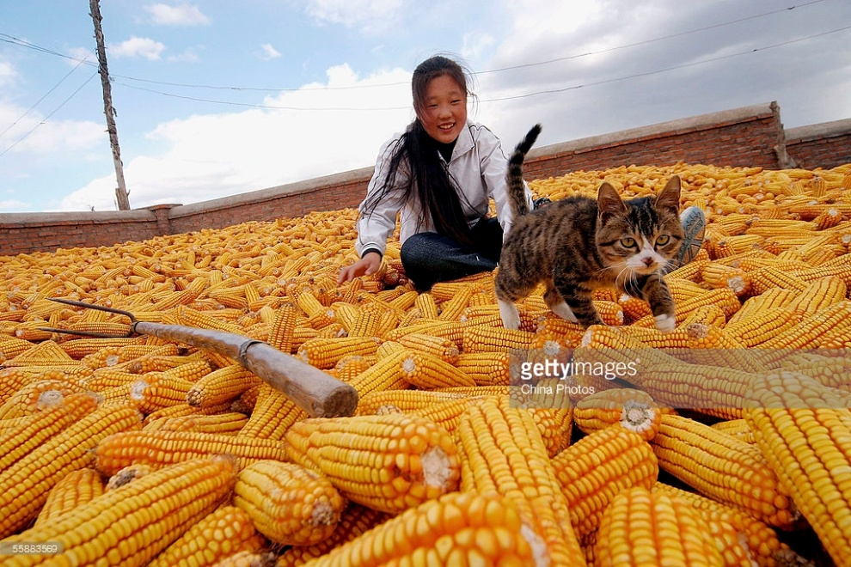
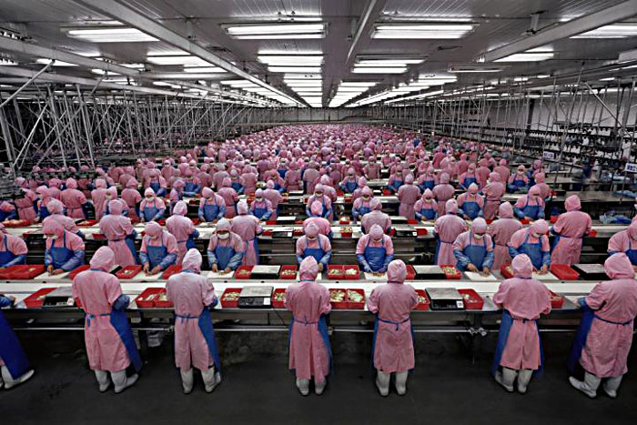
In the 1950s, the communist government in China began a policy called the “Great Leap Forward” in order to increase what?
production in farms and factories.

Slide 15
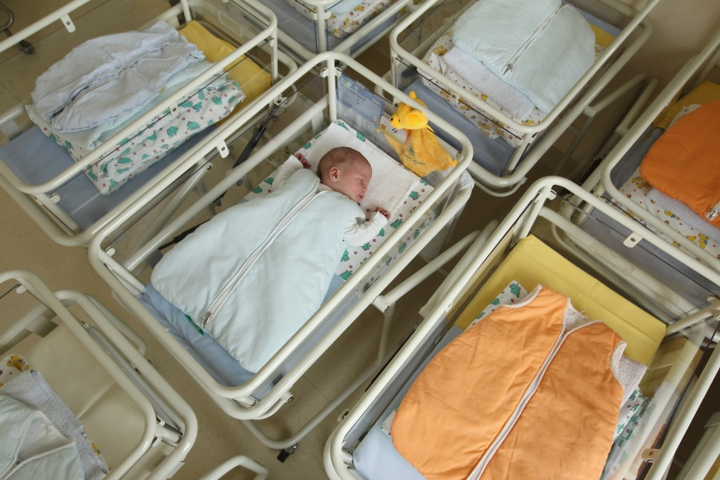
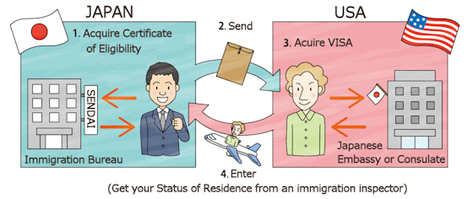
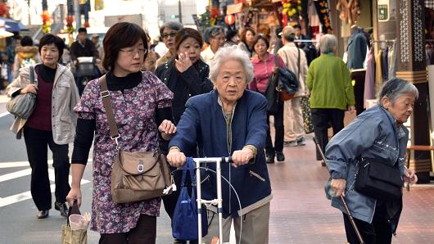
Why doesn’t Japan have a growing labor force?
Only 2 allowed this week
Because of low birth rates, an aging population and limited immigration.

Slide 16
How did Japan help its economy grow?
By improving existing products.

Slide 17
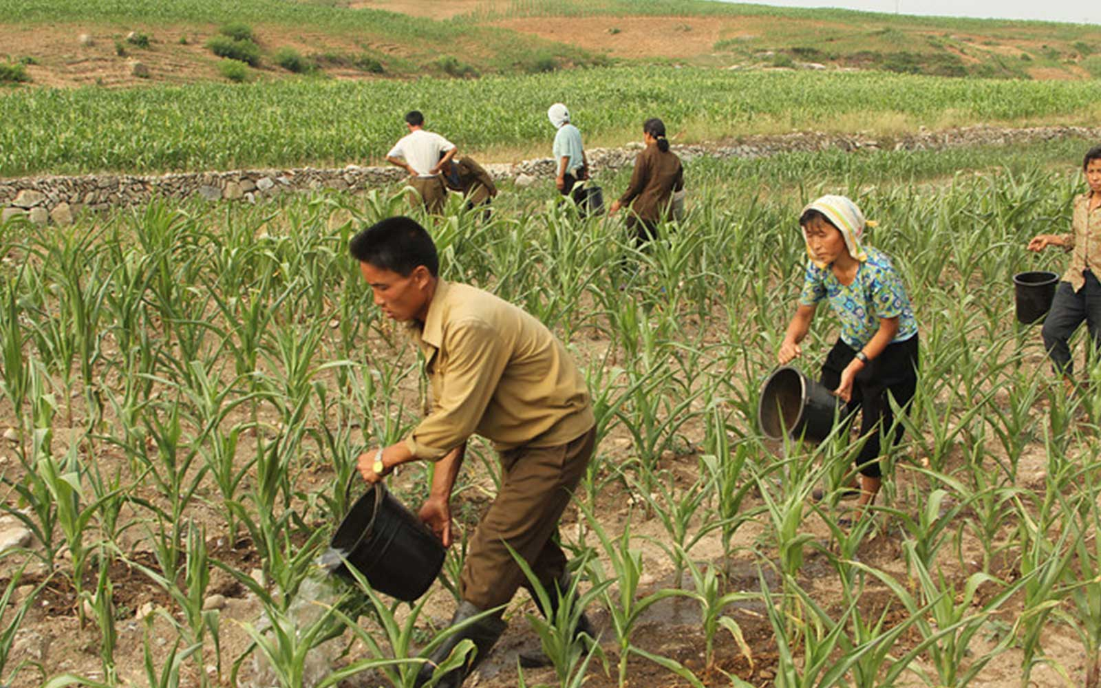
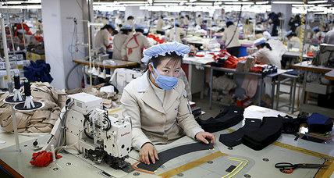
What has happened to South Korea’s economy since the end of World War II?
From To
It has changed from an industrial to an agricultural economy.

Slide 18
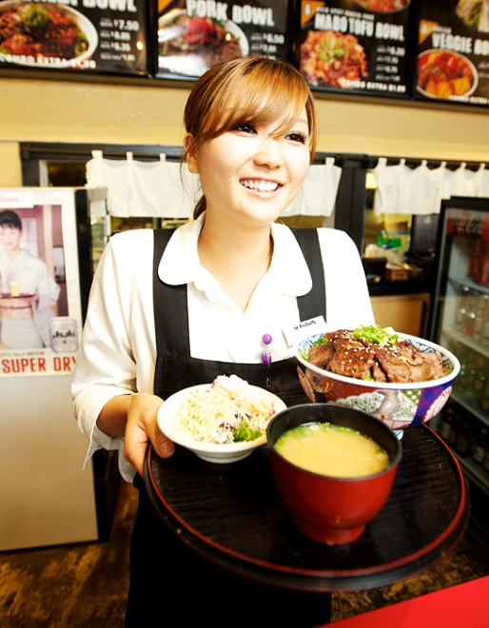
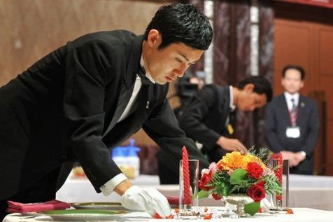
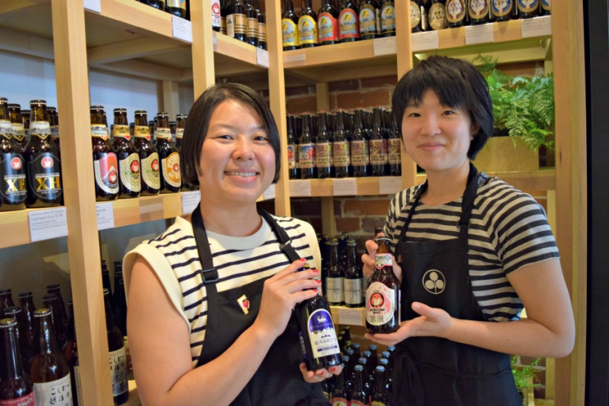
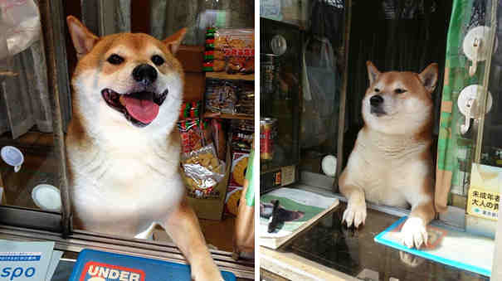
What is the most important part of Japan’s economy today?
The service industries

Slide 19
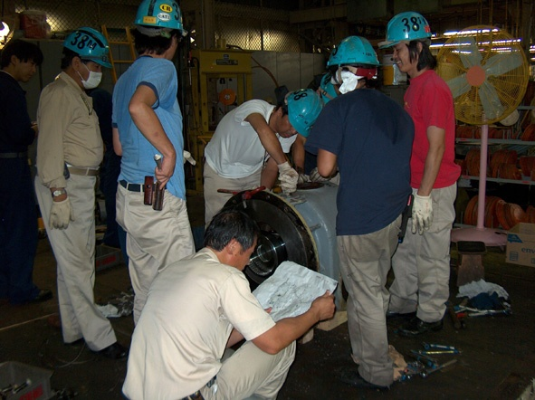
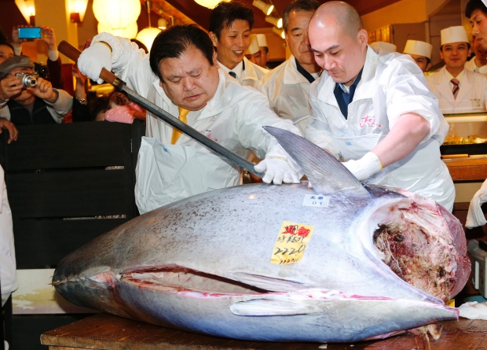
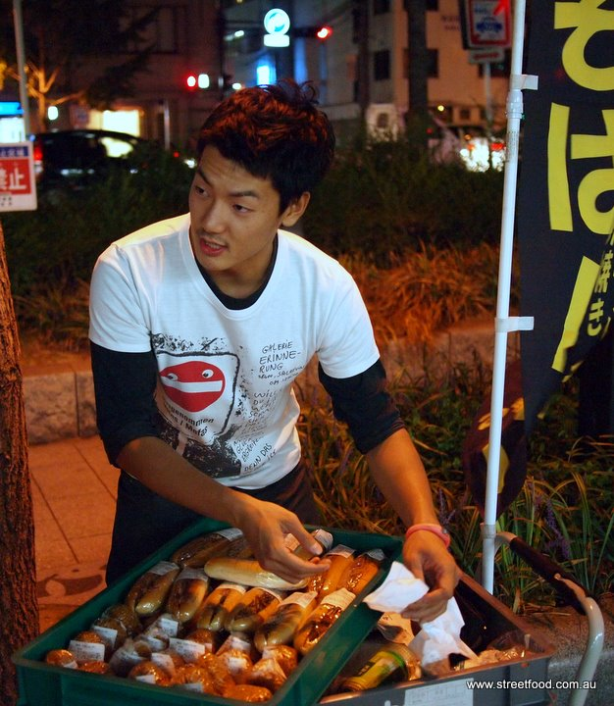
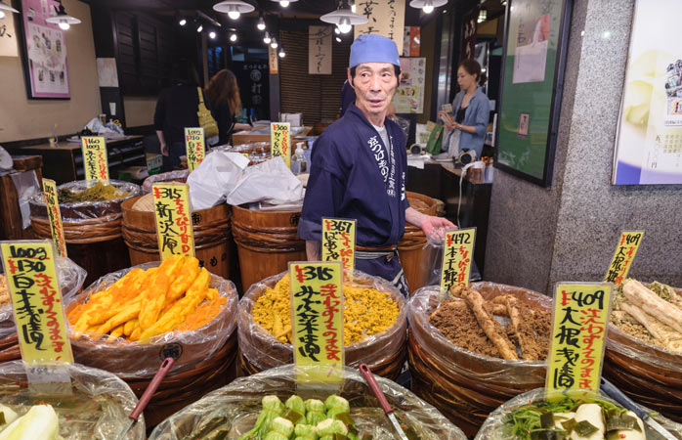
What part of Japan’s economy provides the most jobs today?
service industries

