Slide 1
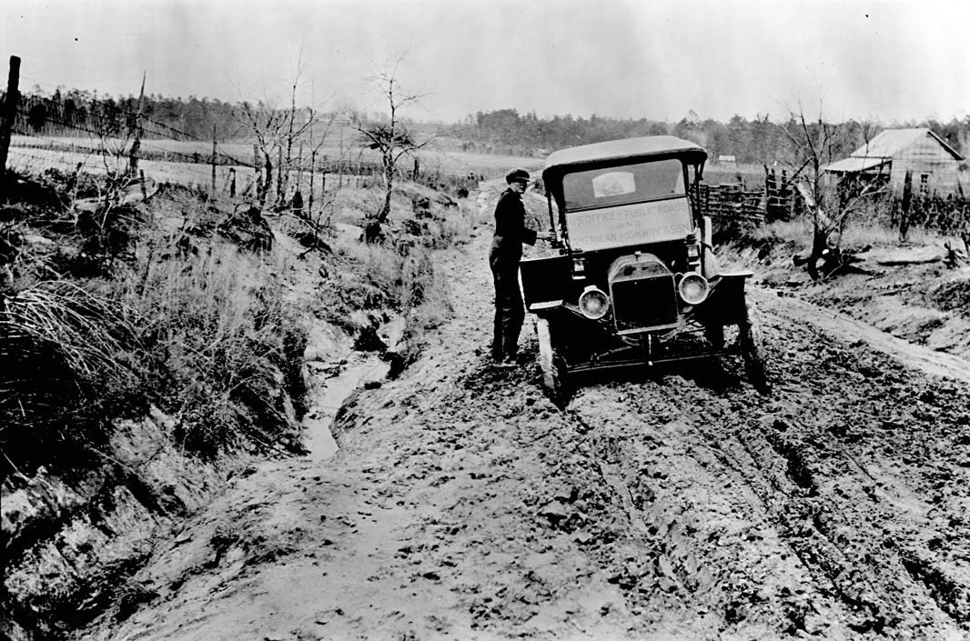
Why did southern cotton planters rely on the region’s rivers to ship goods.
The lack of roads made shipping by land very difficult.

Slide 2
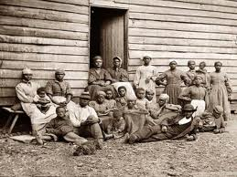
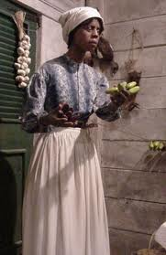
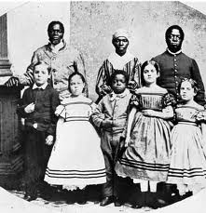
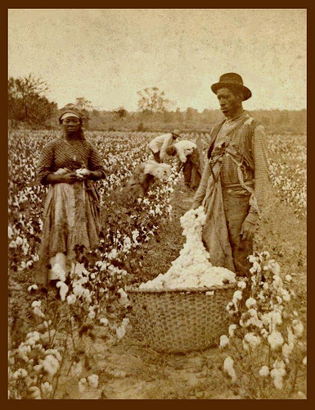
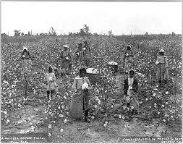
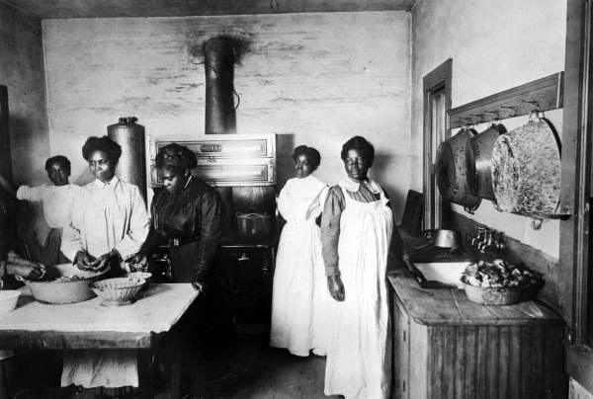
Unlike slaves working on the plantations, slaves working in the planter’s houses usually had…..?
Field Slaves
House Slaves
Better food, clothing, and shelter.

Slide 3
In the first half of the 1800’s, what portion of white southern families owned slaves?
One Third

Slide 4
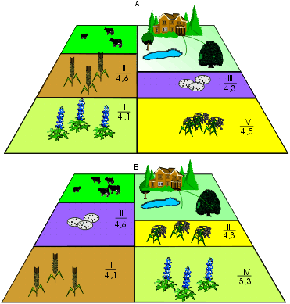
What does “crop rotation” involve?
Changing the type of plants grown on a given plot each year in order to protect the land from mineral loss.

Slide 5
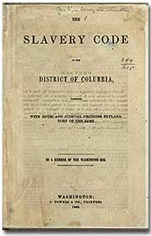
What were “the slave codes?”
Strict laws that controlled the actions of slaves.

Slide 6
Wealthy white southerners used religion to justify the institution of slavery by arguing….?
God created some people to rule over others.

Slide 7
Most of the South’s big cities had started as….?
Shipping Centers

Slide 8
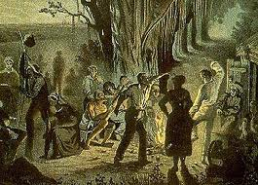
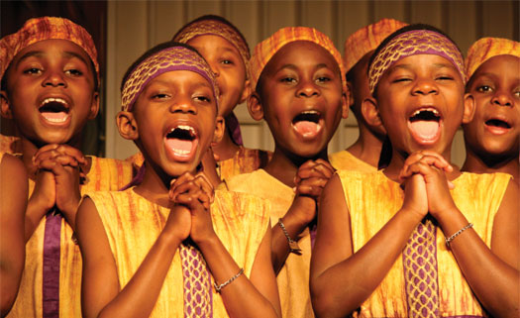
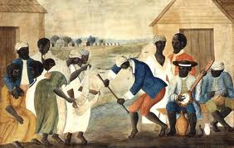
What were spirituals?
Emotional Christian songs, sung by the slaves.

Slide 9
A …….?...... is a white owner of a small farm.
Yeoman

Slide 10
What was one duty of a planter’s wife?
Supervising slaves within the household.

Slide 11
With the help of a white person, free African Amer.’s, (by 1860), could….?
Engage in business transactions.

Slide 12
What did southerners fear, after cities and states, passed laws limiting the rights of freed slaves and free African-Amer.’s?
Slave Rebellions

Slide 13
What have some historians called “the invisible institution?”
Slave Religion

Slide 14
What was the effect of Nat Turner’s rebellion of 1831?
Slave codes were toughened.

Slide 15
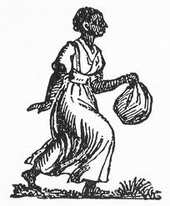
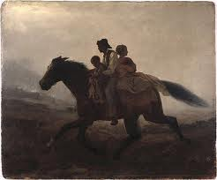
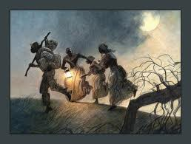
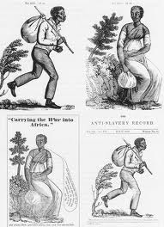
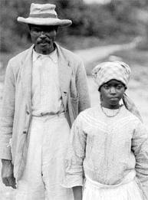
Slaves most often ran away from slaveholders in order to do what?
Visit relatives.

Slide 16
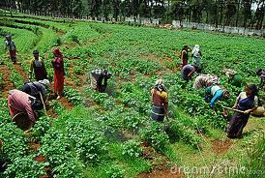
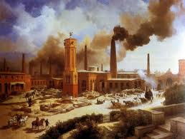
What made agriculture more profitable than industry, in the South?
Tax cuts

Slide 17
He was sentenced to death.
What happened to Nat Turner after the rebellion he started in 1831?

Slide 18
What advantage did skilled slaves have over unskilled slaves?
Earning money to buy their freedom.

Slide 19
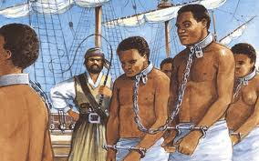
What was responsible for increasing the domestic slave trade in the early 1800’s?
An act of congress banned the importation of slaves to the U.S.

Slide 20
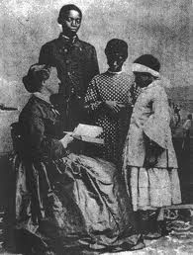
Why were slaves uneducated?
NO!
NO!!
NO!!!
Teaching slaves was prohibited in most states.

Slide 21
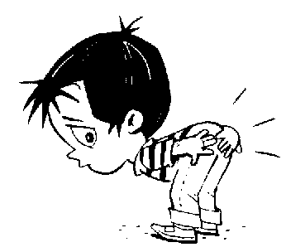
How did most planters encourage obedience?
Mostly through physical punishment.

Slide 22
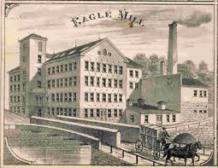
Many of the first factories of the South were built for….???
The processing of crops such as sugar cane.

Slide 23
What was the “Cotton Belt?”
An area stretching from S. Carolina to Texas that grew most of the country’s cotton crop.

Slide 24
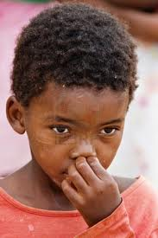
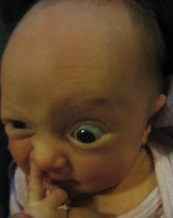
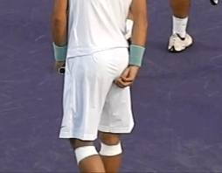
In what way did the slaves rebel against long working hours?
They slowed down their work in the fields.

Slide 25
What would a slave have worried about the most when coming up for auction.
The fate of parents, brothers, sisters, and children.

Slide 26
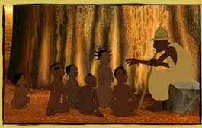
How did enslaved parents pass their culture down to their children?
Through folktales, with traditional characters and morals.

Slide 27
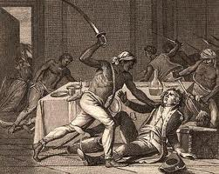
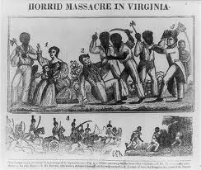
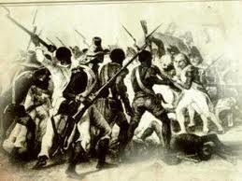
What was the most violent slave uprising in the U.S.?
Nat Turner’s Rebellion.

