Slide 1
READY

Slide 2
What was the position of South Carolina Senator John C. Calhoun in the debate for the Compromise of 1850?
Slave states should separate peacefully from the Union.

Slide 3
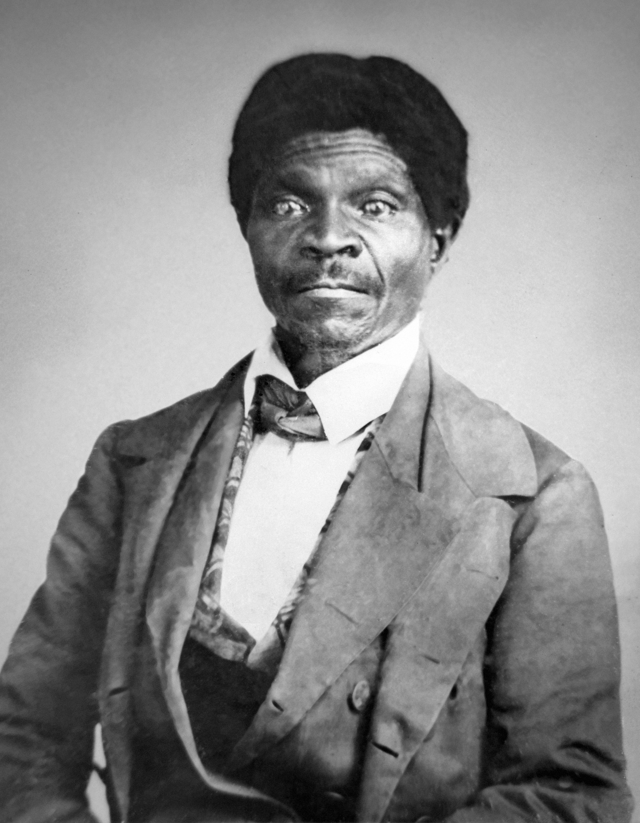
Why were Republicans angered by the Dred Scott decision?
The Supreme Court ruled that Congress did not have the power to ban slavery.

Slide 4
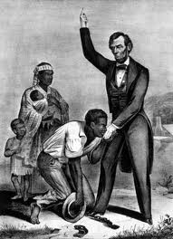
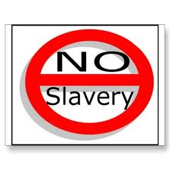
Why did the southern states decided to secede from the Union after the election of 1860?
The South
+
=
The southern economy and way of life would be destroyed.

Slide 5
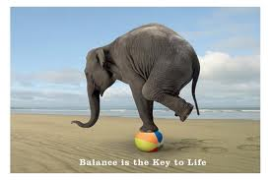
What was a consequence of the Compromise of 1850?
Free
Slave
The balance between free and slave states ended in the Union.

Slide 6
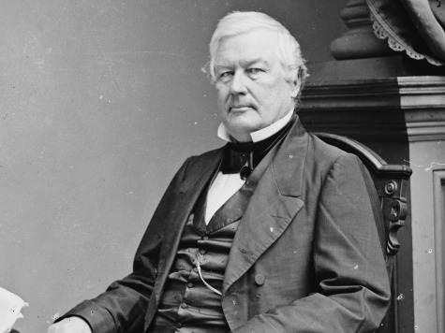
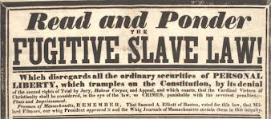
Why did the Whigs pass over President Millard Fillmore when choosing their candidate for the election of 1852?
His strict enforcement of fugitive slave laws would cost votes.

Slide 7
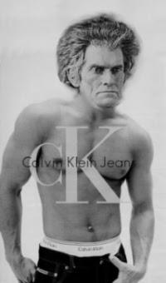
What, South Carolina Senator, (in the debate for the Compromise of 1850), believed that the Slave states should separate peacefully from the Union?
John C. Calhoun
1849 Calvin Klein ad.

Slide 8
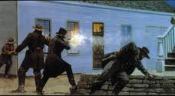
On the night of May 24, 1856, five pro-slavery men were killed in Kansas. What is this event called?
ThePottawatomie Massacre.

Slide 9
What was the result of the Pottawatomie Massacre?
Kansas collapsed into a civil war and many citizens were killed.

Slide 10
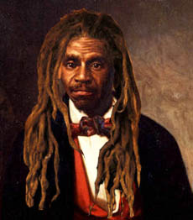
In what case did the Supreme Court ruled that Congress did not have the power to ban slavery, (which angered the Republican party)?
The Dred Scott decision.

Slide 11
Most northerners opposed the Fugitive Slave Act because it ……?
The
Commish
Slave
gave commissioners too much power and should have allowed slaves the right to jury trials.

Slide 12
The purpose of the Lincoln-Douglas debates was for Abraham Lincoln and Stephen Douglas to ……..?
announce their candidacies for Senator of Illinois and gain the support of voters.

Slide 13
Why was the case of Anthony Burns Important?
It persuaded many to join the abolitionist cause.

Slide 14
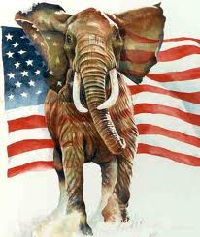
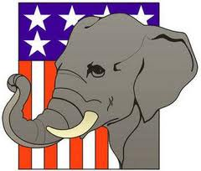
What changes occurred to political parties in the United States after the Kansas-Nebraska Act was passed?
The Republican Party formed.

Slide 15
The Wilmot Proviso was an idea proposed to Congress to………?
Mexican Cession
Prohibit/Ban slavery in all parts of the Mexican Cession.

Slide 16
The Wilmot Proviso spurred a debate that showed growing sectionalism, which refers to…..?
favoring the interests of a region over the interest of the country.

Slide 17
What did southerners fear after John Brown’s raid on Harpers Ferry?
The safety of the South was in jeopardy, and another attack from the North might occur.

Slide 18
When Lincoln was elected in 1860, he stated that the government would…..?
not start a war with the southern states.

Slide 19
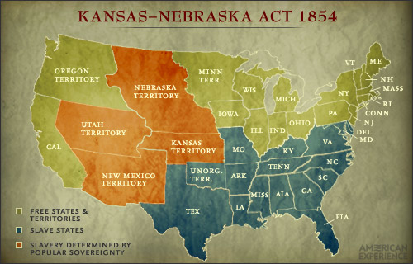
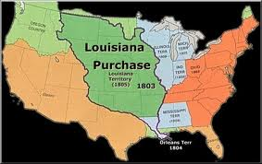
Introduced in 1854, the Kansas-Nebraska Act did what?
divided the Louisiana Purchase into two territories.

Slide 20
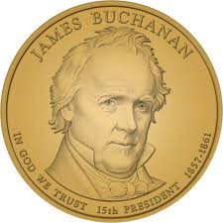
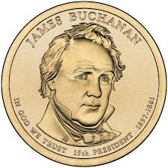
Democrats nominated James Buchanan to run in the 1856 presidential election because he was …..?
not involved in the Kansas-Nebraska debate.

Slide 21
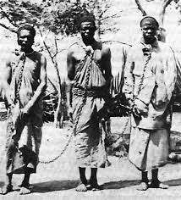
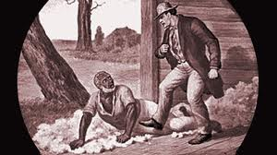
Chief Justice Roger B. Taney argued in 1857 that Congress could not prohibit someone from taking slaves into a federal territory because ……?
=
=
=
slaves were property, and property was defended by law.

Slide 22
What did the Freeport Doctrine, (proposed by Stephen Douglas), state?
Free
Slave
Free
Wait!....What?
The decision to practice slavery in the territories belonged to the people.

Slide 23
The Election of 1860
Electoral Vote Popular Vote % of Pop. Vote
Lincoln 180 1,865,593 39.8
Douglas 12 1,382,713 29.5
Breckinridge 72 848,536 18.1
Bell 39 592,906 12.6
Which of the following statements about the election of 1860 is true?
a. Senator Douglas was the least popular candidate.
b. Abraham Lincoln won both the electoral and the popular votes.
c. John C. Breckenridge had the second most electoral votes and the second most popular votes.
d. John Bell had the least popular votes and the least electoral votes.

Slide 24
What helped inspire Harriet Beecher Stowe to write Uncle Tom’s Cabin?
listening to the stories of fugitive slaves she met in Ohio.

Slide 25
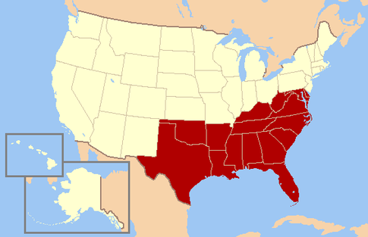
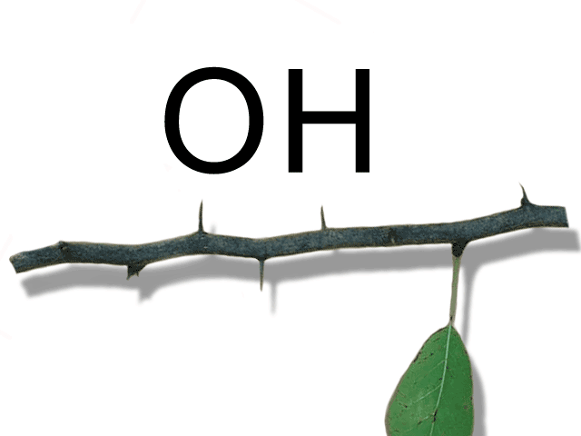
After the election of 1860, What did the South decide to do, because they believed their economy and way of life would be destroyed?
Secede from the Union

Slide 26
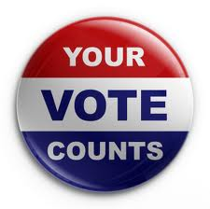
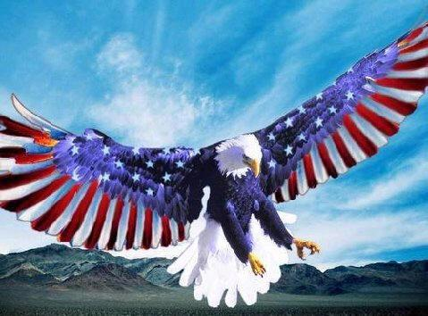
How did the idea of popular sovereignty affect slavery in the United States?
States or territories would decide whether to permit slavery.

Slide 27
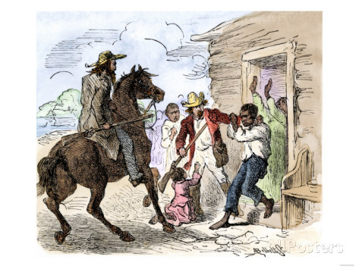
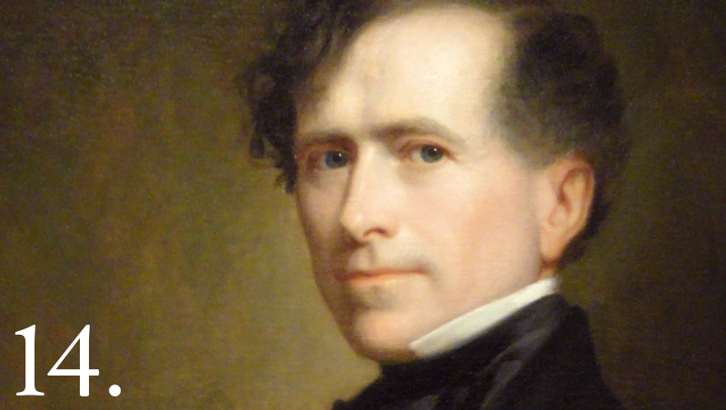
Southern Democrats trusted Franklin Pierce to represent their party in the election of 1852 because he ……..?
promised to enforce the Fugitive Slave Act.

Slide 28
Why was John Brown’s raid on Harpers Ferry a failure?
He didn’t have enough supporters for his cause.

Slide 29
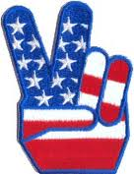
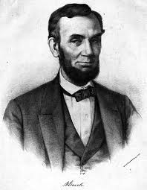
What was Abraham Lincoln’s opinion of John Brown’s raid in Virginia?
No Blood Shed
The antislavery movement should not be one of violence and bloodshed.

Slide 30
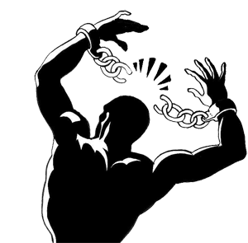
The Kansas-Nebraska Act led to the …..?
return of the slavery issue between the North and South.

Slide 31
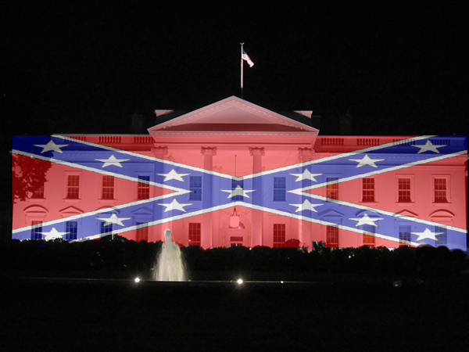
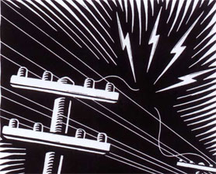
What was the significance of the election of 1860?
It showed that the South was losing its political power in the nation.

Slide 32
The balance between free and slave states ended in the Union, as a consequence of the……?
Slave States
Free States
Compromise of 1850

Slide 33
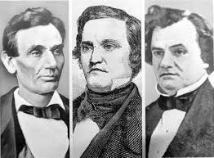
Why was the Democratic Party not a strong force in the election of 1860?
Republican Democrat Democrat
The Democrats could not agree on a single candidate so their votes were divided between two candidates.

Slide 34
Newly elected President Lincoln affirmed that..?
“Any people anywhere, being inclined and having the power, have the right to rise up, and shake off the existing government, and form a new one that suits them better. This is a most valuable - a most sacred right - a right, which we hope and believe, is to liberate the world.”
citizens have the right to overthrow the government.

Slide 35
In 1854 the Republican Party rallied around the……?
spread of slavery in the West.

Slide 36
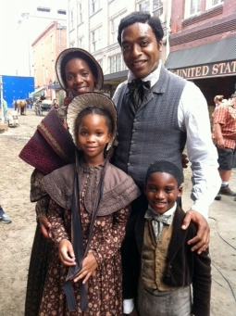
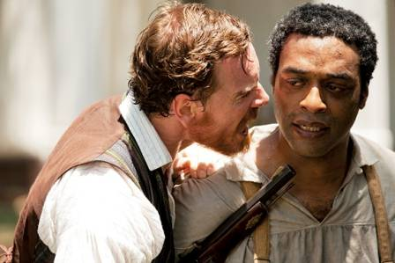
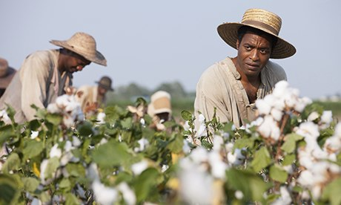
Which was an aspect of the Fugitive Slave Act that horrified northerners?
Some free African Americans had been captured and sent to the South.

Slide 37
Which was an aspect of the Fugitive Slave Act that horrified northerners?
Some free African Americans had been captured and sent to the South.

Slide 38
What was Senator Henry Clay’s contribution in the Compromise of 1850?
proposing that > California enter the Union as a free state.

Slide 39
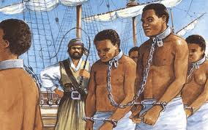
What contributed to the Sack of Lawrence?
The antislavery government in Kansas declared slavery illegal in the state.

Slide 40
Explain the Fugitive Slave Act.
Commissioners benefited from returning slaves to slaveholders.

Slide 41
What did Harriet Beecher Stowe do to influence the debate over slavery?
She exposed the harsh reality of slave life, through her book.

Slide 42
What did the Freeport Doctrine, (proposed by Stephen Douglas), state?
The decision to practice slavery in the territories belonged to the people.

Slide 43
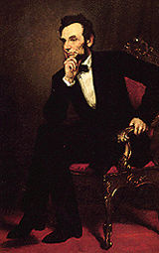
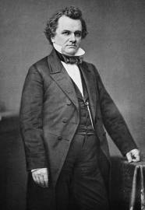
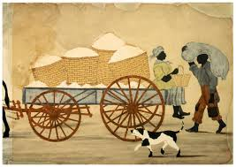
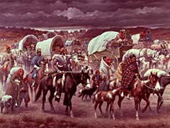
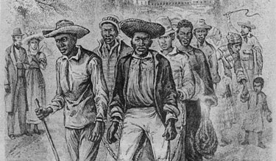
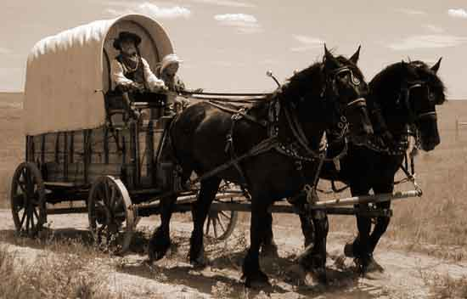
In the Lincoln-Douglas debates, Abraham Lincoln accused Democrats of wanting to..?
Vs.
spread slavery in the West.

Slide 44
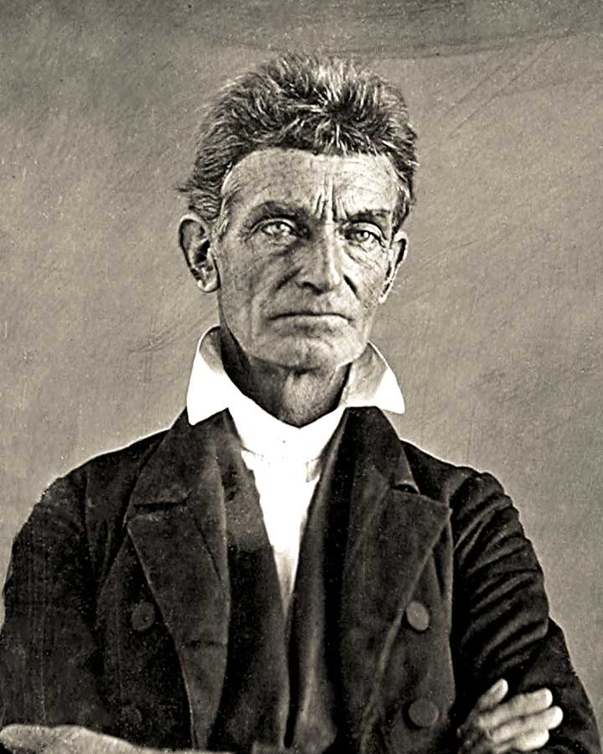
What did John Brown’s raid on Harpers Ferry do to affected life in the United States by ……?
It heightened the conflicts between slave and free states.

Slide 45
The Supreme Court’s ruling in Dred Scott v. Sandford established that..?
The Missouri Compromise’s restriction on slavery was unconstitutional

Slide 46
Harriet Beecher Stowe’s Uncle Tom’s Cabin is a/an …..?
Novel.

Slide 47
Why did members of the Free-Soil Party support the abolition of slavery?
for fear that slave labor would have taken white workers’ jobs.

Slide 48
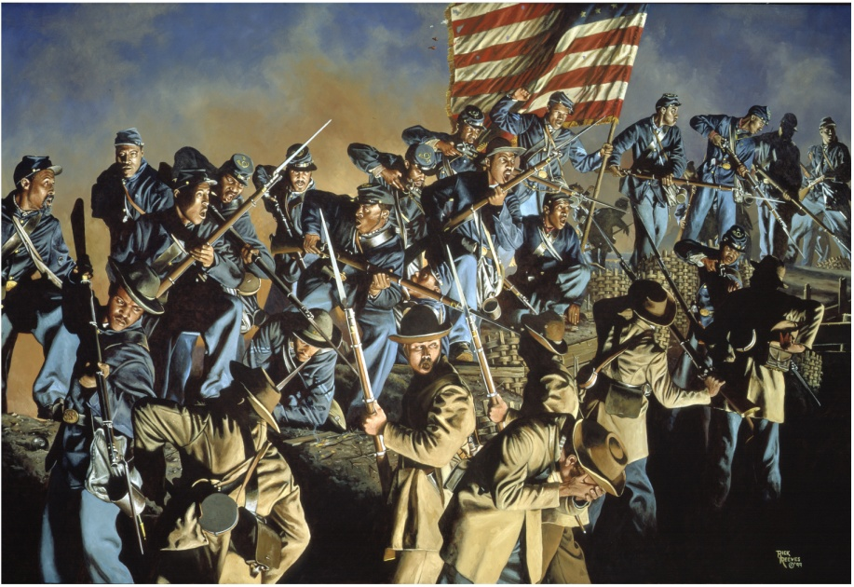
John Brown’s raid on Harper’s Ferry affected life in the U.S. by…..?
Heightening the conflicts between slave and free states.

