Slide 1
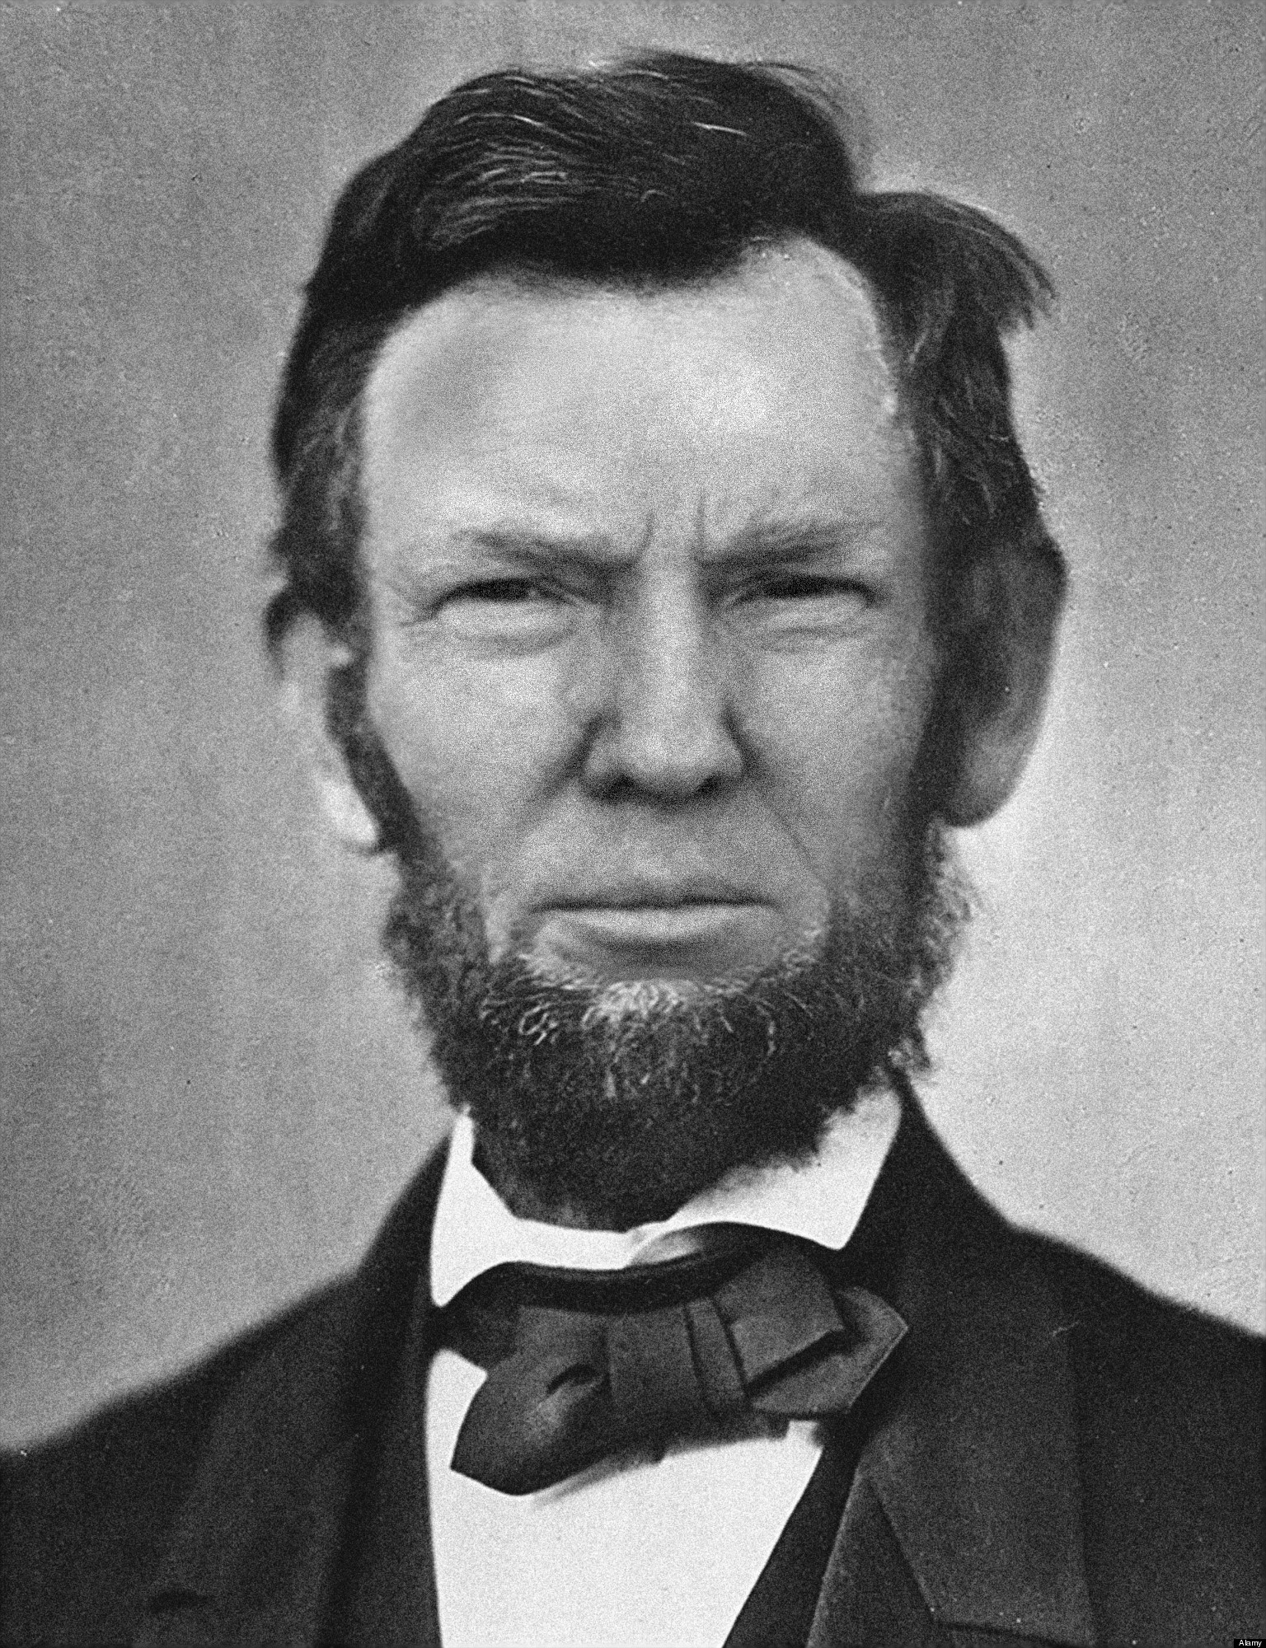
Ch 16.
Study Guide
Part 2

Slide 2
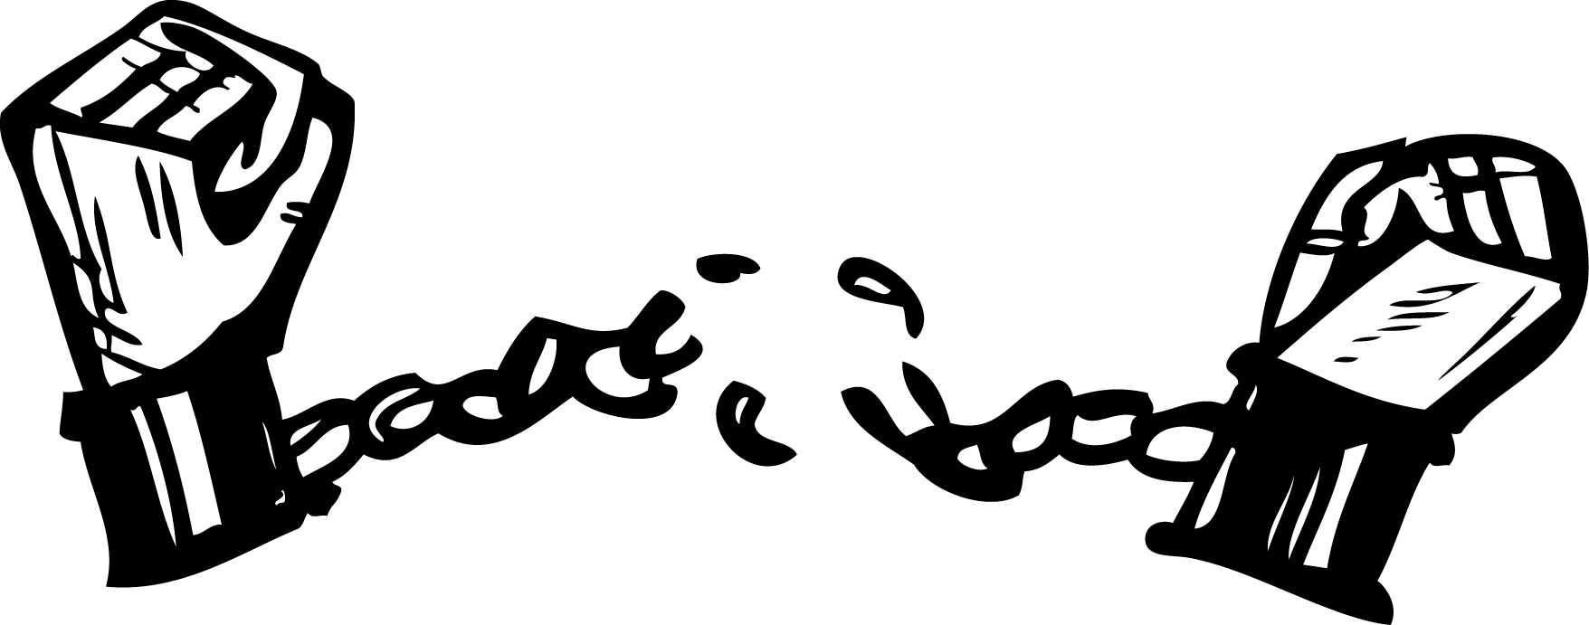
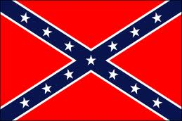
The Emancipation Proclamation was an order from Lincoln…..?
calling for all Confederate slaves to be freed.

Slide 3
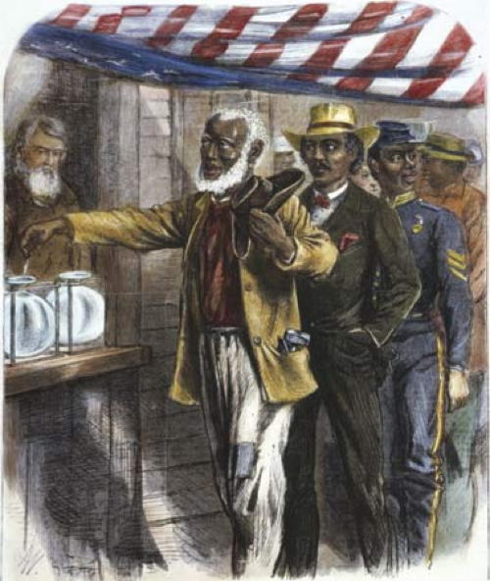
In 1864 how did Lincoln propose rewarding African American soldiers who had served for the Union Army?
He suggested granting them the right to vote.

Slide 4
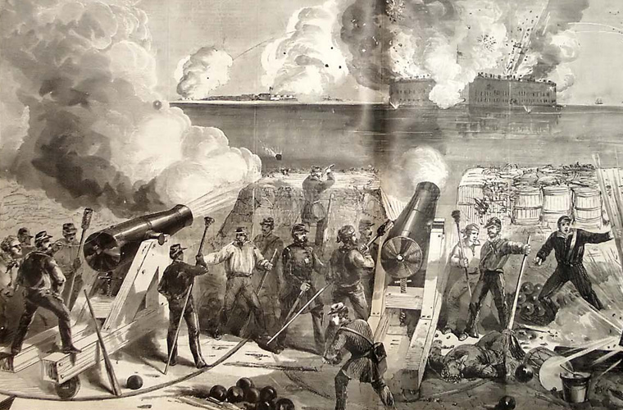
The Civil War began with the
Firing of Confederate guns on Fort Sumter.

Slide 5
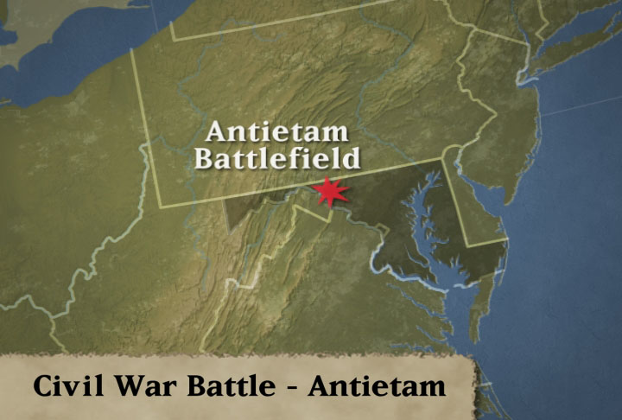
The Battle of Antietam…..?
shifted control of the Civil War from the South to the North.

Slide 6
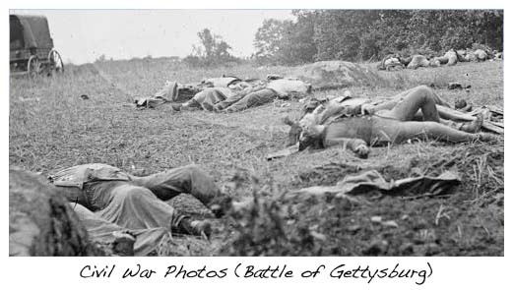
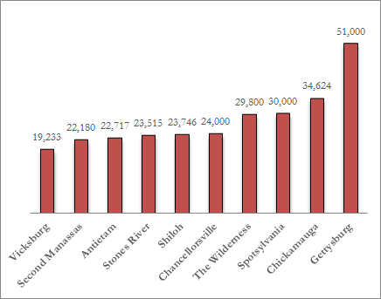
Many Northerners began to oppose the Civil War because they…..?
were upset by the length of the war and the number of casualties.

Slide 7
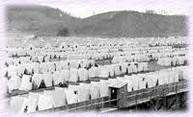
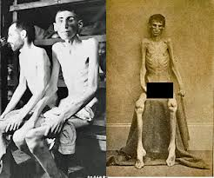
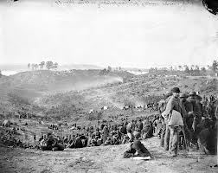
How were prisoners of war treated during the Civil War?
Union prison for Confederacy in Elmira, NY.
Union prisoners of the Confederates
at Andersonville, Ga.
Confederate prisoners at Belle Plain, Richmond Va.
They were often held without shelter and given little food.

Slide 8
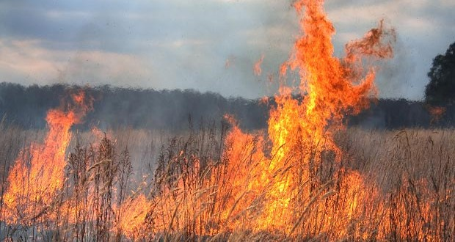
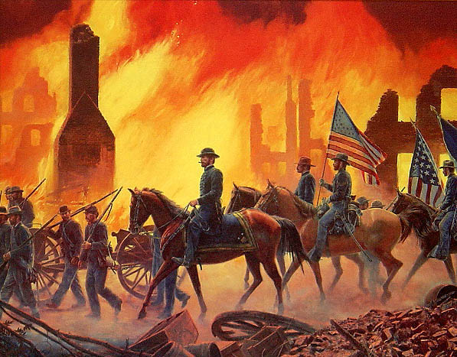
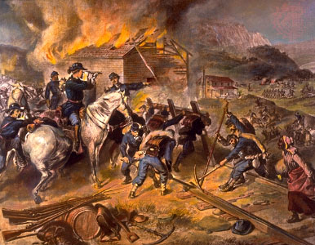
What was the type of warfare where civilian and military resources are destroyed ?
Total War

Slide 9
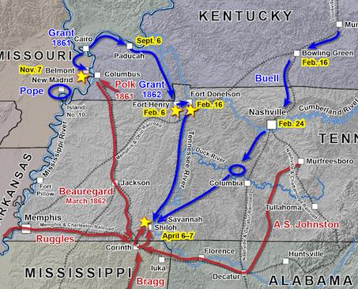
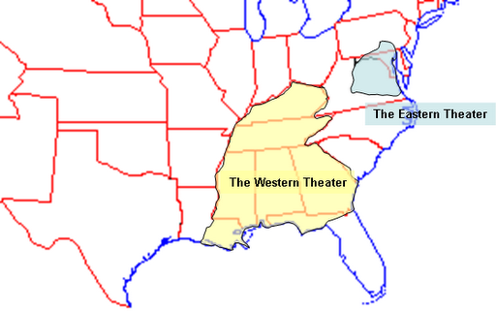
How would you describe the situation in the Far West in the early years of the war?
The Union succeeded in halting several Confederate attacks.

Slide 10
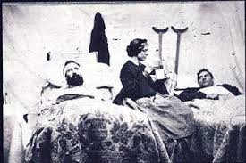
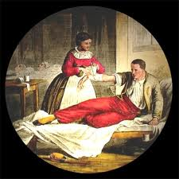
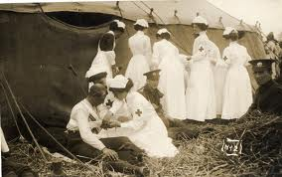
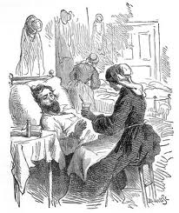
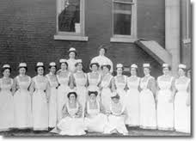
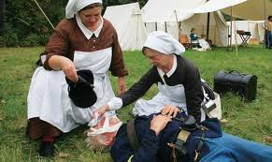
During the Civil War many women…?
provided medical care for soldiers injured in the war.

Slide 11
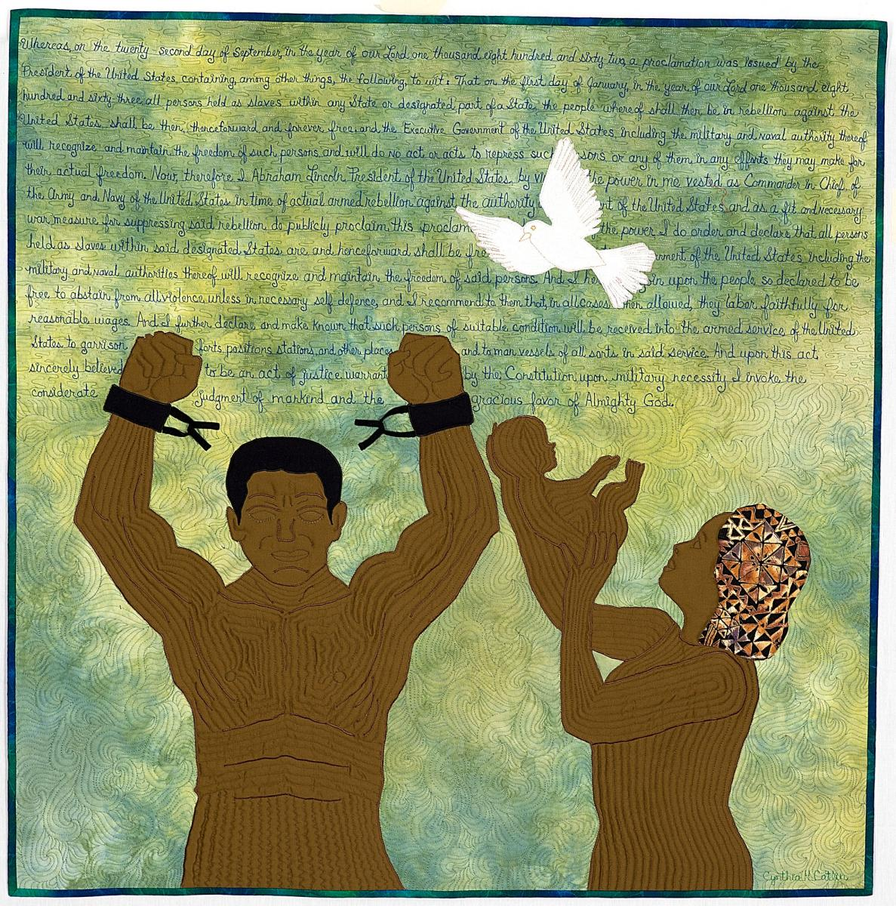
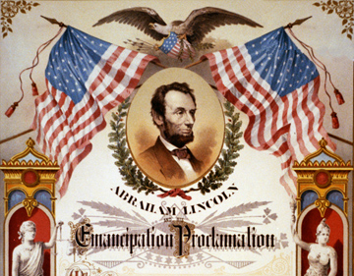
Life for African Americans in the South changed after the Civil War because many African Americans….?
were now free because of the Emancipation Proclamation.

Slide 12
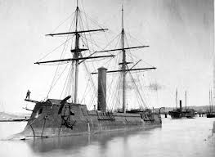
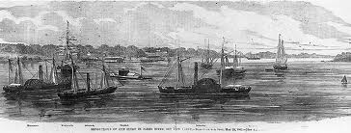
Why did the Union find it difficult to maintain the blockade it set up to control southern ports?
The Union navy had to patrol thousands of miles of coastline.

Slide 13
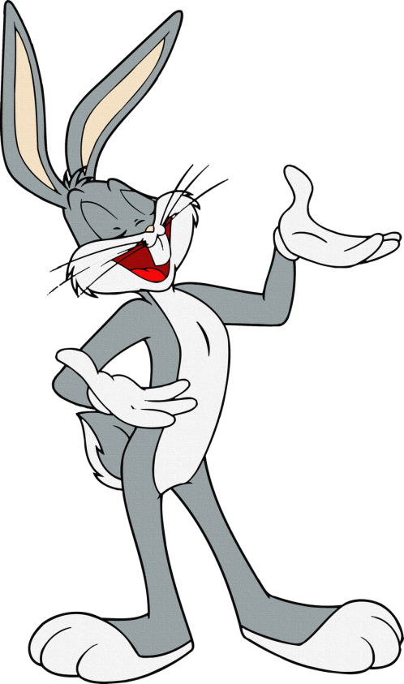
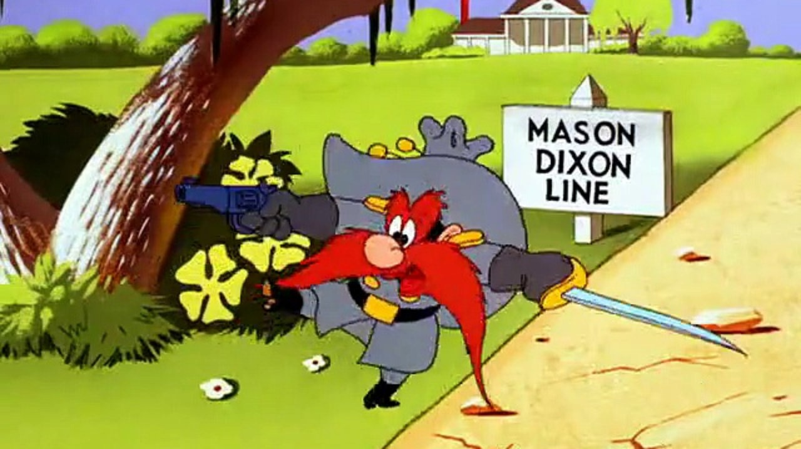
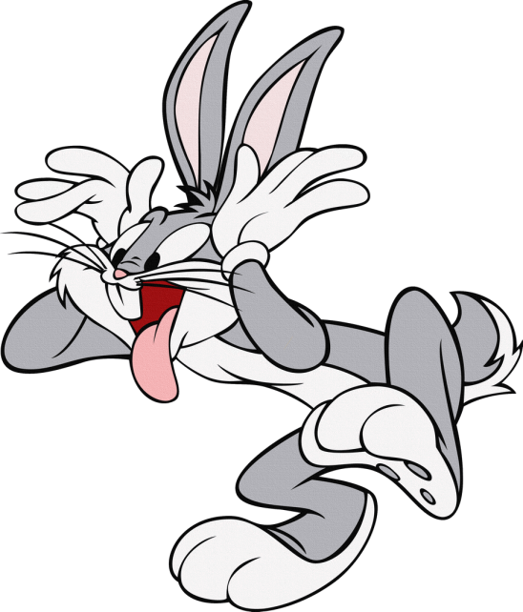
Why was the Battle of Gettysburg a turning point in the Civil War?
Ah, What’s up Reb.?
It was the last time Lee’s troops launched an attack in the North.

Slide 14
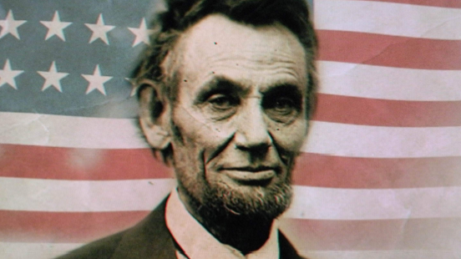
How did the Union’s capture of Atlanta contribute to Lincoln’s reelection?
It convinced Union voters that the North was making progress in the war.

Slide 15
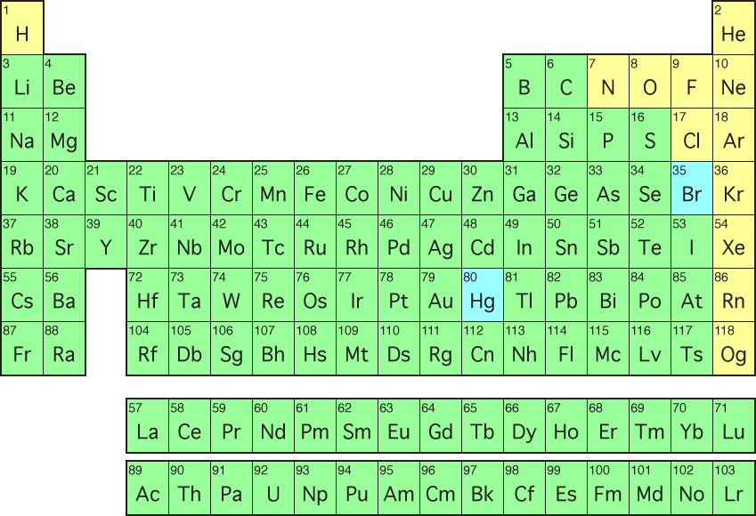
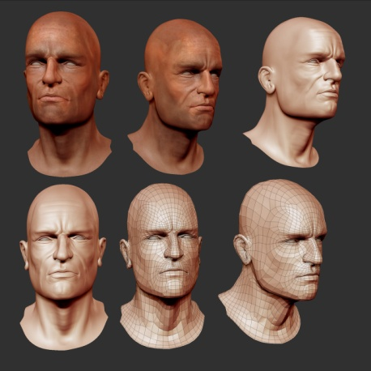
What group of Midwestern Democrats sympathized with the South and opposed abolition?
+
Copperheads

Slide 16
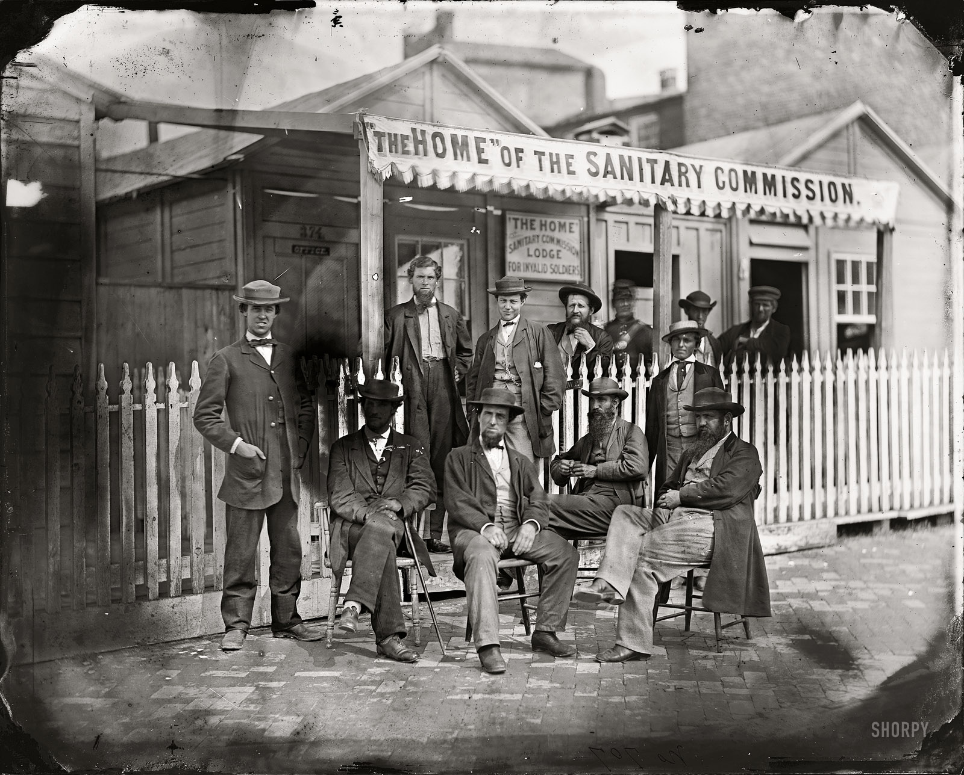
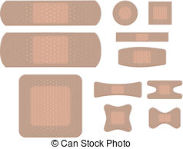
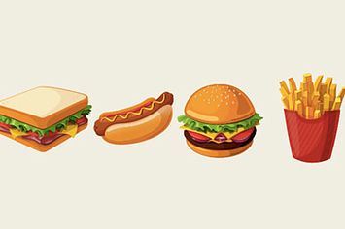
The U.S. Sanitary Commission, formed in preparation for the Civil War, is an example of the…?
role of civilians in helping Union troops get medicine, bandages, and food.

Slide 17
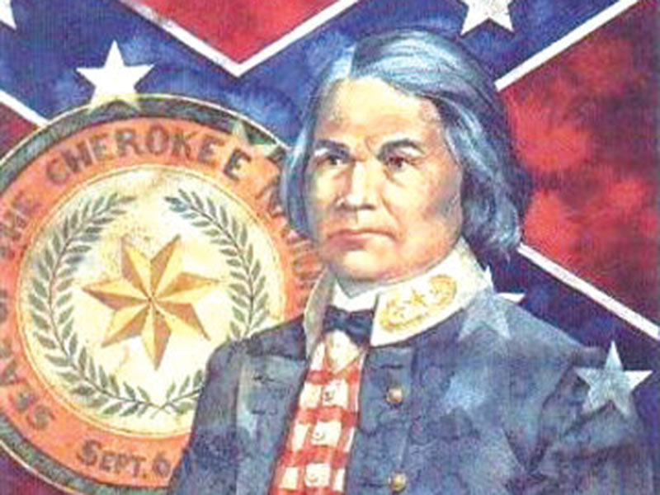
Why did many Native Americans choose to join the Confederacy in the war effort in the Far West?
They hoped that Confederate leaders would give them more independence.

Slide 18
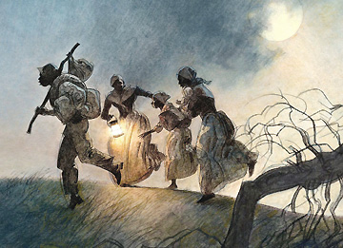
Contrabands refers to ….?
Escaped Slaves

Slide 19
Why did President Lincoln support the abolition of slavery?
He thought that it would help the North win the war.

