Slide 1
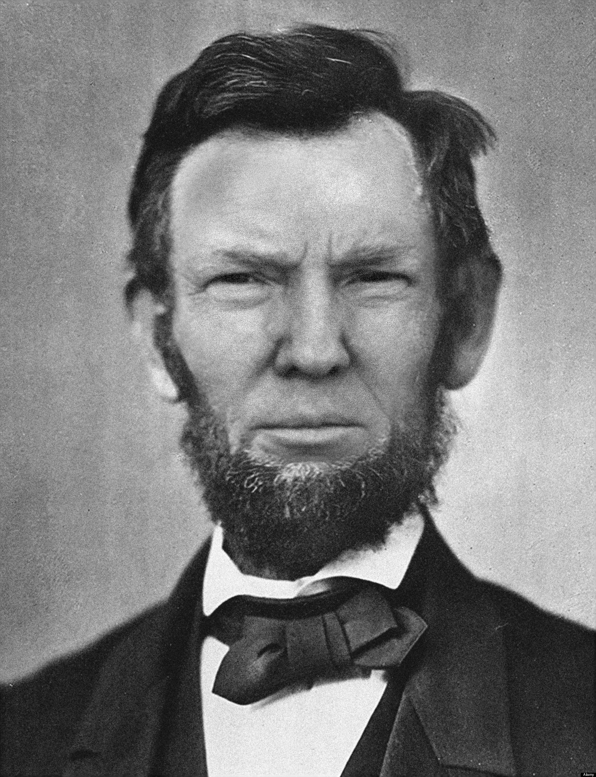
Ch 16.
Study Guide
Part 1

Slide 2
What was the economic condition of the South after the end of the Civil War?
critical, as homes and jobs were not available to most people.

Slide 3
The scene of the meeting between Union and Confederate leaders in which the Confederacy surrendered was…..?
Appomattox Courthouse

Slide 4
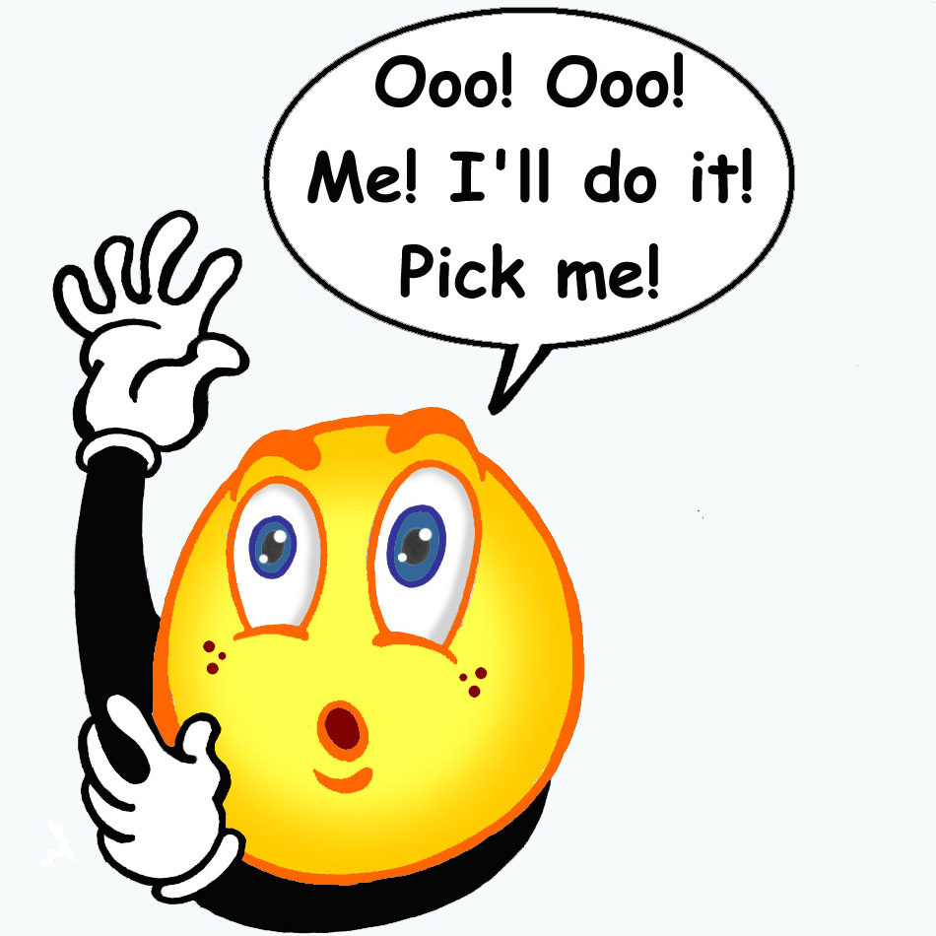
The Union and the Confederate armies built up their troops by…?
relying on help from volunteers to serve in the army.

Slide 5
What African American military troupe led the charge on Fort Wagner in South Carolina?
The 54th Massachusetts Infantry

Slide 6
The goal of the Union army in the West was to gain control of the…?
Mississippi River

Slide 7
Why did many criticize the northern draft of 1863?
They felt that the draft favored the rich by allowing them to buy their way out of serving.

Slide 8
The purpose of Lincoln’s Gettysburg Address was…….?
To remind Americans of the reasons that the Civil War was being fought.

Slide 9
What did President Lincoln do to silence those in opposition to the war?
He ignored protections against unlawful imprisonment by jailing enemies of the Union without trial.

Slide 10
African American soldiers in the Civil War faced more difficulties than white soldiers in that they were…?
killed or sold into slavery if captured by the Confederacy.

Slide 11
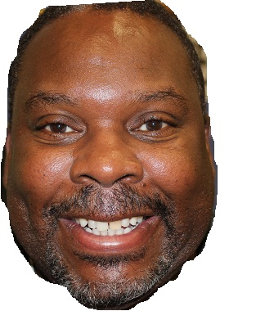
Why did Lincoln wait until after the Union victory at the Battle of Antietam to announce the Emancipation Proclamation?
He wanted the Union to be in a position of strength.

Slide 12
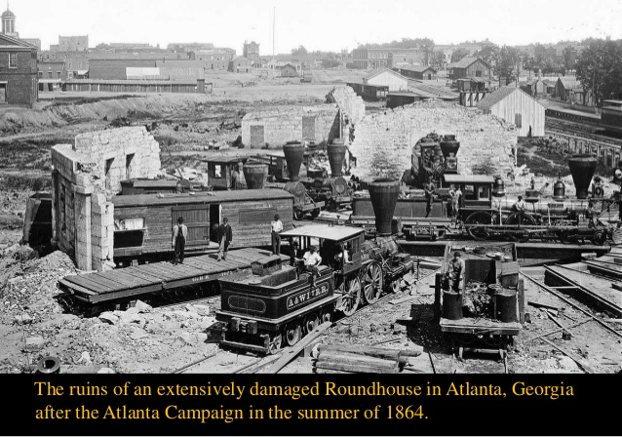
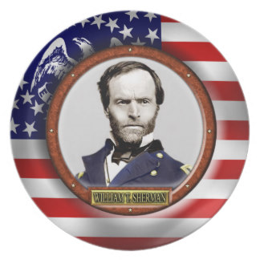
What important contribution did General William Tecumseh Sherman make to the Union war effort?
He succeeded in destroying southern railroads and industries by capturing Atlanta.

Slide 13
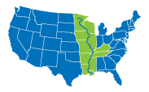
What was the significance of the Siege of Vicksburg?
It gave the Union total control of the Mississippi River.

Slide 14
Lincoln reminded Americans of the reasons that the Civil War was being fought, in what famous address?
The Gettysburg Address

Slide 15
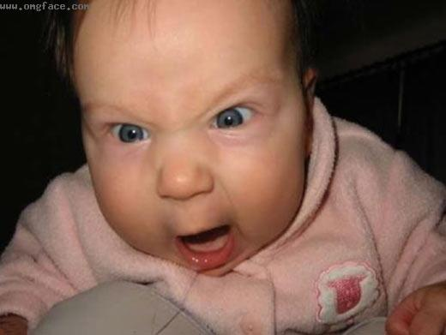
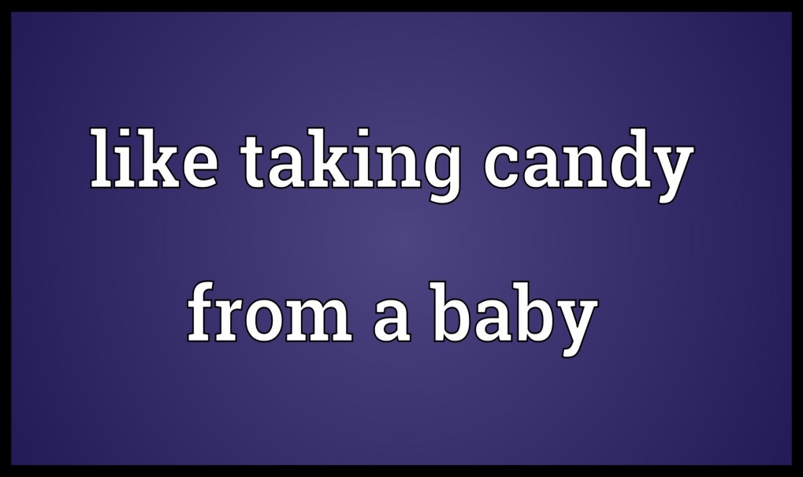
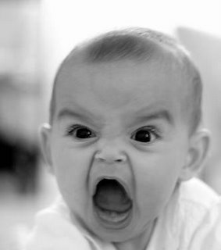
The First Battle of Bull Run…..?
NOT!!!
shattered the Union’s hope of winning the war quickly and easily.

Slide 16
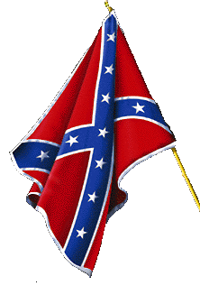
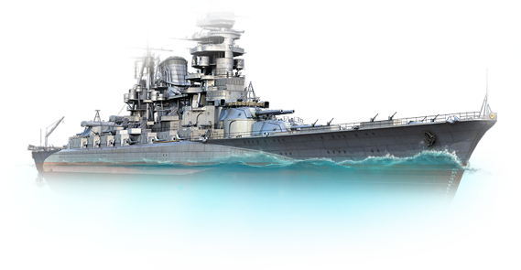
As a strategy for winning the Civil War, Union General Winfield Scott wanted to
Employ a naval blockade of southern ports and gain control of the Mississippi River to divide the Confederacy.

Slide 17
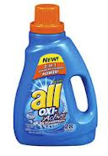
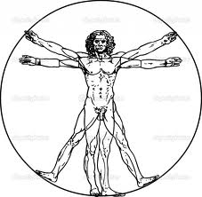
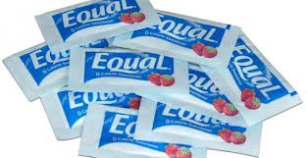
On what principle from the Declaration of Independence did President Lincoln base the Emancipation Proclamation?
the principle that all men are created equal

Slide 18
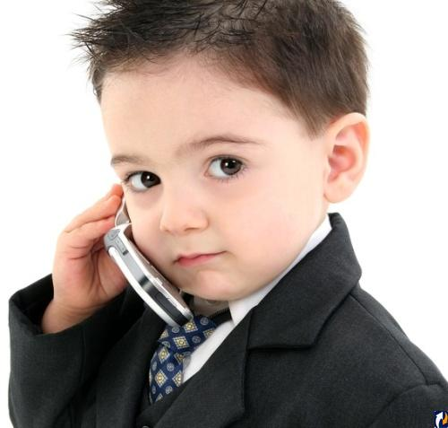
What was the main problem for the Confederate and Union armies when preparing for war?
Vs.
Majority
Minority
Most soldiers were inexperienced and undisciplined.

Slide 19
The “cotton diplomacy” advanced by Confederate President Jefferson Davis was based on the belief that
Britain would support the South because it needed the raw cotton.

Slide 20
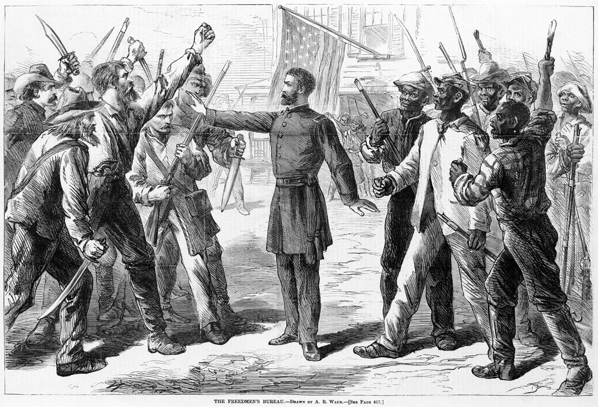
How did many northern Democrats feel about Lincoln’s Emancipation Proclamation?
Go back to the South!!!
We just want to work!!!
They feared that freed slaves would come north and take their jobs at lower wages.

Slide 21
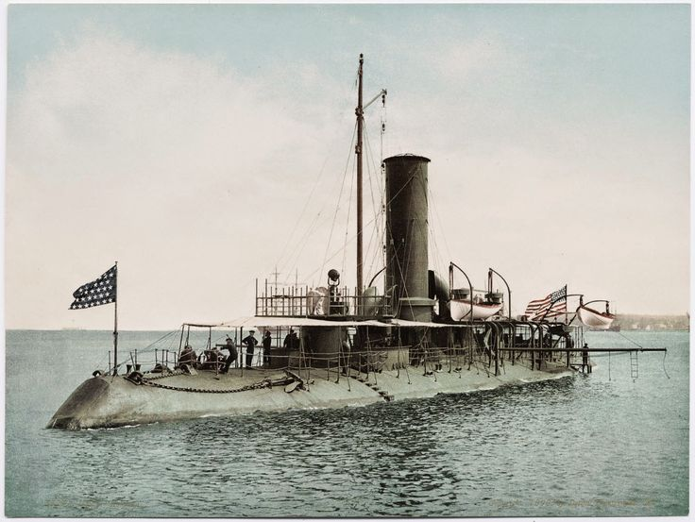
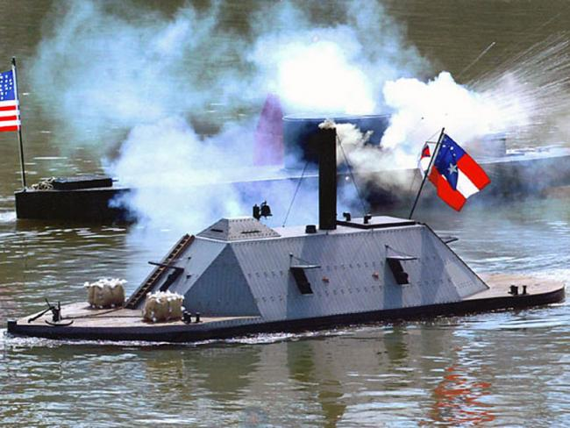
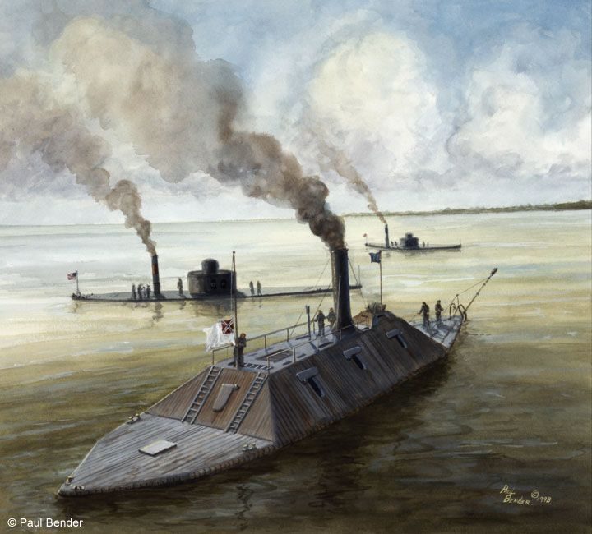
What feature made the new warships developed by the South dangerous to the Union navy?
The ships were heavily armored with thick metal plating.

