Slide 1
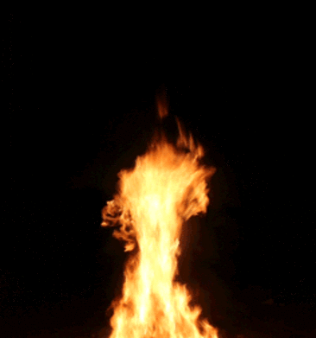
Heat Transfer

Slide 3
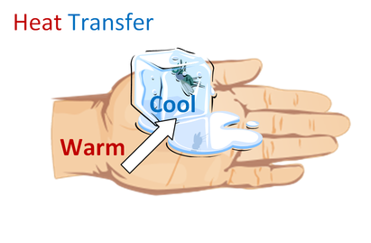
to

Slide 7
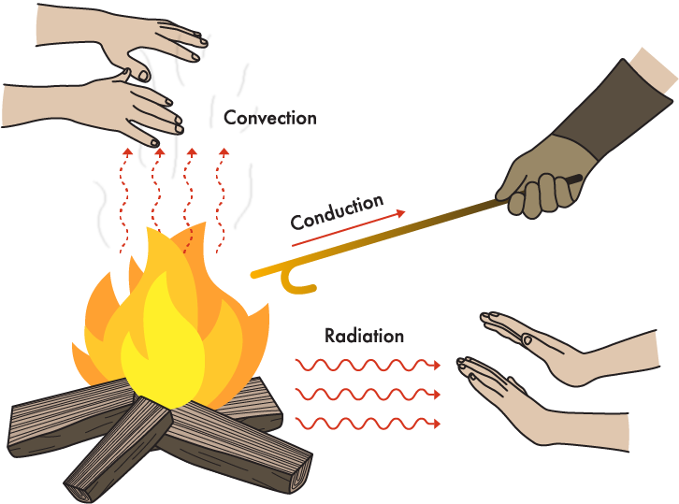

Slide 9
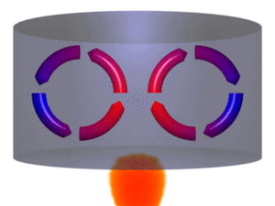
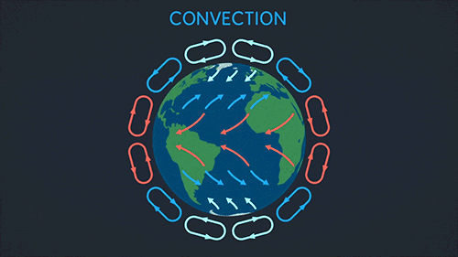

Slide 10
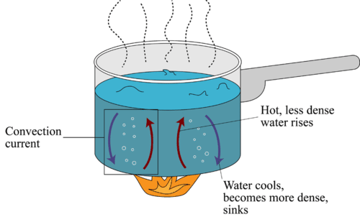
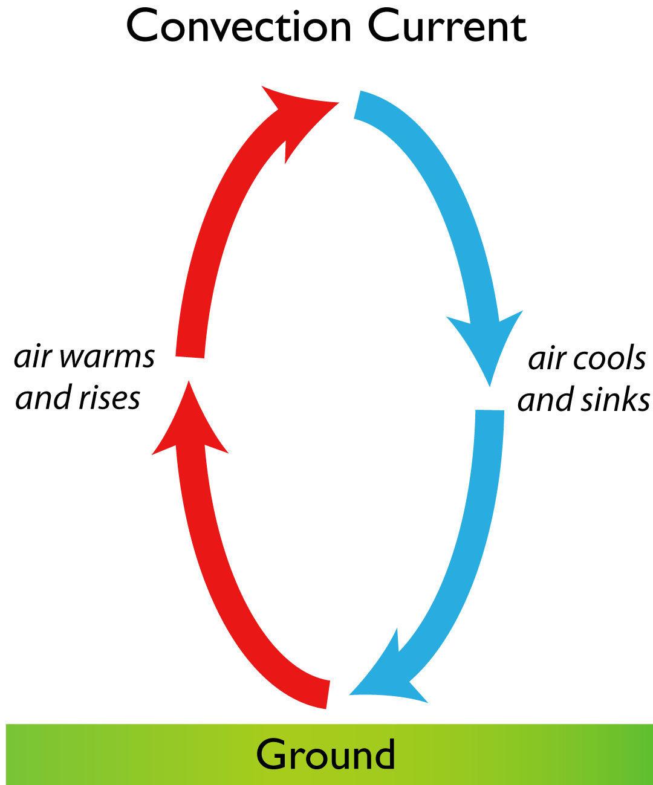
Convection

Slide 11
Radiation

Slide 13
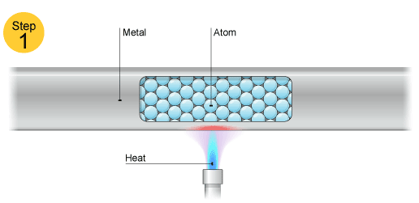
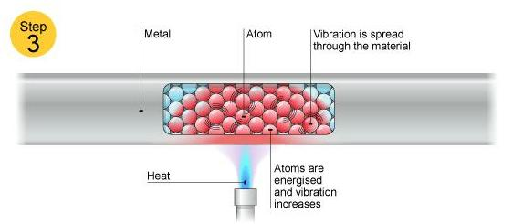

Slide 16
Other

Slide 17
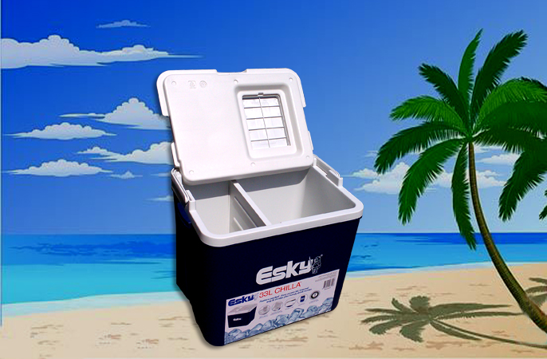
Why is Plastic a good insulator?
"plastic" is a medium to poor conductor of heat. plastic contains air bubbles within it’s structure like a coffee cup, which acts as an excellent insulator, however it is the air pockets that make it effective, the air helps to slow down or prevent the transfer of heat.
Plastics can be used on cookware like an insulated handle. Plastic also it allows ice to form quickly in ice trays. When the tray is put in the freezer heat radiates out of the water. Plastic is far superior in function to aluminum trays, aluminum is a better conductor of heat.

