Slide 1
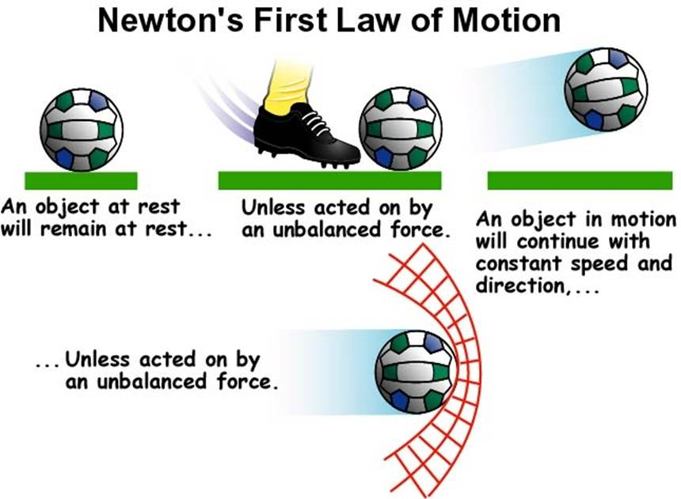
Newton’s 1st Law of Motion

Slide 2
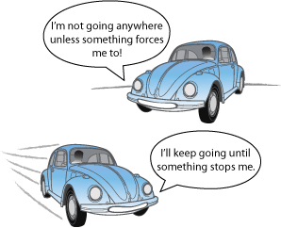
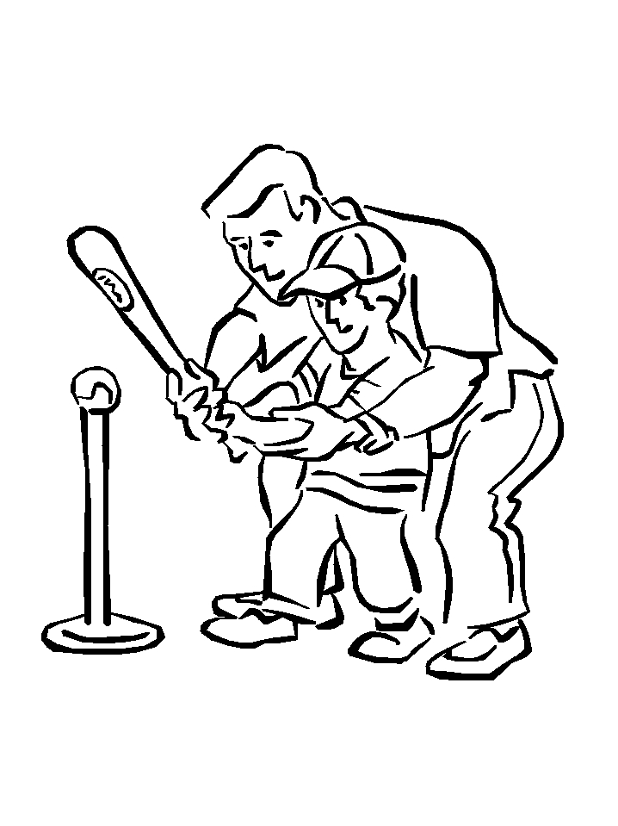
Newton’s 1st Law of Motion
An object will remain at rest or in motion, unless acted upon by an unbalanced force.
The ball is the object, while the bat carries the unbalanced force acting upon the ball

Slide 3
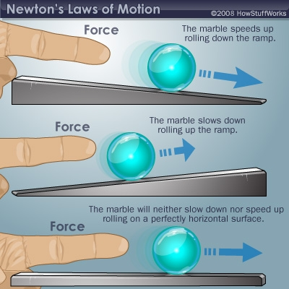
Newton’s 1st Law of Motion

Slide 4
Newton’s 2nd Law of Motion

Slide 5
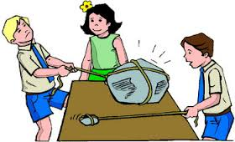
Newton’s 2nd Law of Motion

Slide 6
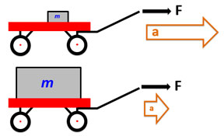
Newton’s 2nd Law of Motion

Slide 7
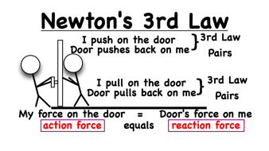
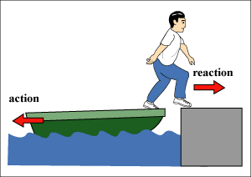
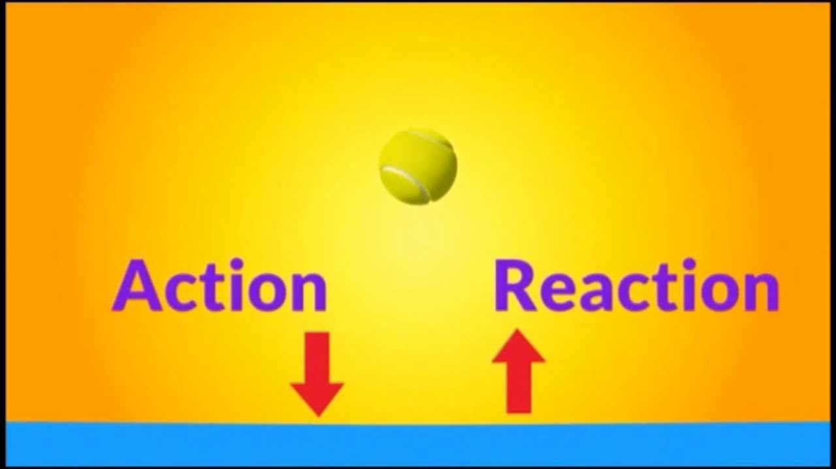
Newton’s 3rd Law of Motion

Slide 8
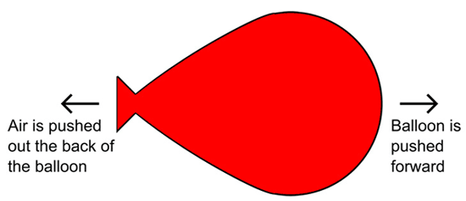
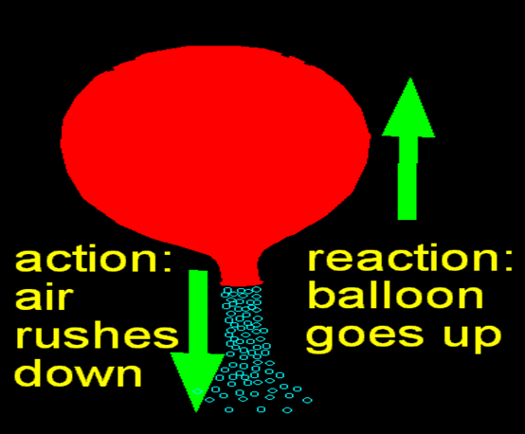
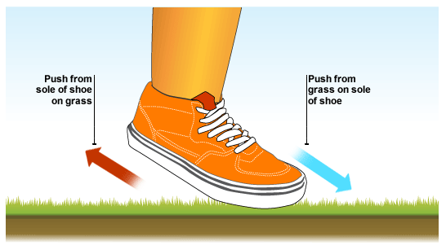
Newton’s 3rd Law of Motion

Slide 9
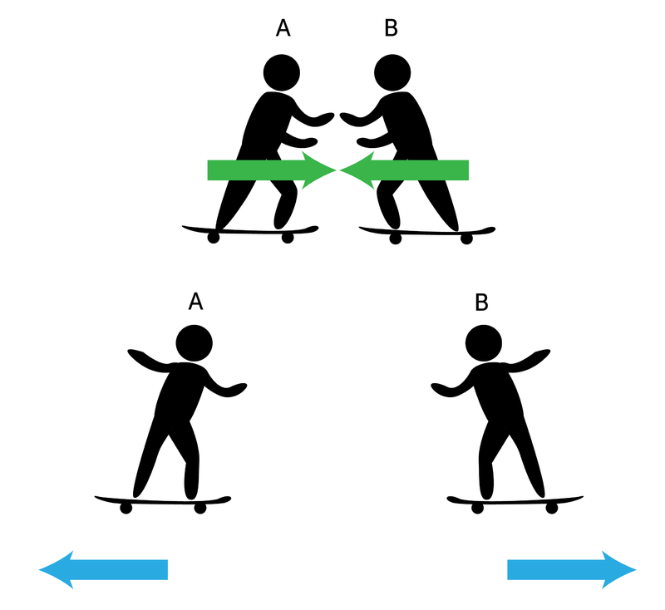
Newton’s 3rd Law of Motion

