Slide 1
History Tri-3 Final Exam2016-17

Slide 2
History Tri-3 Final Exam2016-17

Slide 3
The regulations that forced segregation/separation of blacks and whites were known as….?
Jim Crow Laws

Slide 4
What were the reasons behind the creation of the Ku Klux Klan in 1866?
the expansion of suffrage rights, (The right to vote), to include African Americans.

Slide 5
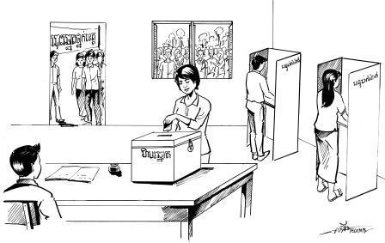
The Fifteenth Amendment protected what right of African American men?
The right to Vote.

Slide 6
Why were more American textile mills built in the North than in the South?
The North had more rivers to provide power.

Slide 7
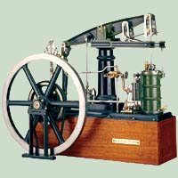
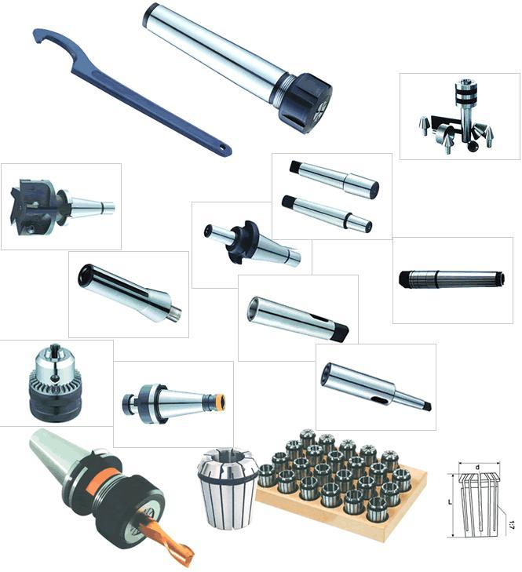
The tools used to produce items or to do work are known as
Technology.

Slide 8
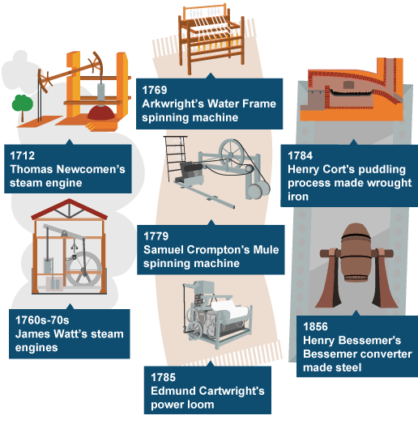
The Industrial Revolution is best defined as a
period of rapid growth during which machines became essential to industry.

Slide 9
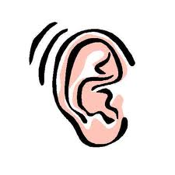
The set of laws that limited the freedom and rights of African Americans were….?
The Black Codes

Slide 10
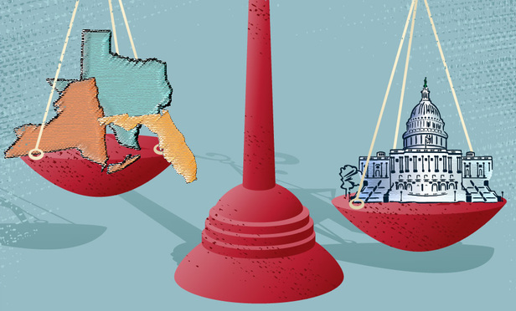
What did the Supreme Court decide in the case of Gibbons v. Ogden?
Texas
New York
Florida
Ogden
Federal Gov’t
Gibbons
Thomas Gibbons’ federal license had priority over Aaron Ogden’s state license.

Slide 11
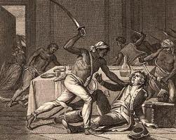
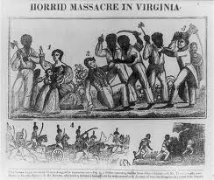
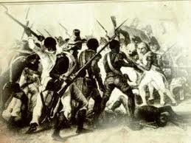
What was the most violent slave uprising in the U.S.?
Nat Turner’s Rebellion.

Slide 12
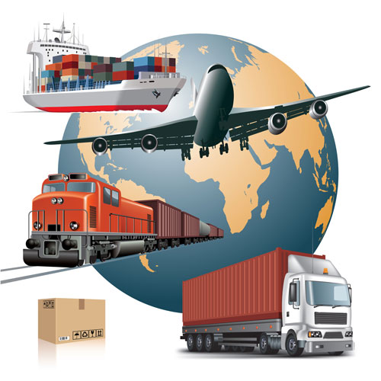
The Transportation Revolution was a period of…?
rapid growth in the speed and convenience of travel.

Slide 13
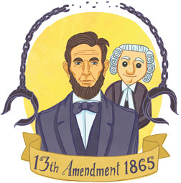
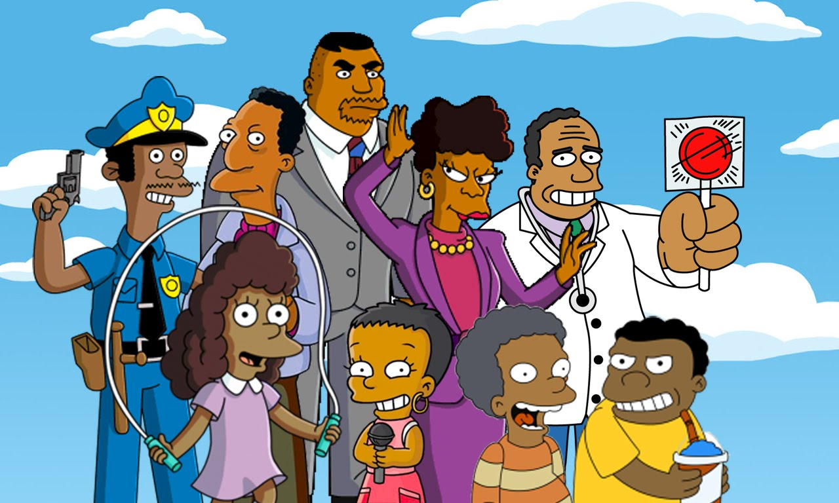
What did ratification of the Thirteenth Amendment mean for African Americans?
From 1865
To
2017 & beyond
It provided African Americans with a future free from slavery.

Slide 14
How did the War of 1812 help American manufacturing?
Tariffs on foreign goods encouraged Americans to buy domestic goods.

Slide 15
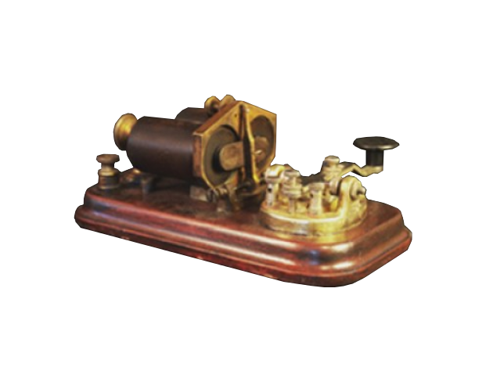
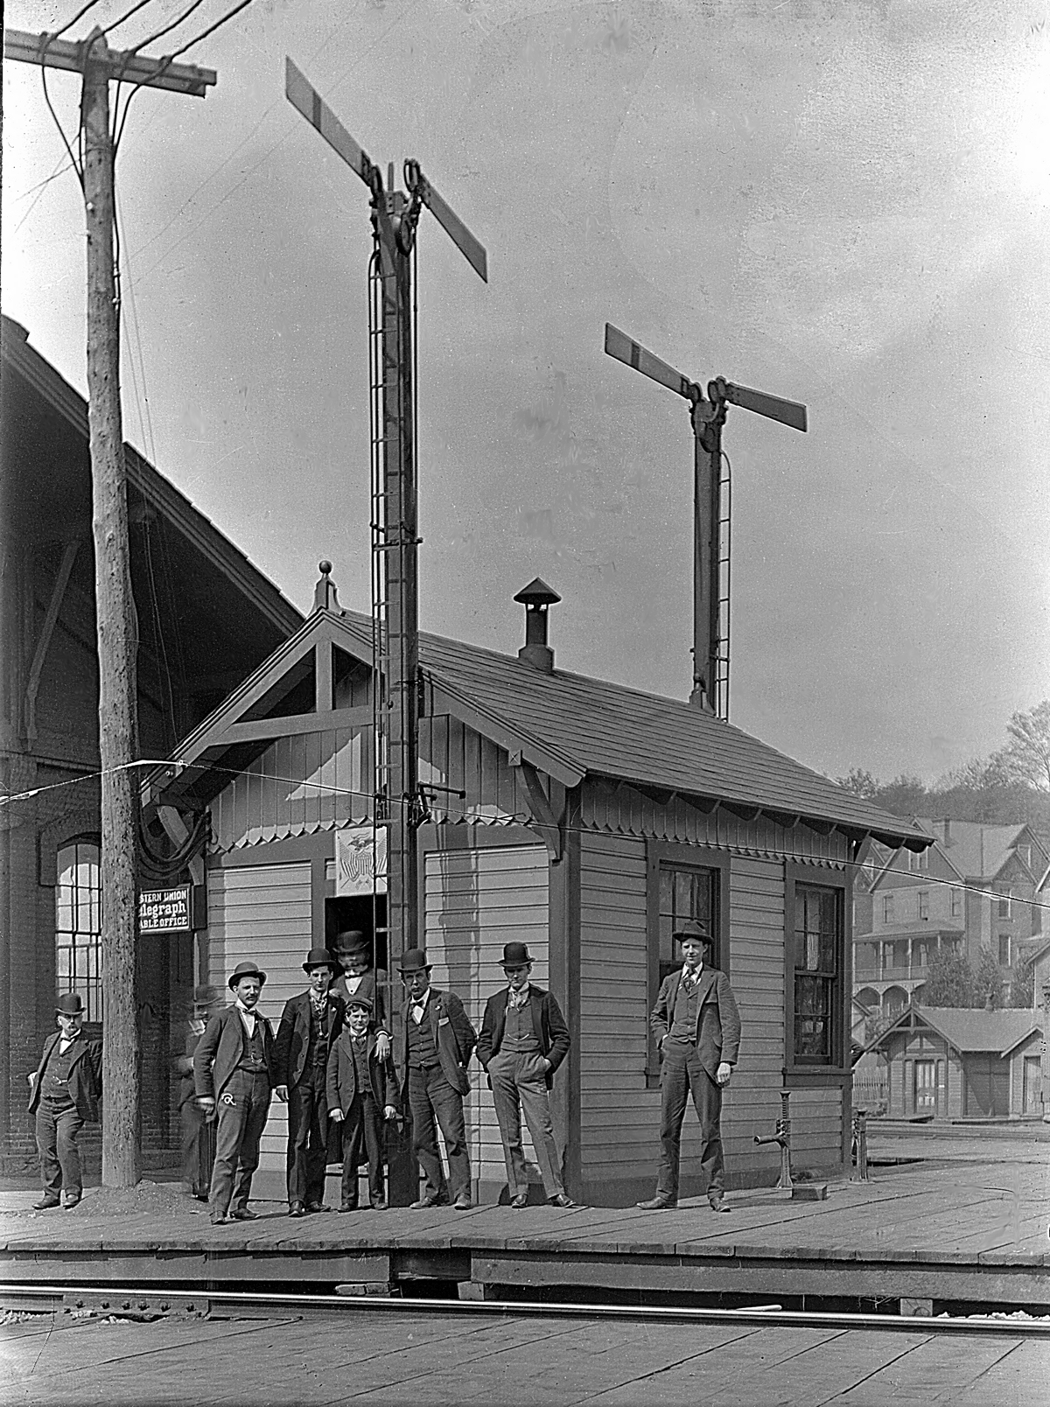
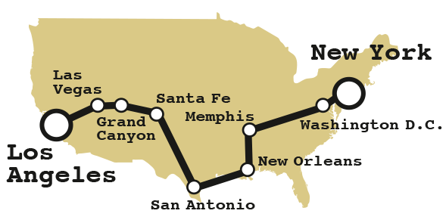
The telegraph was significant because it
Enabled people to send news quickly from coast to coast.

Slide 16
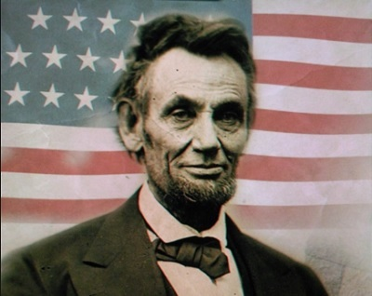
When Lincoln was elected in 1860, he stated that the government would
not start a war with the southern states.

Slide 17
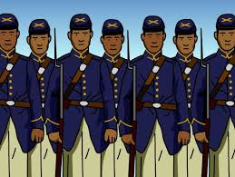
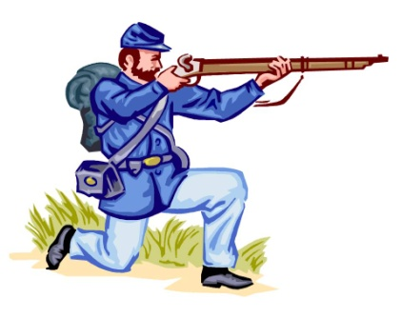
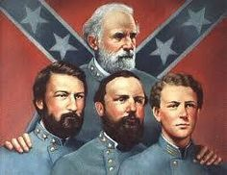
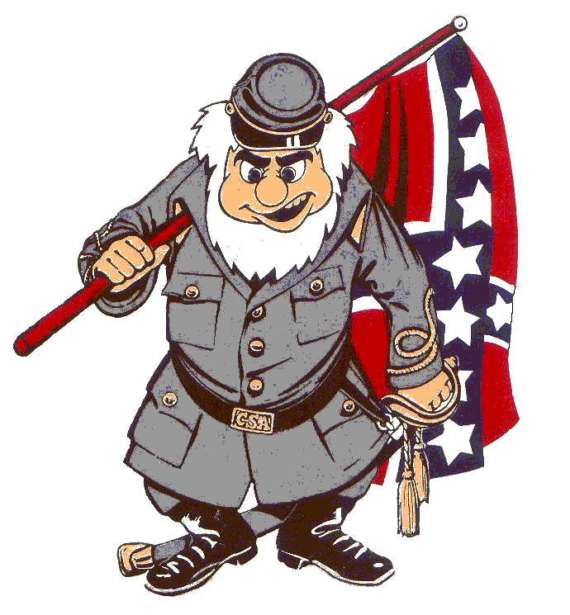
Why did General Lee decide to surrender his troops at Appomattox Courthouse?
Looks like them Yankees got us covered, General Lee
The Union had surrounded his troops and he had run out of supplies.

Slide 18
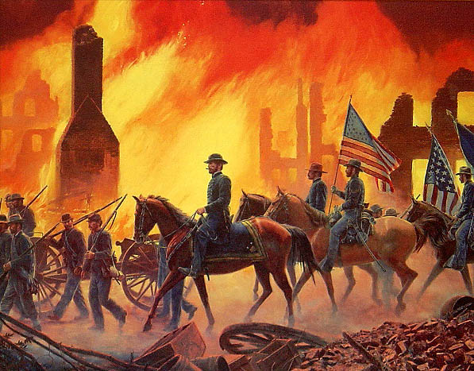
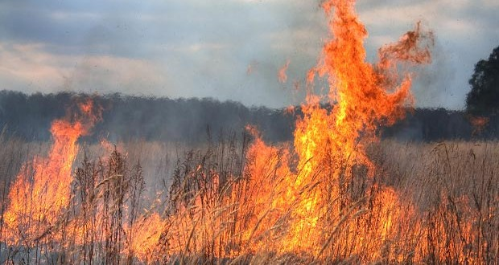
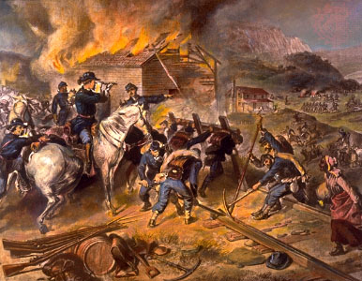
What was the strategy of total war adopted by General Sherman?
destroying civilian and military resources.

Slide 19
The goal of the Union army in the West was to gain control of the…?
Mississippi River

Slide 20
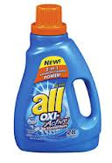
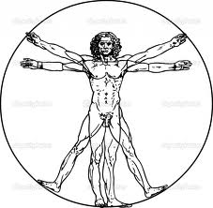
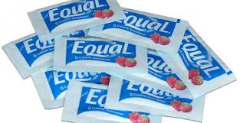
On what principle from the Declaration of Independence did President Lincoln base the Emancipation Proclamation?
the principle that all men are created equal

Slide 21
What was a trade union?
Organization of workers who tried to improve pay and working conditions for members.

Slide 22
The Wilmot Proviso was an idea proposed to Congress to………?
Mexican Cession
Prohibit/Ban slavery in all parts of the Mexican Cession.

Slide 23
What did the Freeport Doctrine, (proposed by Stephen Douglas), state?
Free!
I vote
Free!!
Slave!
Wait!....What?
The decision to practice slavery in the territories belonged to the people.

Slide 24
The Wilmot Proviso spurred a debate that showed growing sectionalism, which refers to…..?
favoring the interests of a region over the interest of the country.

Slide 25
Most northerners opposed the Fugitive Slave Act because it ……?
The
Commish
Slave
gave commissioners too much power and should have allowed slaves the right to jury trials.

Slide 26
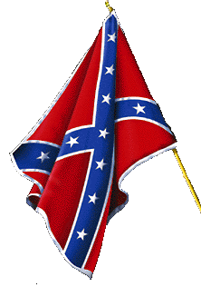
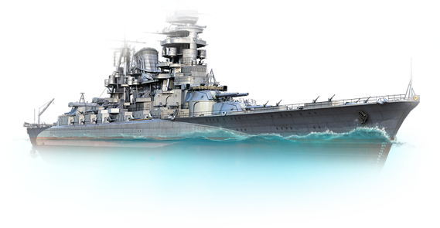
As a strategy for winning the Civil War, Union General Winfield Scott wanted to
Employ a naval blockade of southern ports and gain control of the Mississippi River to divide the Confederacy.

Slide 27
How did the Wade-Davis Bill differ from Lincoln’s Ten Percent Plan?
The Wade-Davis Bill required that a majority of southern males take an oath of loyalty.

Slide 28
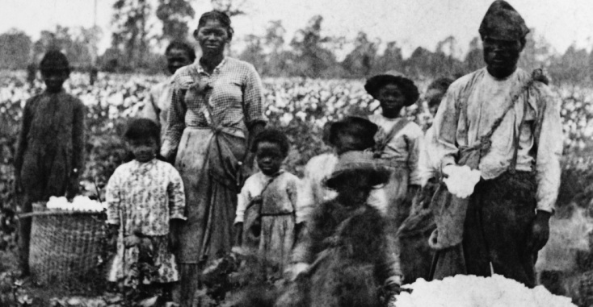
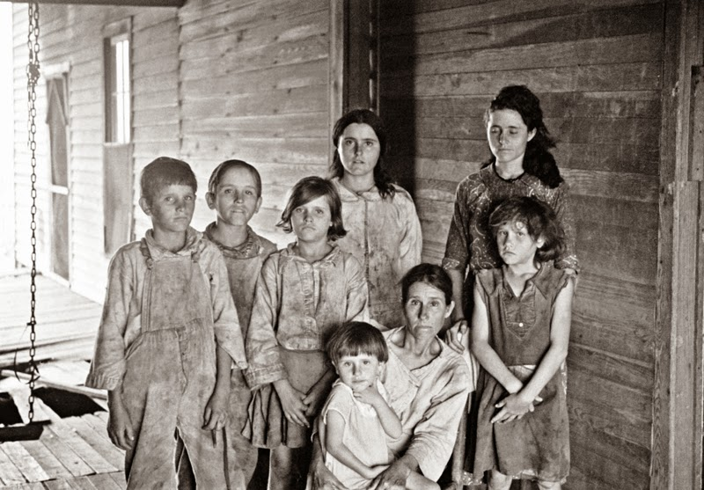
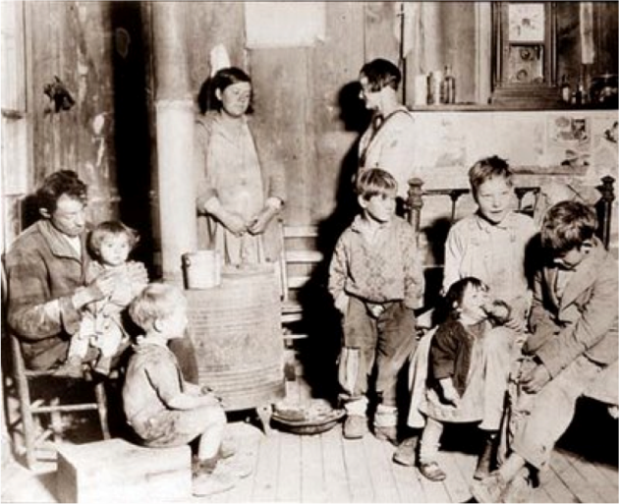
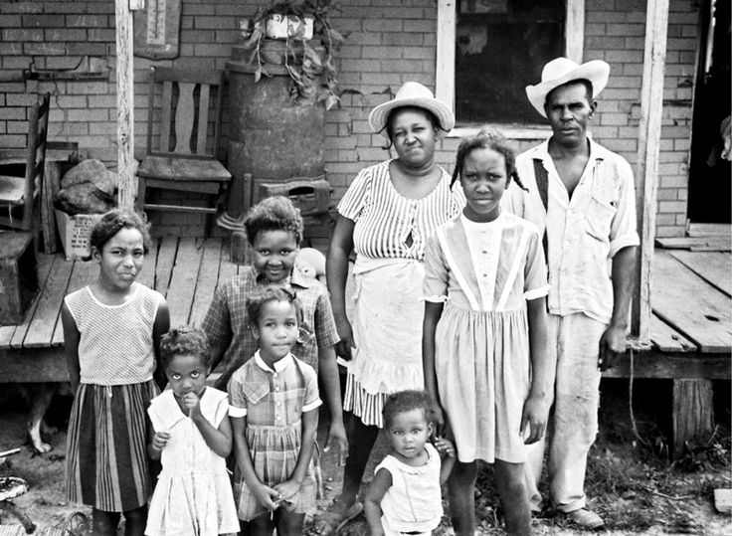
What is the name of the organization that provided assistance to all poor people living in the South
The
Freedmen’s
Bureau

Slide 29
What main benefit did the Transportation Revolution bring to trade?
It enabled goods to travel quickly across the United States.

Slide 30
In the mid-1800s, most of America’s industry was located in the…?
Northeast.

Slide 31
What was the “Cotton Belt?”
An area stretching from S. Carolina to Texas that grew most of the country’s cotton crop.

Slide 32
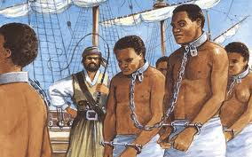
What was responsible for increasing the domestic slave trade in the early 1800’s?
An act of congress banned the importation of slaves to the U.S.

Slide 33
In the first half of the 1800’s, what portion of white southern families owned slaves?
One Third

Slide 34
What advantage did skilled slaves have over unskilled slaves?
Earning money to buy their freedom.

Slide 35
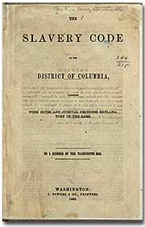
What were “the slave codes?”
Strict laws that controlled the actions of slaves.

Slide 36
How did the idea of popular sovereignty affect slavery in the United States?
States or territories would decide whether to permit slavery.

Slide 37
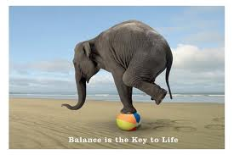
What was a consequence of the Compromise of 1850?
The balance between free and slave states ended in the Union.

Slide 38
The Kansas-Nebraska Act led to the …..?
return of the slavery issue between the North and South.

Slide 39
The Supreme Court’s ruling in Dred Scott v. Sandford established that …..?
The Missouri Compromise’s restriction on slavery was unconstitutional.

Slide 40
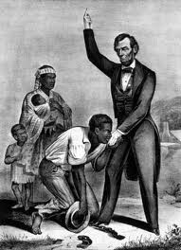
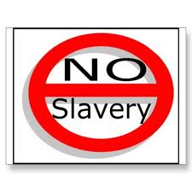
For what reason did the southern states decided to secede from the Union after the election of 1860?
The South
+
=
The southern economy and way of life would be destroyed.

Slide 41
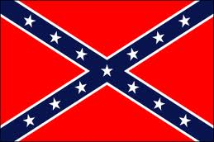
The Emancipation Proclamation was an order from Lincoln…..?
calling for all Confederate slaves to be freed.

Slide 42
The purpose of Lincoln’s Gettysburg Address was to….?
remind Americans of the reasons that the Civil War was being fought.

Slide 43
The main goal of Reconstruction was to…..?
readmit the former Confederate states into the Union.

Slide 44
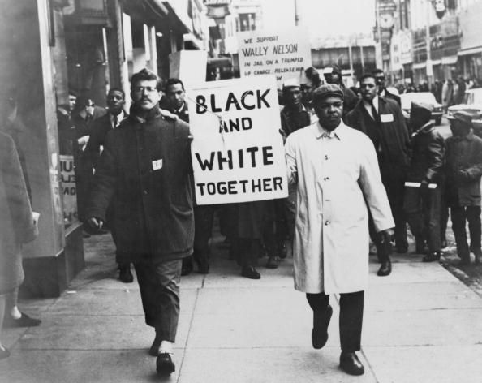
How did Reconstruction affect the social structure of the South?
African Americans began to demand the same economic and political rights as whites.

Slide 45
The Reconstruction Acts, passed by Congress in March 1867, affected the makeup of the southern states by…..?
Dividing the South into five military districts controlled by a military commander.

Slide 46
The verdict in Plessy v. Ferguson was……?
Legalizing segregation as long as “separate but equal” facilities were provided.

