Slide 1
Ch. 12

Slide 2
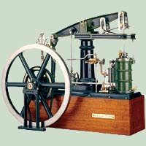
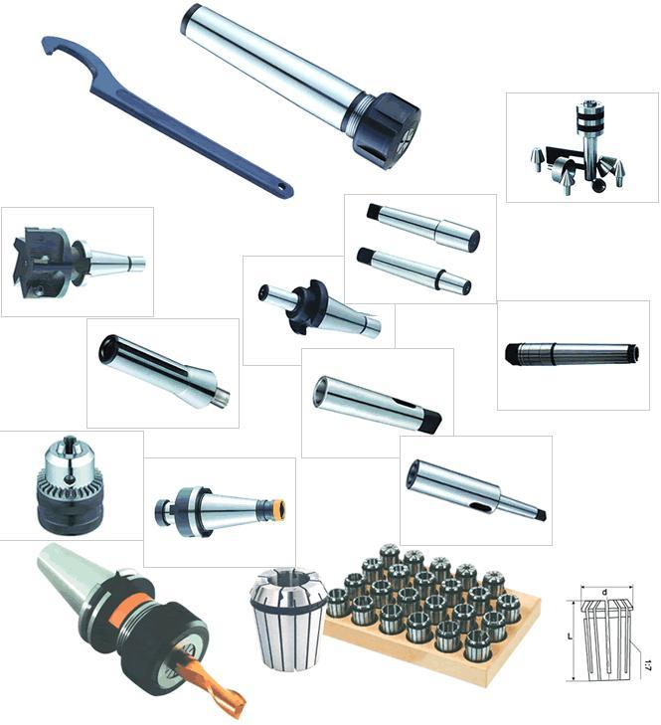
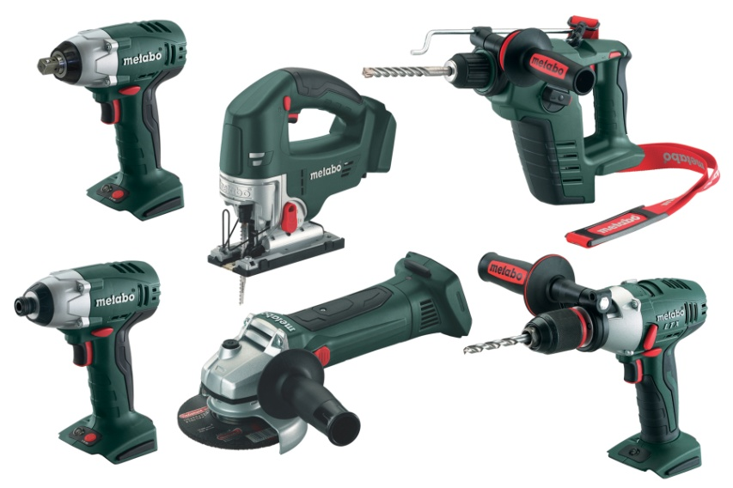
The tools used to produce items or to do work are known as
Technology.

Slide 3
Gibbons v. Ogden was a Supreme Court case that decided ………?
Ogden
Gibbons
Thomas Gibbons’ federal license had priority over Aaron Ogden’s state license.

Slide 4
How did the Transportation Revolution affect America’s farming industry?
Settlers plowed up prairies and cut down trees to make farmland out of the Midwest.

Slide 5
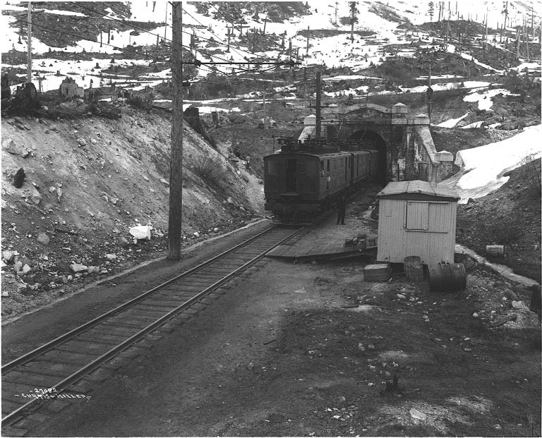
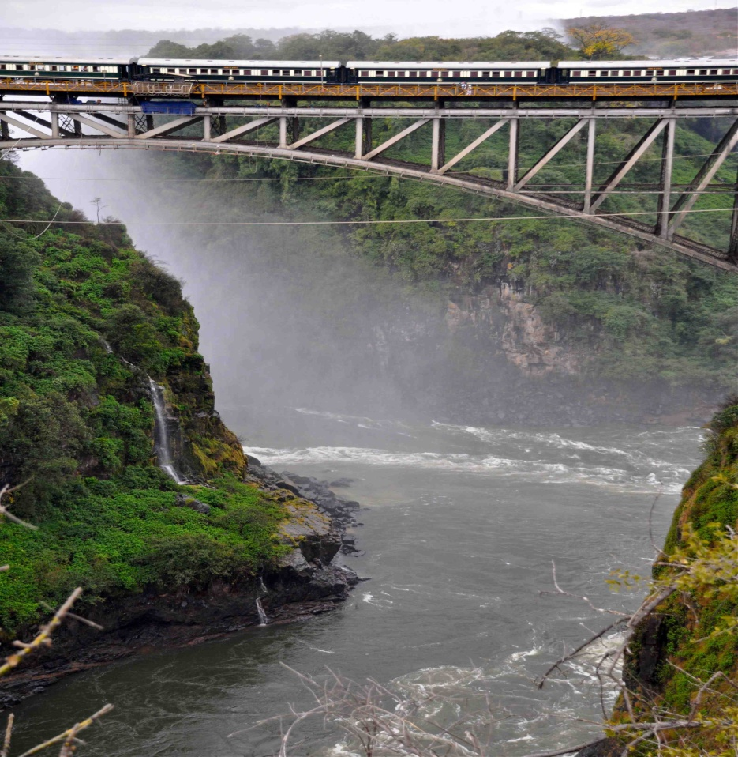
What challenges did engineers and mechanics face while building railroads?
The railroads had to pass through mountains and over rivers.

Slide 6
How did the water frame revolutionize the production of cloth?
It shifted the location of production from homes to textile mills.

Slide 7
What communication system, featuring different combinations of dots and dashes to represent letters, was developed by Alfred Lewis Vail?
Morse code

Slide 8
Why were more American textile mills built in the North than in the South?
The North had more rivers to provide power.

Slide 9
Steel is made through a process called smelting, which means
Heating iron ore to very high temperatures.

Slide 10
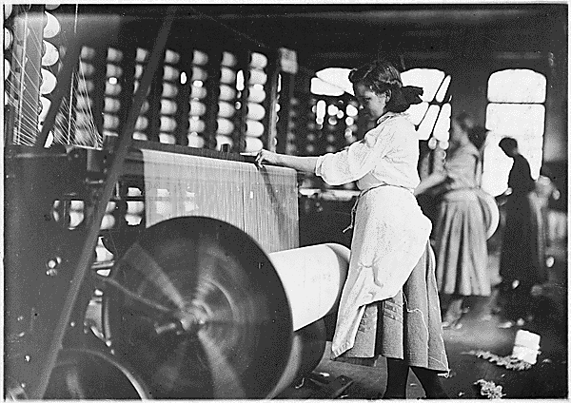
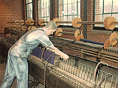
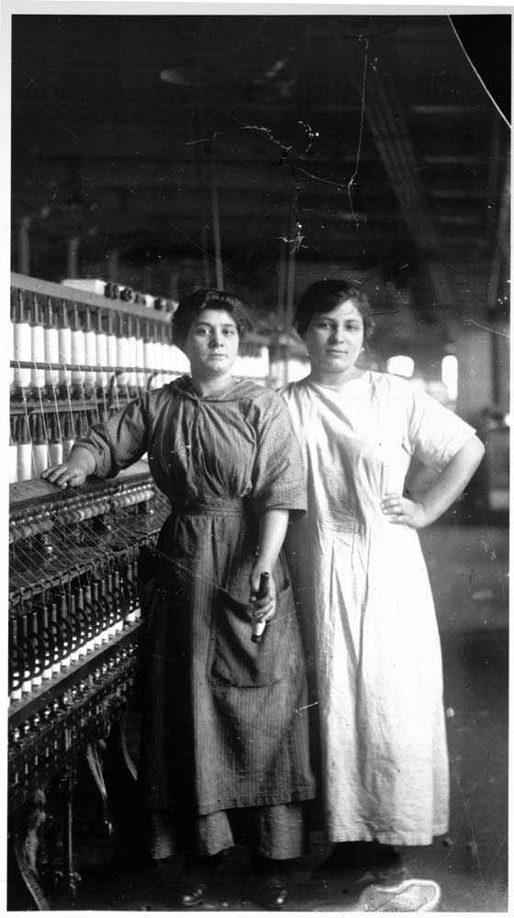
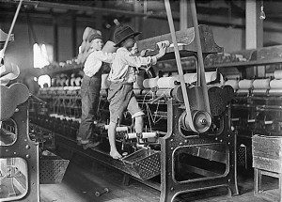
The “Rhode Island system” was Samuel Slater’s strategy of….?
Cissy
Dad
Frank &
Me
Mom and Aunt “B”
hiring families of workers and dividing factory work into simple tasks.

Slide 11
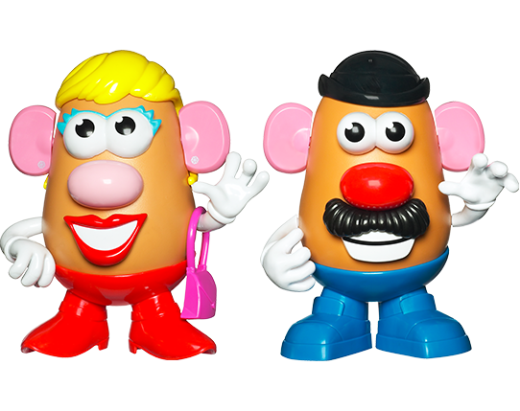
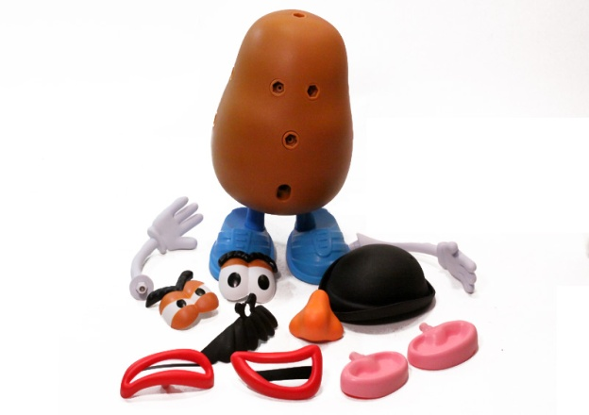
What was Eli Whitney’s influence on American manufacturing?
He came up with the idea of interchangeable parts.

Slide 12
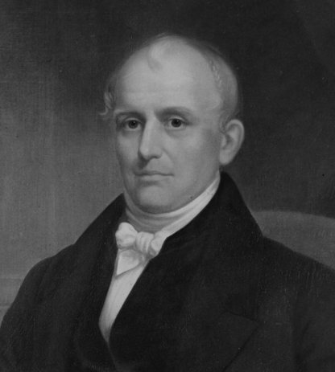
Who was the man responsible for bringing new textile machines to the United States?
Samuel Slater

Slide 13
How did technological developments during the Industrial Revolution enable people to build factories almost anywhere?
The shift to steam power meant factories no longer had to be built near streams, rivers, or waterfalls.

Slide 14
Why was the steamboat well suited to river travel?
It traveled well upstream.

Slide 15
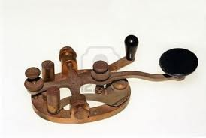
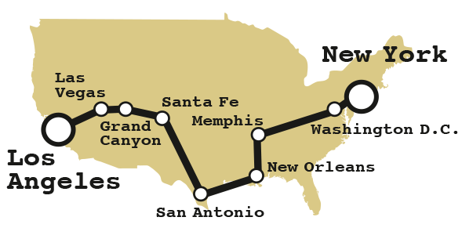
The telegraph was significant because it
Enabled people to send news quickly from coast to coast.

Slide 16
Why did companies build their factories closer to cities and transportation centers in the mid-1800s?
It provided easier access to workers.

Slide 17
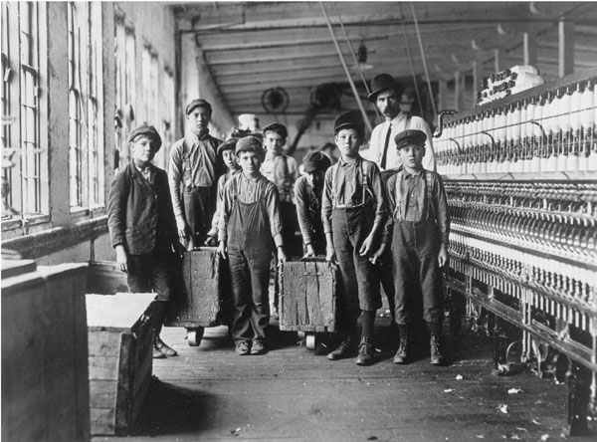
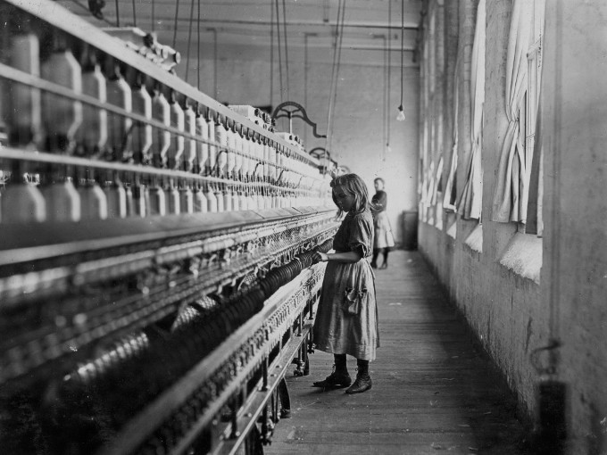
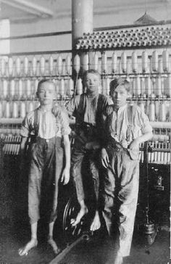
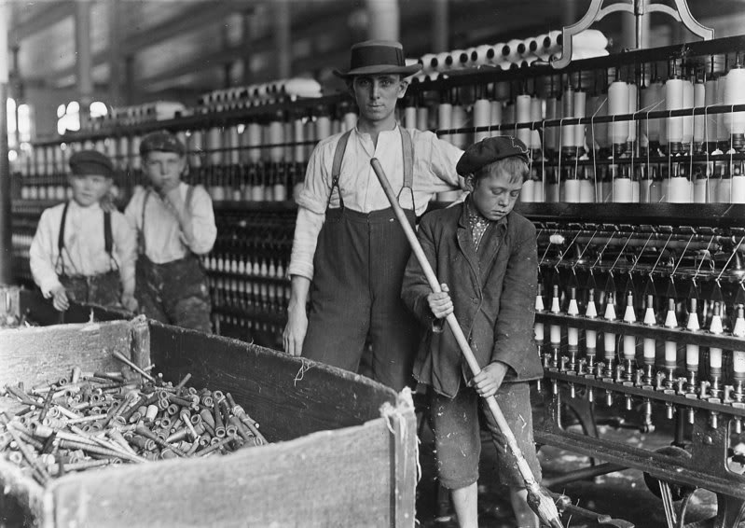
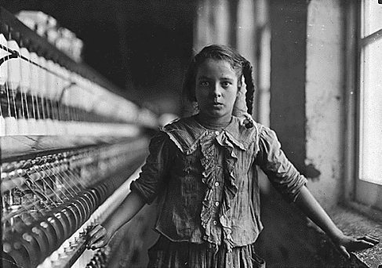
What did textile manufacturers do to keep the costs of running a mill low?
Hired children and paid them very little

Slide 18
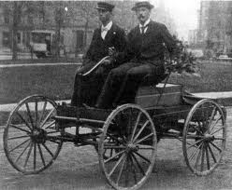
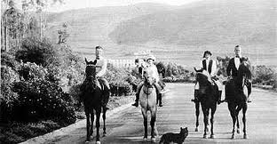
French writer Alexis de Tocqueville said that the contributions made by the Industrial Revolution made American life more….?
Convenient.

Slide 19
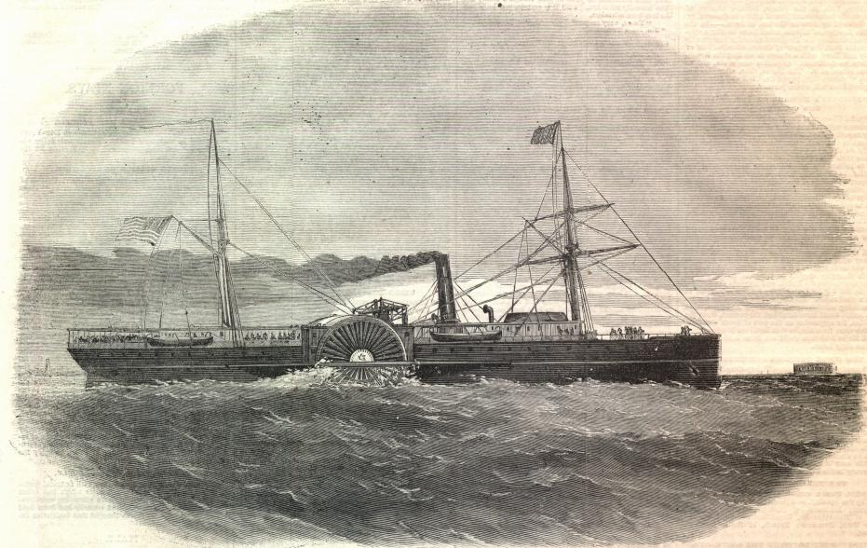
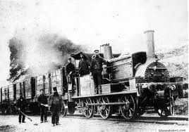
Two new forms of transportation invented during the Transportation Revolution were the….?
Steam-powered train and the steamboat.

Slide 20
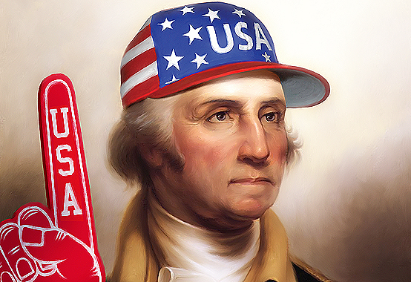
How did the War of 1812 help American manufacturing?
Tariffs on foreign goods encouraged Americans to buy domestic goods.

Slide 21
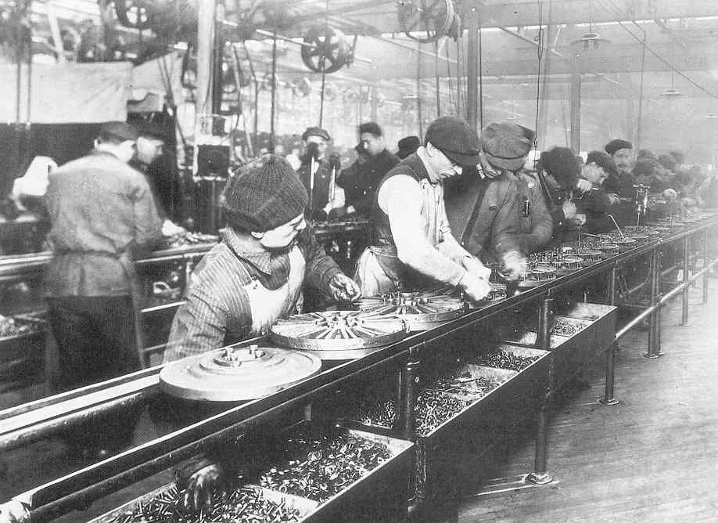
In the mid-1800s, companies began to mass-produce earlier inventions. What effect did this have on families?
They could buy items they could not afford in the past.
1 | 2 | 3 | 4 | 5 | 6 | 7 | 8 | 9 | 10 | 11 | 12 | 13 | 14 | 15 | 16 | 17 | 18 | 19 | 20
21 | 22 | 23 | 24 | 25

Slide 22
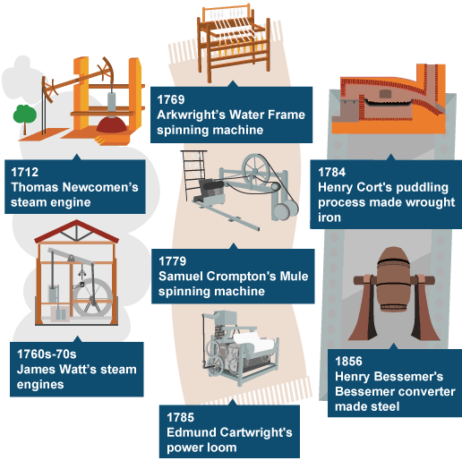
The Industrial Revolution is best defined as a
period of rapid growth during which machines became essential to industry.

Slide 23
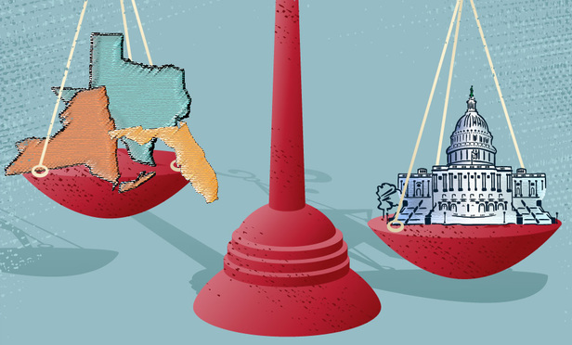
What did the Supreme Court decide in the case of Gibbons v. Ogden?
Texas
New York
Florida
Federal Gov’t
Thomas Gibbons’ federal license had priority over Aaron Ogden’s state license.

Slide 24
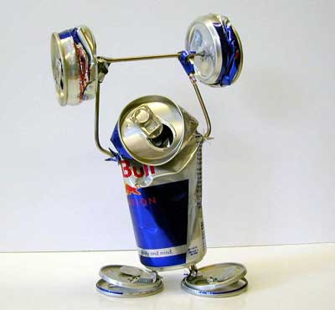
Coal was a more appealing fuel source than wood because it
Produced more energy

Slide 25
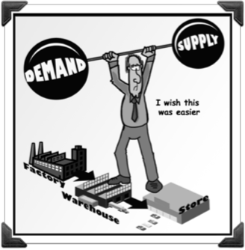
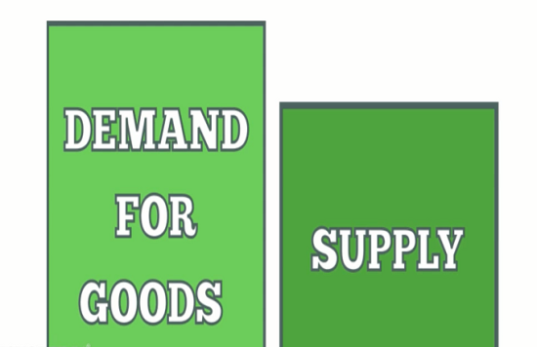
Why were changes to manufacturing needed in the mid-1700s?
Demand was greater than the available supply of goods.

Slide 26
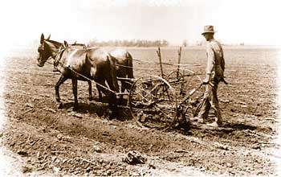
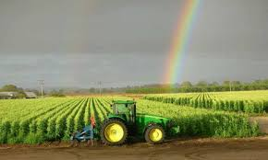
How did the inventions of the plow and the reaper help the farming industry?
They allowed farmers to plant and harvest huge crop fields.

Slide 27
What was a trade union?
Organization of workers who tried to improve pay and working conditions for members.

Slide 28
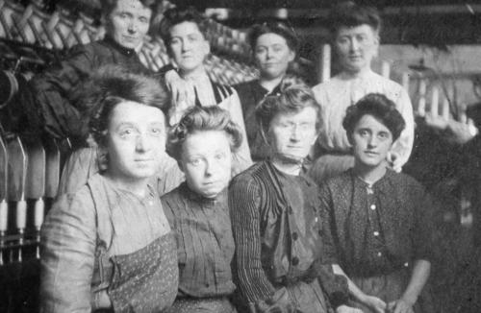
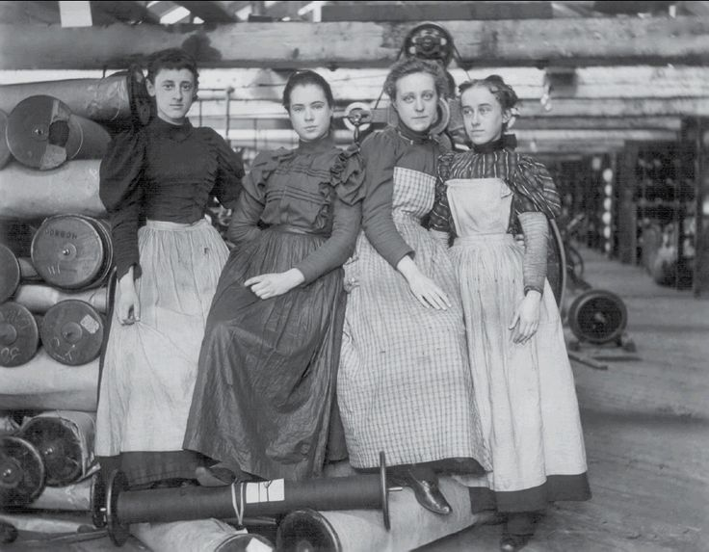
What happened to workers in the textile industry as a result of Francis Cabot Lowell’s introduction of a new system?
More women became mill workers because of the opportunity to earn better wages than most available jobs.

Slide 29
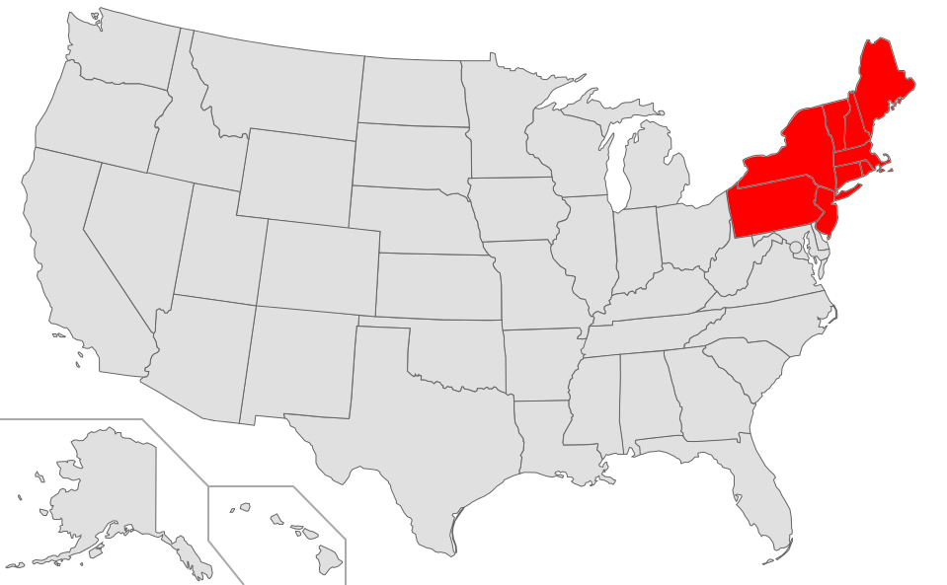
In the mid-1800s, most of America’s industry was located in the…?
Northeast.

Slide 30
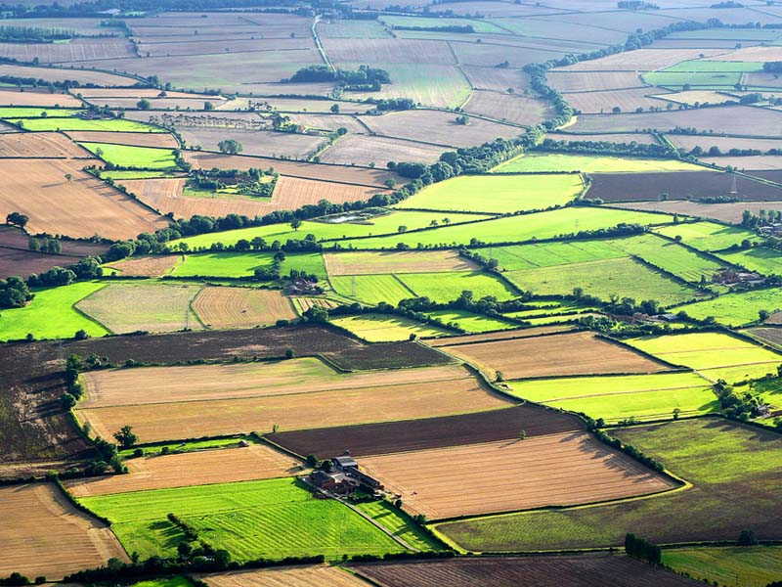
What was one argument given by Secretary of the Treasury Albert Gallatin about why there were so few factories in the United States?
There was a high availability of farmland in the United States.

Slide 31
What main benefit did the Transportation Revolution bring to trade?
It enabled goods to travel quickly across the United States.

Slide 32
Why were most early strikes by union members unsuccessful?
Break it up!
Go Home!
The courts and the police did not take their side.

Slide 33
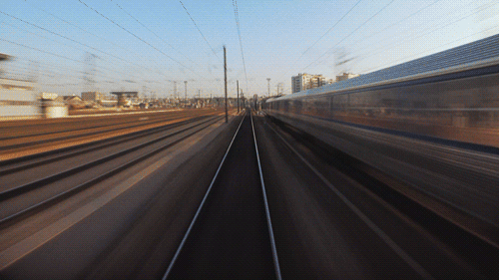
Why did locomotives make a powerful impression on passengers?
The trains traveled faster than most people had ever gone.

Slide 34
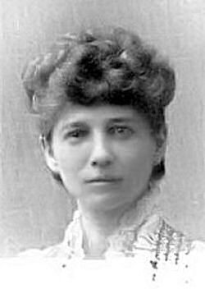
Who was Sarah G. Bagley?
She fought to bring the 10-hour working day of public employees to private business employees.

Slide 35
Which statement best describes working conditions at the mills?
Workers suffered from health problems, such as chronic cough, due to unsafe conditions.

