Slide 1
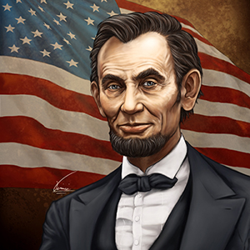
Ch. 17
Reconstruction of the South

Slide 2
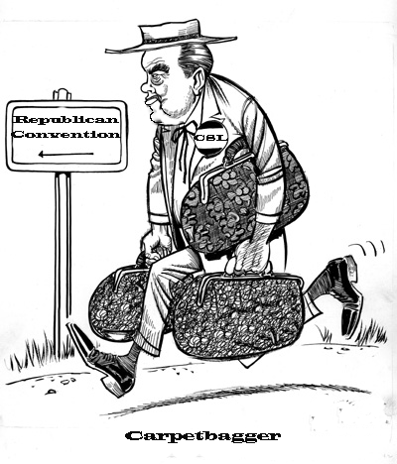
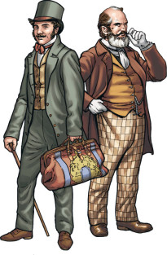
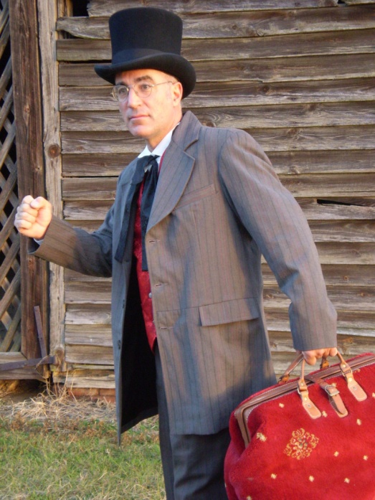
Whom did white southerners call “carpetbaggers”?
northern-born Republican office-holders in the South

Slide 3
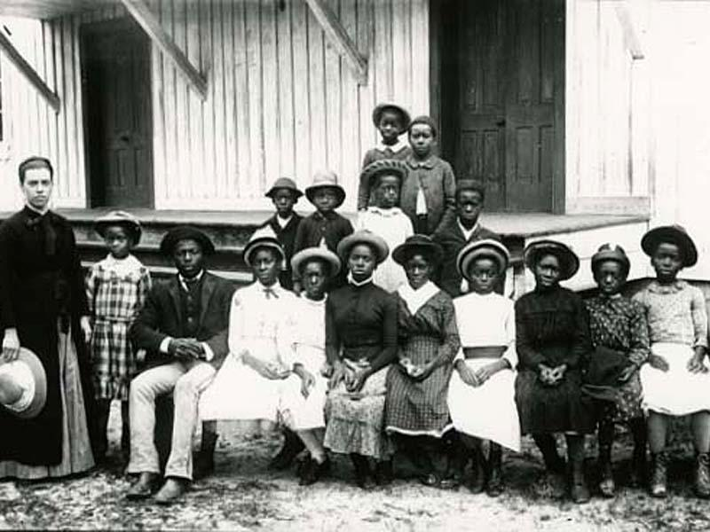
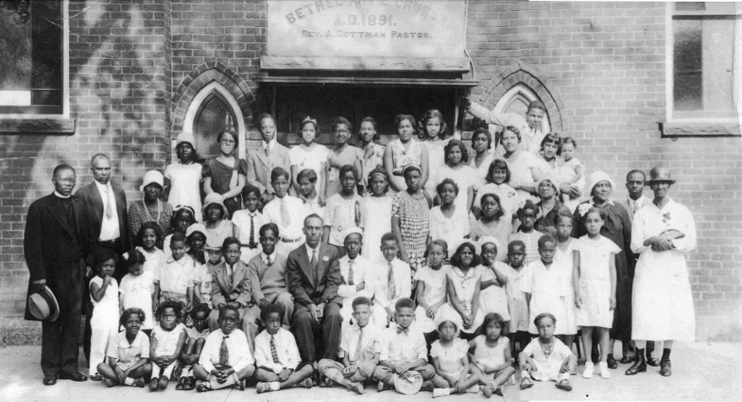
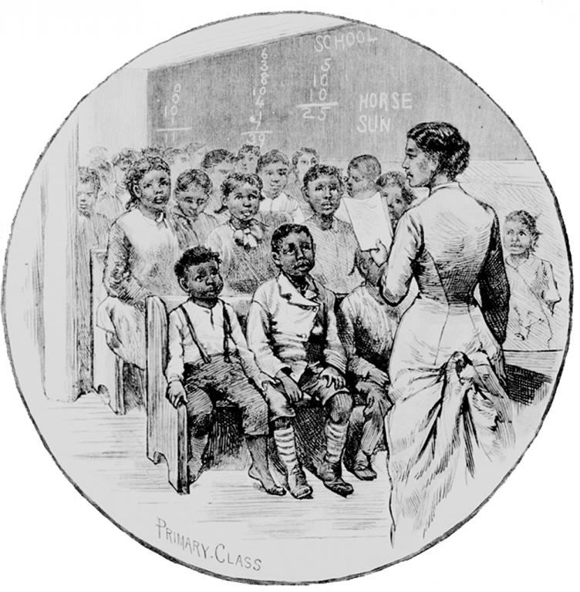
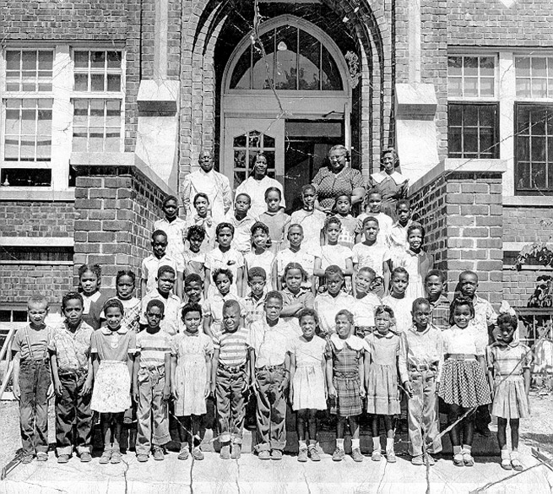
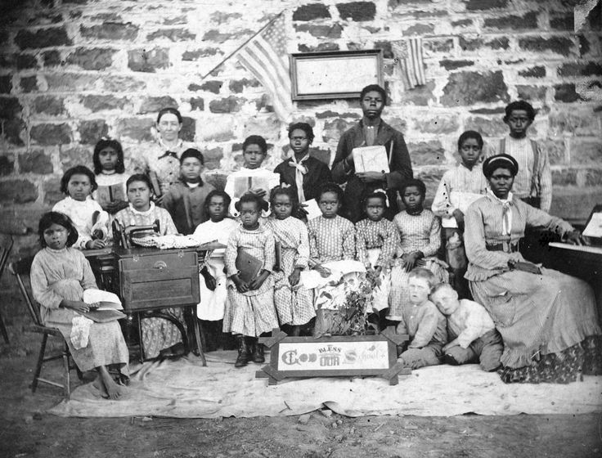
How did the Freedmen’s Bureau affect education for freed slaves in the South?
It established more schools and increased efforts to educate freed slaves.

Slide 4
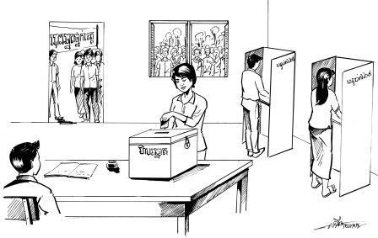
The Fifteenth Amendment protected what right of African American men?
The right to Vote.

Slide 5
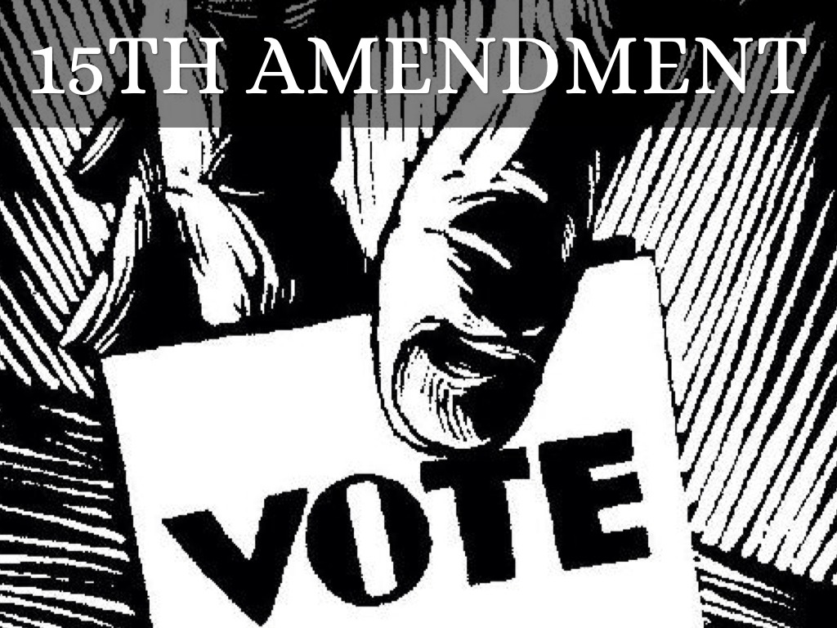
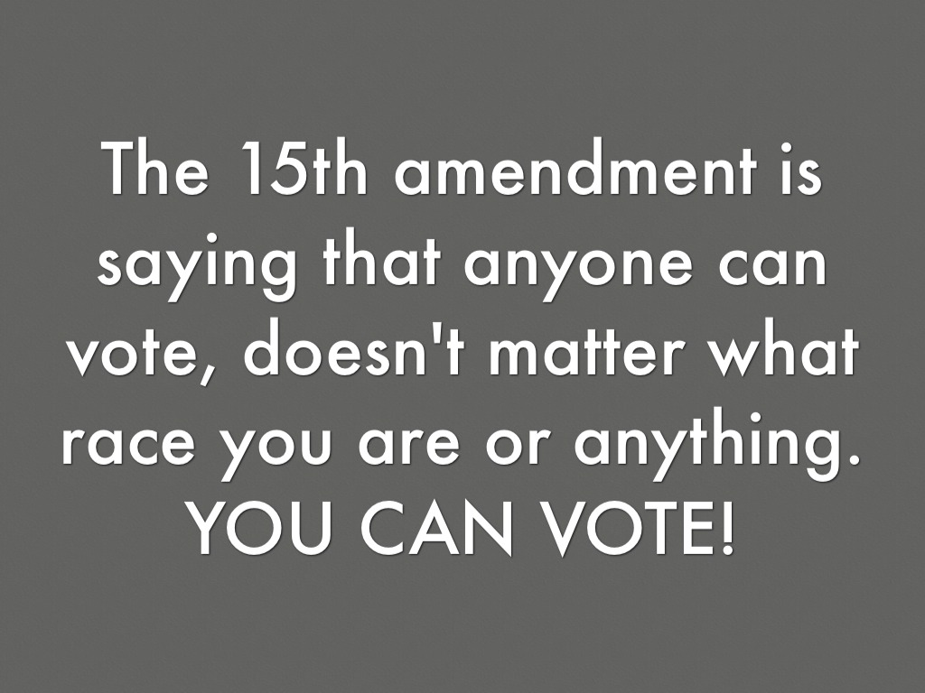
Why did congressional Republicans think that passing the Fifteenth Amendment would help protect their Reconstruction plan?
African Americans would vote to support the plan.

Slide 6
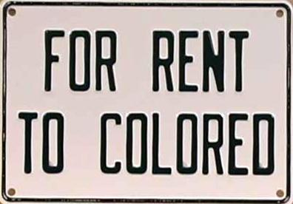
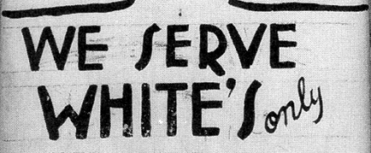
What is the forced legal separation of the races, introduced by Redeemer governments?
Segregation

Slide 7
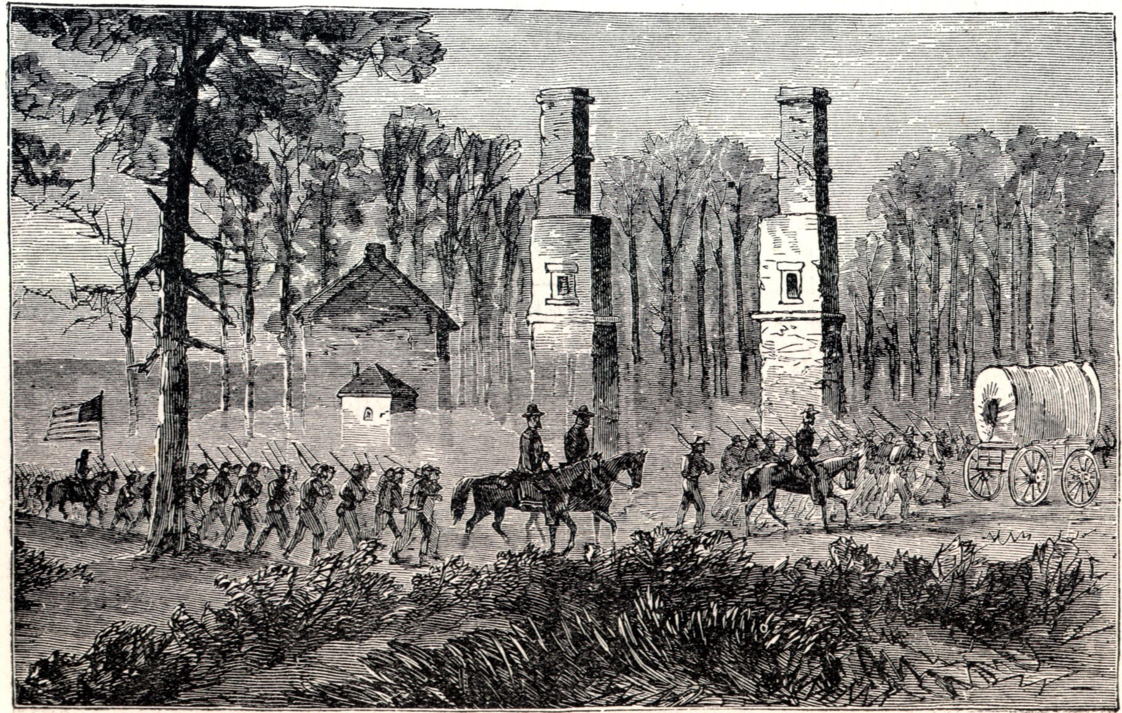
What were the direct effects of the Compromise of 1877?
Let’s head back North
removal of federal troops from the South.

Slide 8
The political group that wanted the federal government to become more involved in Reconstruction was….?
The Radical Republicans

Slide 9
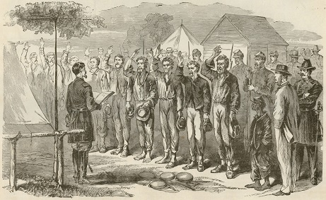
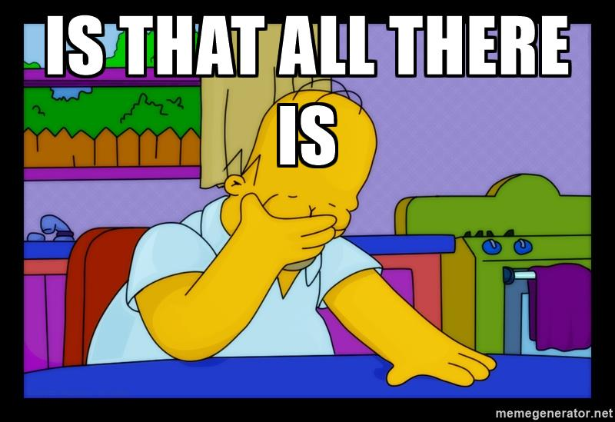
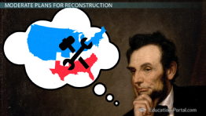
Why did many Republican Congress members disagree with Lincoln’s 10% Plan for Reconstruction?
They thought it would take more to restore the Union than for southern states to swear an oath of loyalty.

Slide 10
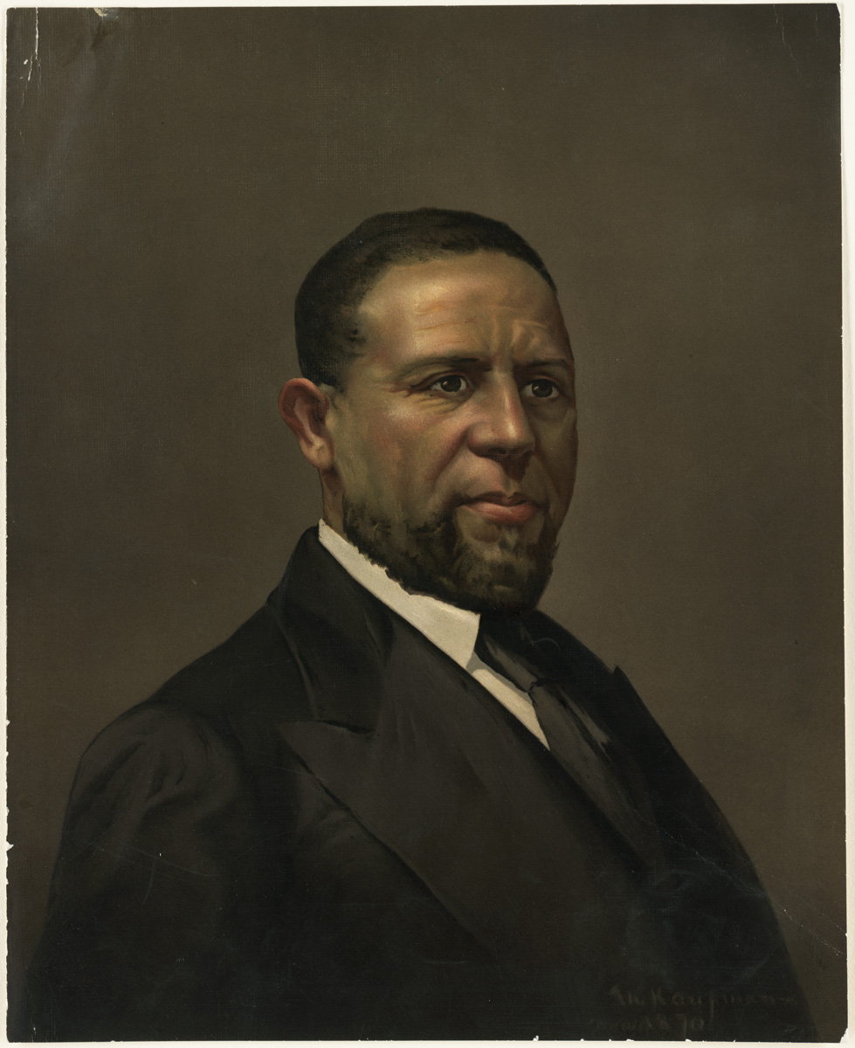
Hiram Revels was the first African American to hold which post?
U.S.
Senator

Slide 11
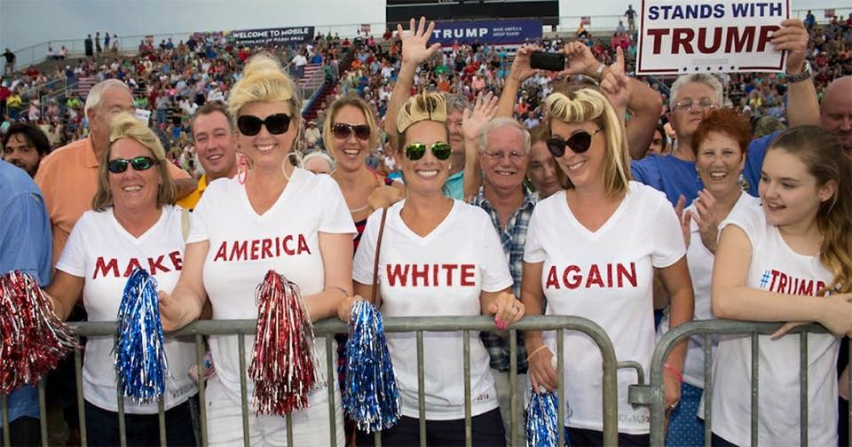
Why did Southern governments believe they were justified in passing the Black Codes?
They believed government was intended for white men only and not African Americans.

Slide 12
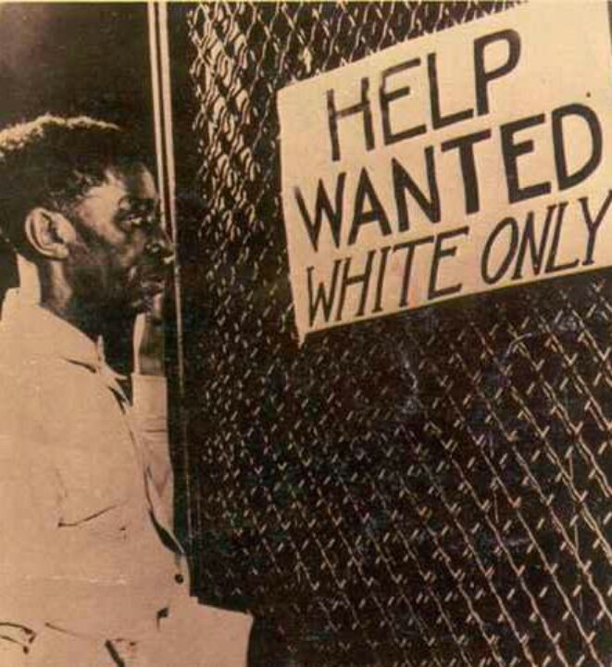
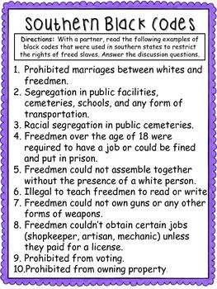
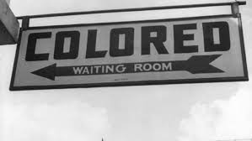
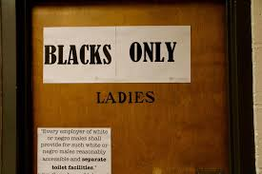
Why did Southern governments pass the Black Codes?
In order to limit the civil rights of freed African Americans.

Slide 13
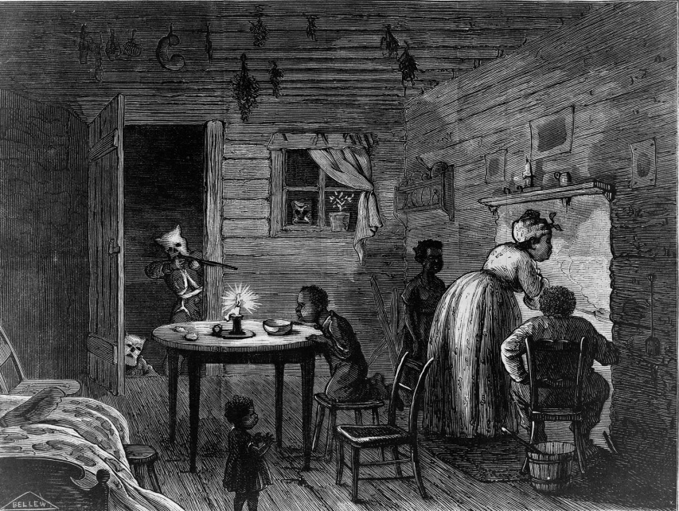
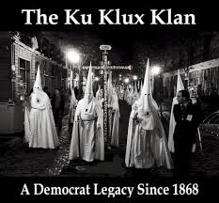
Why was the Ku Klux Klan able to obtain a great deal of power in the South before 1870?
Local governments did not do much to stop the violence of the group.

Slide 14
How did the Wade-Davis Bill differ from Lincoln’s Ten Percent Plan?
The Wade-Davis Bill required that a majority of southern males take an oath of loyalty.

Slide 15
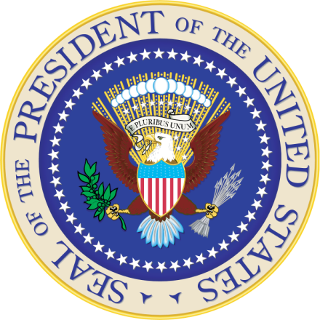
What was President Andrew Johnson’s plan for wealthy southerners and former Confederate officials?
grant them amnesty through presidential pardons.

Slide 16
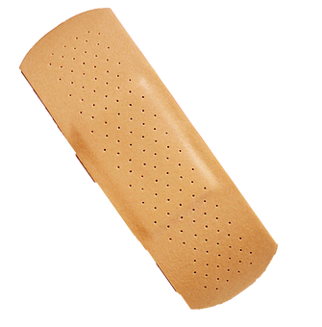
What was Lincoln’s main vision for Reconstruction?
reunite the nation as quickly and painlessly as possible.

Slide 17
What did the verdict in Plessy v. Ferguson establish?
legalized segregation as long as “separate-but-equal” facilities were provided.

Slide 18
Who were the Redeemers?
Democrats who brought their party back to power in the South

Slide 19
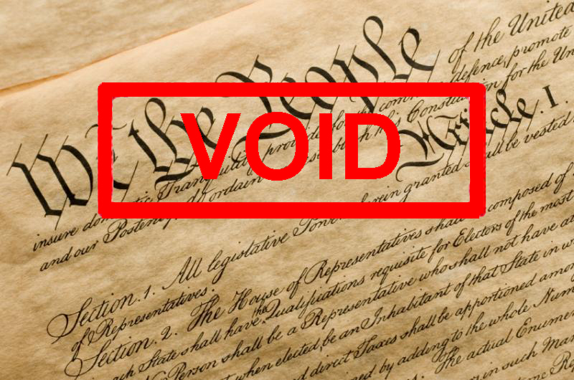
Why did President Johnson decided to reject the Freedmen’s Bureau?
He determined the Bureau to be unconstitutional.

Slide 20
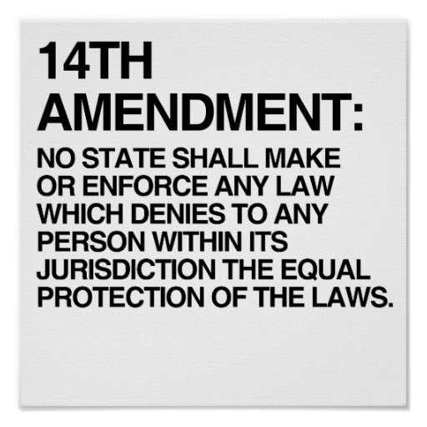
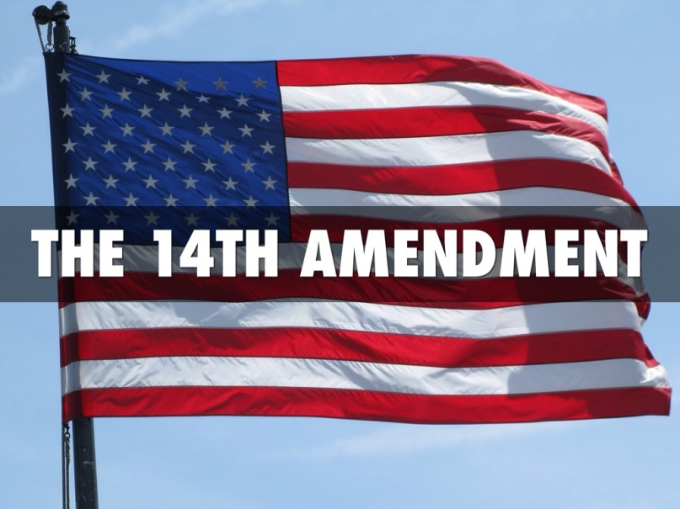
Why did Republicans propose the 14th Amendment before southern states were readmitted to the Union?
In order to protect the Civil Rights Act from being overturned by the South.

Slide 21
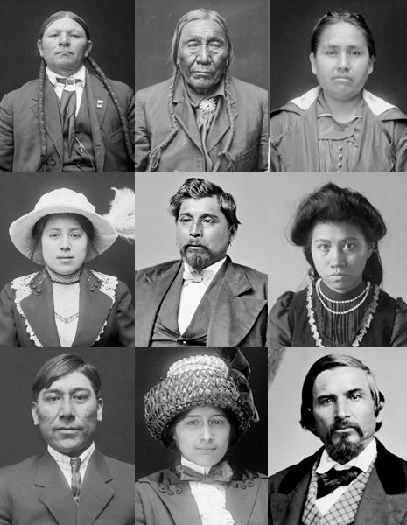
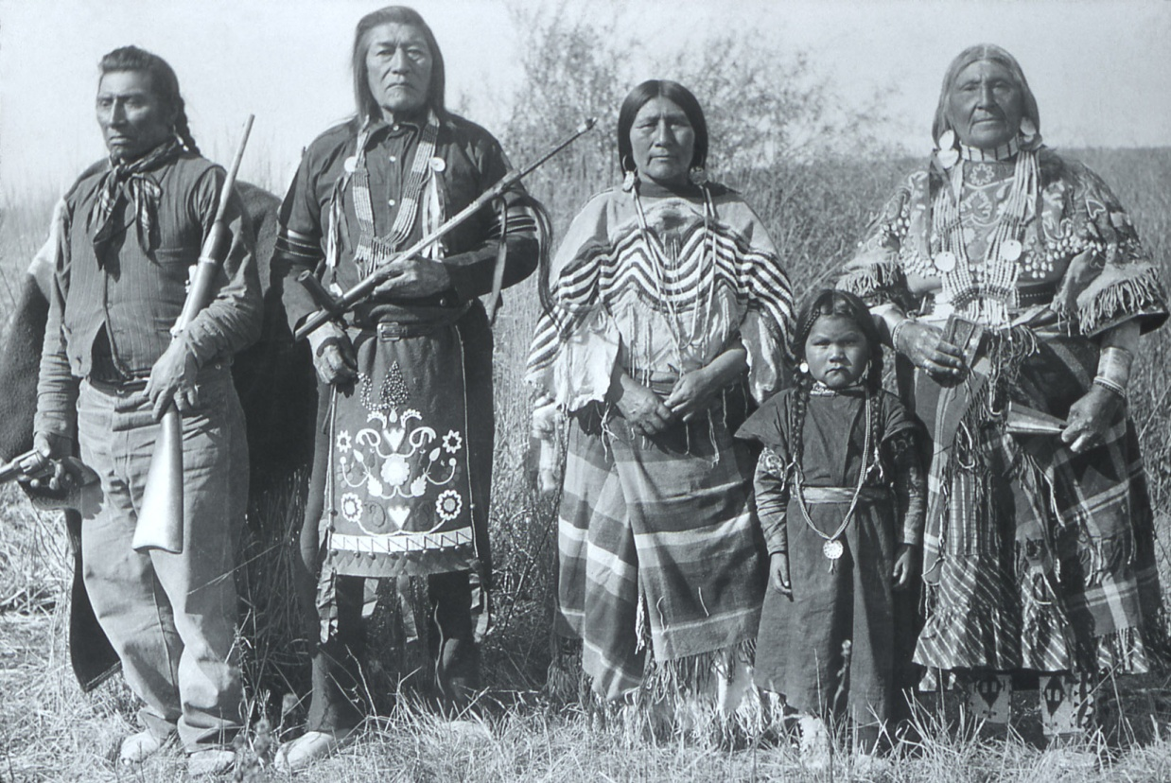
The Fourteenth Amendment defined who could be considered a U.S. citizen. Which group did the Amendment exclude from U.S. citizenship?
Native Americans

Slide 22
What were the reasons behind the creation of the Ku Klux Klan in 1866?
the expansion of suffrage rights, (The right to vote), to include African Americans.

Slide 23
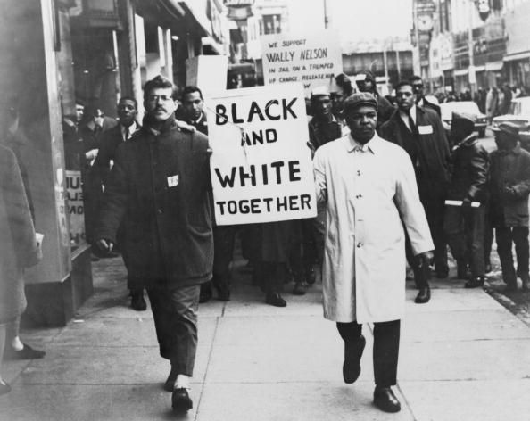
How did Reconstruction affect the social structure of the South?
African Americans began to demand the same economic and political rights as whites.

Slide 24
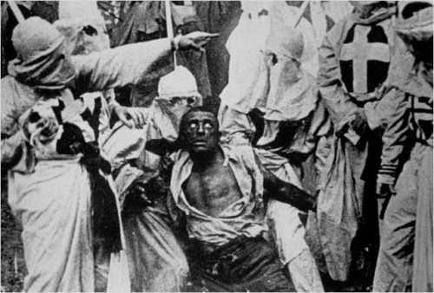
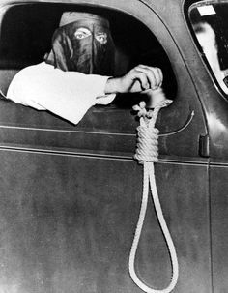
How did members of the Ku Klux Klan demonstrate their anger towards African Americans?
They used violence and terror.

Slide 25
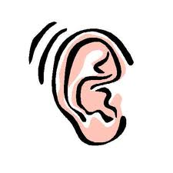
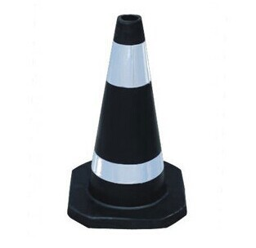
The set of laws that limited the freedom and rights of African Americans were….?
The Black Codes

Slide 26
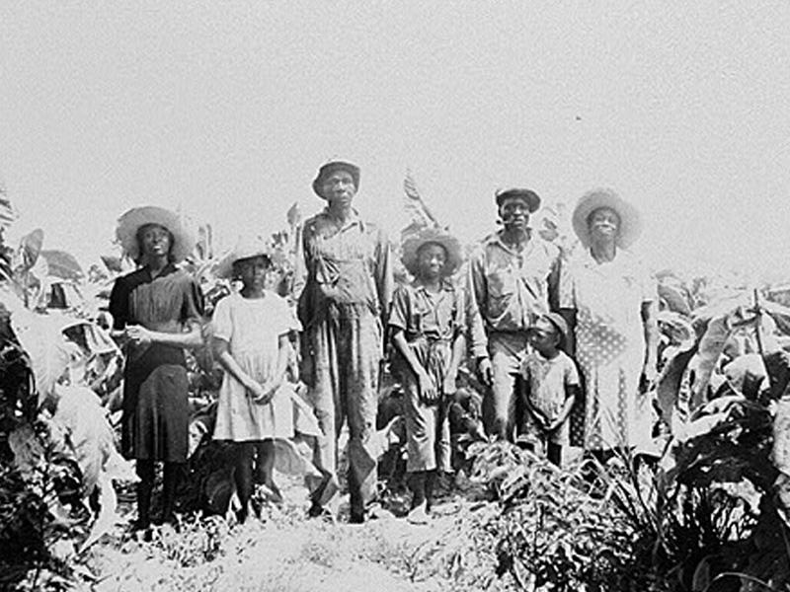
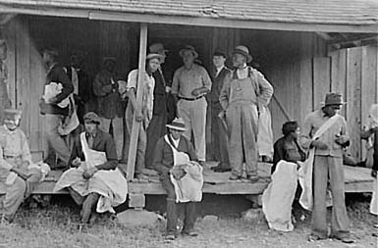
How did the sharecropping system limit opportunities for African Americans to own farms and property?
Most sharecroppers lived in a cycle of debt, first buying goods on credit and then failing to make much money selling their crops

Slide 27
What law passed by Congress, gave African Americans the same legal rights as white Americans?
The Civil Rights Act of 1866

Slide 28
Which industry jobs, offered many southern workers an alternative to farming in the late 1800s?
The Cotton Industry

Slide 29
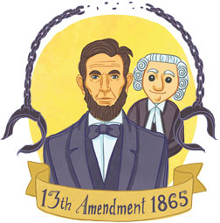
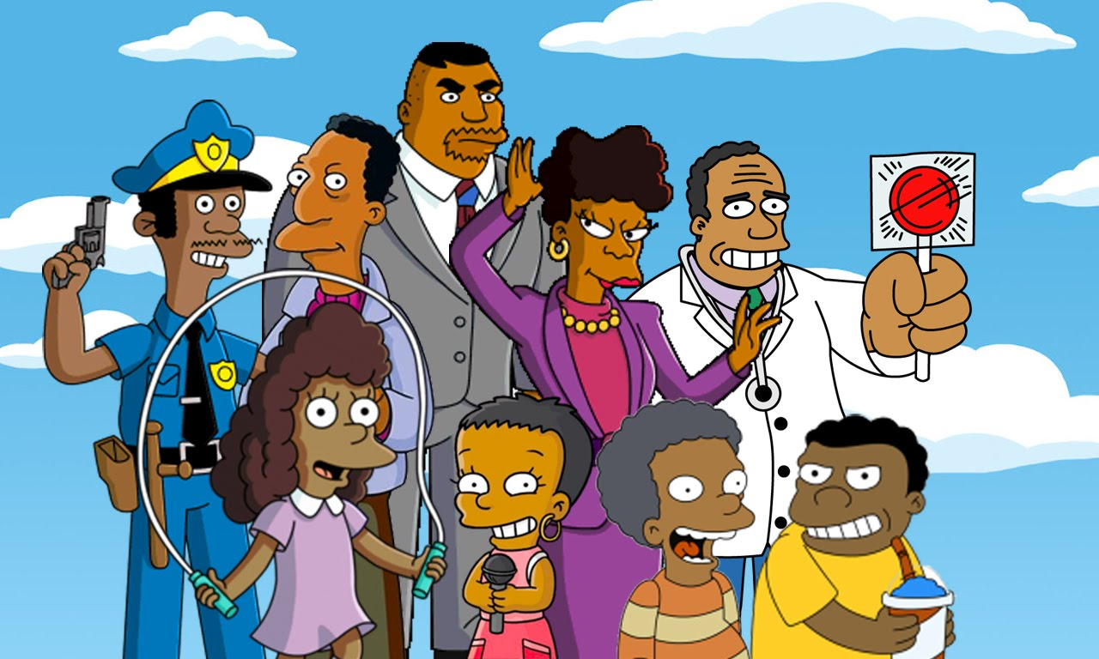
What did ratification of the Thirteenth Amendment mean for African Americans?
From 1865
To
2017 & beyond
It provided African Americans with a future free from slavery.

Slide 30
The regulations that forced segregation/separation of blacks and whites were known as….?
Jim Crow Laws

Slide 31
The set of laws that divided the South into five districts under military control were the…?
Reconstruction Acts

Slide 32
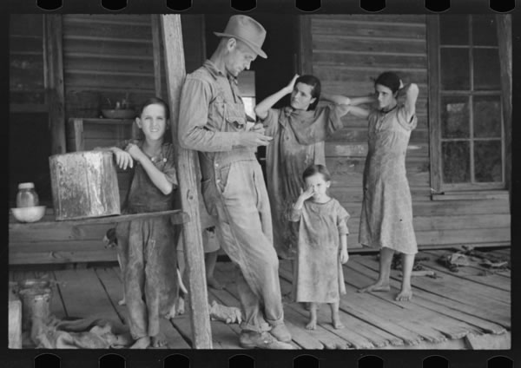
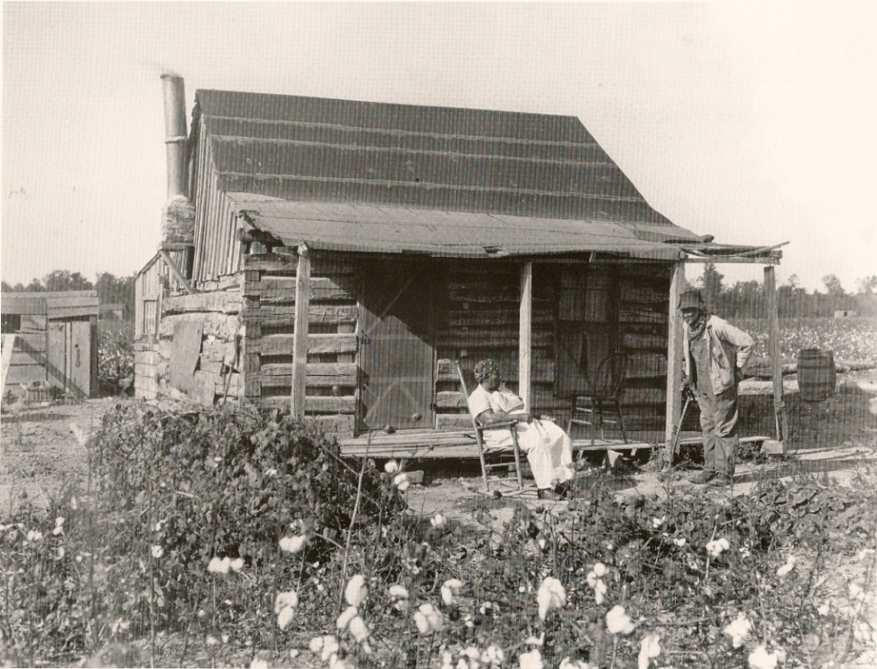
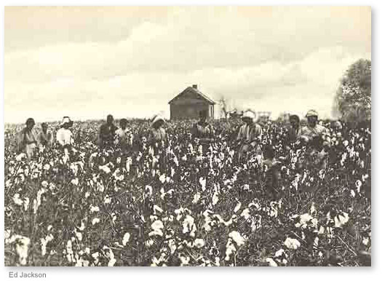
What is the farming system used in the South in which a worker farms the land and gives the landowner a portion of the crop as payment for rent
Sharecropping

Slide 33
The main goal of Reconstruction was to …..?
readmit the former Confederate states into the Union..

Slide 34
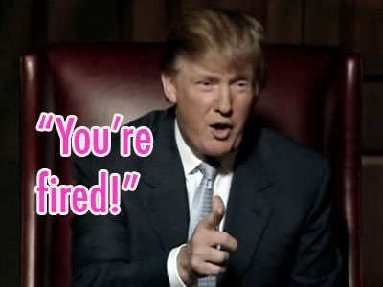
Why did the House of Representatives vote to impeach President Johnson in 1868?
But, you can’t do that!
The president had fired a cabinet official without Senate approval.

Slide 35
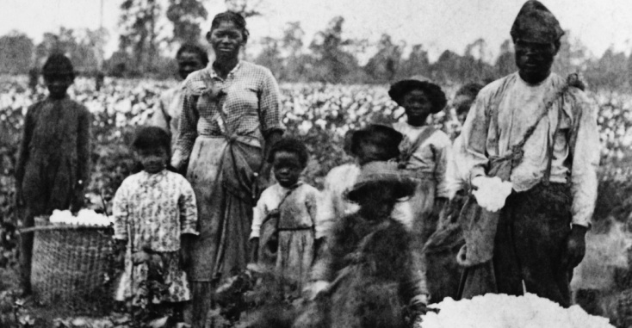
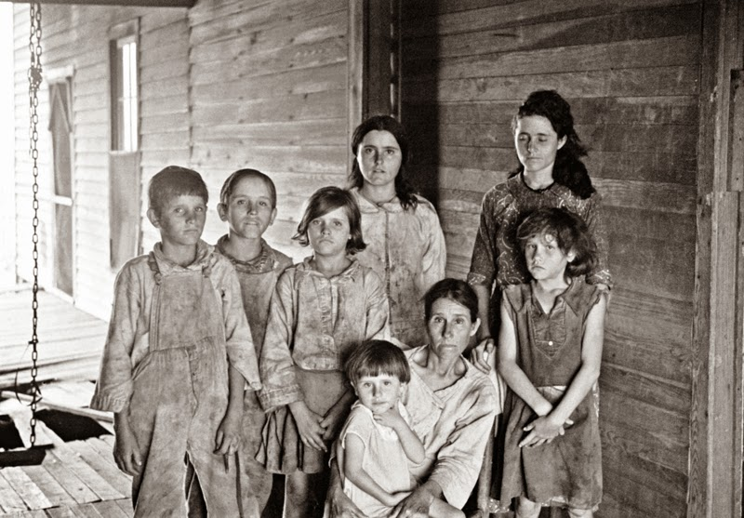
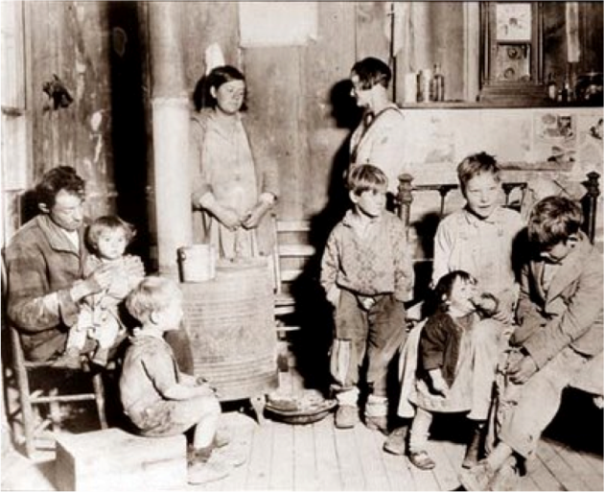
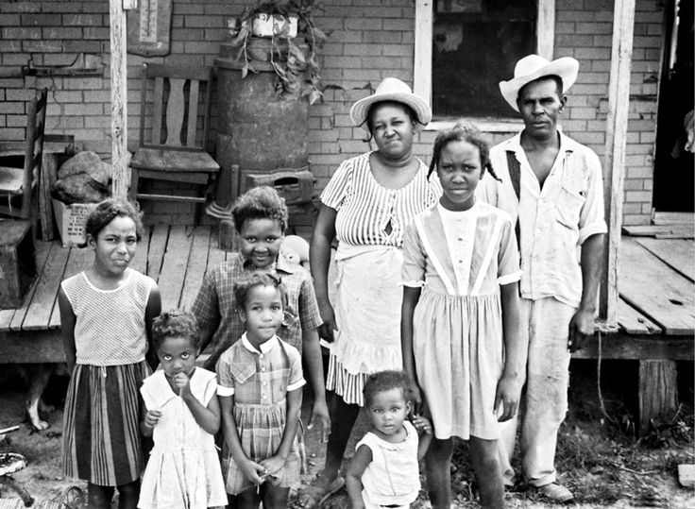
What is the name of the organization that provided assistance to all poor people living in the South
The
Freedmen’s
Bureau

Slide 36
In 1872, what change in southern state governments, brought about the end of many Reconstruction reforms?
Low-ranking former Confederates were permitted to hold public office.

Slide 37
Over!?

