Slide 1
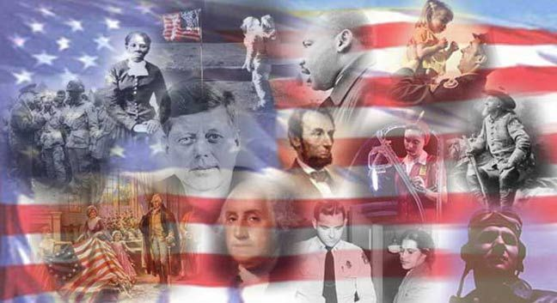
Trimester
2
Part 1

Slide 2
What is the significance of Marbury vs. Madison ?
It established the Supreme Court’s power to check the other branches of gov’t.

Slide 3
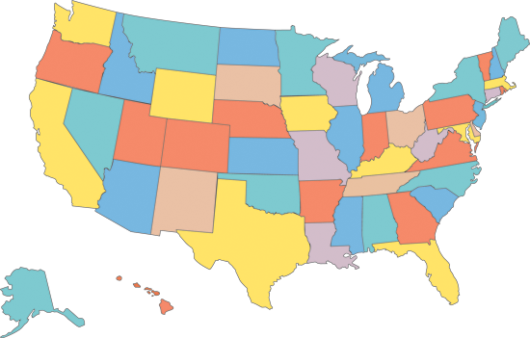
Mormons moved from New York to the West in the early 1830s in order to…?
seek out religious freedom.

Slide 4
The Louisiana Purchase was significant to the U.S. because it….?
Nearly doubled the size of the country.

Slide 5
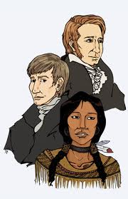
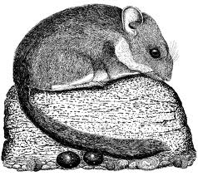
The Lewis and Clark expedition was undertaken in order to explore the Louisiana Purchase, to learn about the plants and animals of the west, and to ……?
Attempt to find a river route to the Pacific Ocean.

Slide 6
What effect did Nat Turner’s Rebellion of 1831 have on southern society?
Shhh!!....They’re coming ……Umm, Hi, how are you slaves today?
And I’ll tell you another thing about those good fer noth’n….!
People stopped discussing slavery openly.

Slide 7
What did the Treaty of Ghent accomplish?
It ended the War of 1812

Slide 8
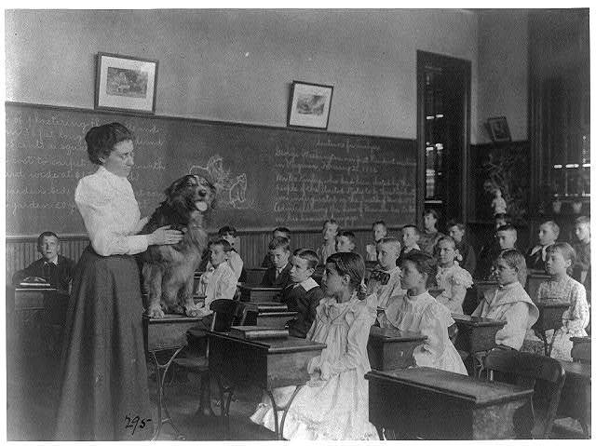
Members of the common-school movement believed that all children should…?
Er…Yes!...it’s True !...I do eat off of the floor….Next question…..?.....Ah , ..the little boy with the delicious booger in his nose.
learn in the same place regardless of their backgrounds.

Slide 9
What did the War of 1812 do for the U.S.?
It strengthened patriotism among Americans

Slide 10
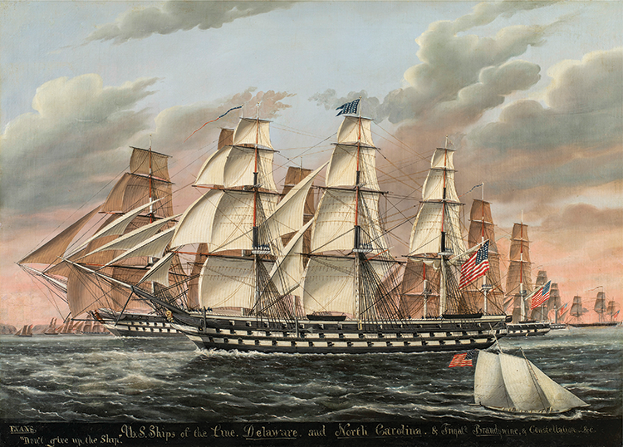
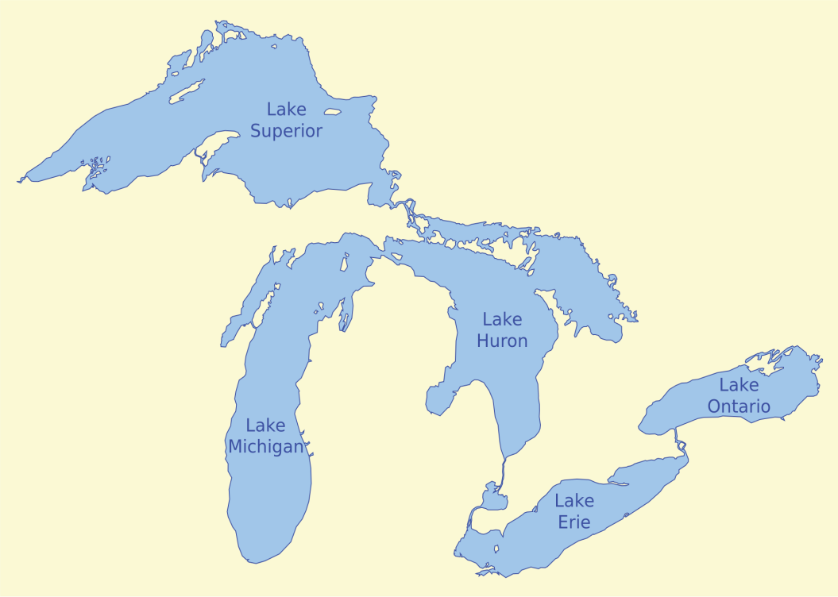
After the War of 1812, the Rush-Bagot Agreement between the United States and British Canada was signed to….?
What do you mean we have too many Battleships
limit naval power on the Great Lakes.

Slide 11
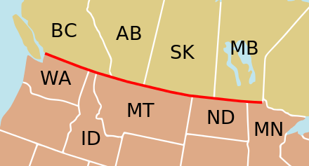
The Convention of 1818 affected the boundaries of the United States by…?
establishing a border between the United States and Canada extending to the Rocky Mountains.

Slide 12
What settlement did the United States and Spain reach in the Adams-Onís Treaty?
The United States would receive control of East Florida from Spain in return for U.S. claims to what is now Texas.

Slide 13
The Monroe Doctrine affected U.S. relations with Europe by…?
Monroe
Doc
U.S.A.
Europe
preventing the United States from interfering with any future conflicts or wars between European nations

Slide 14
The majority of German immigrants who came to the United States in the late 1840s came because the United States had….?
economic opportunity and freedom from government control.

Slide 15
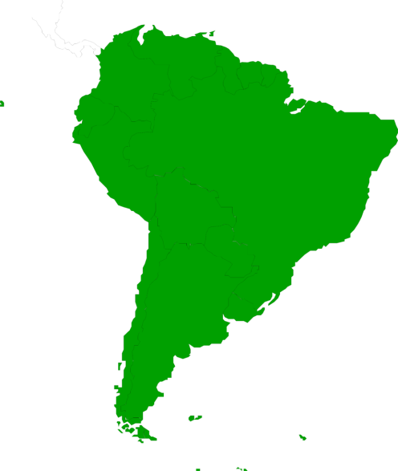
The Monroe Doctrine affected the United States’ relationship with Latin America by….?
placing Latin American nations within the United States’ sphere of influence.

Slide 16
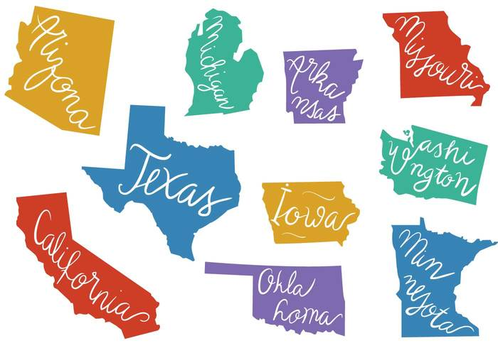
What was the Supreme Court’s decision in the 1824 case of Gibbons v. Ogden?
States cannot interfere with the power of Congress to regulate interstate commerce.

