Slide 1
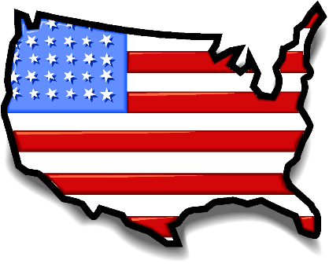
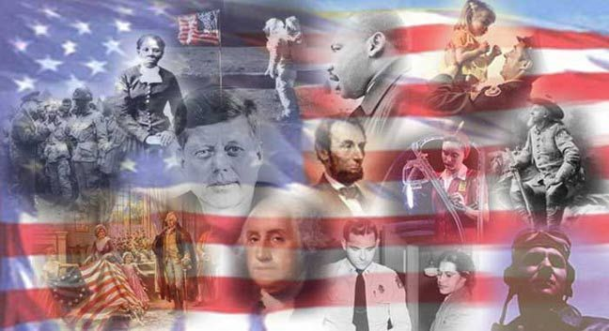
Trimester
2
Part 2

Slide 2
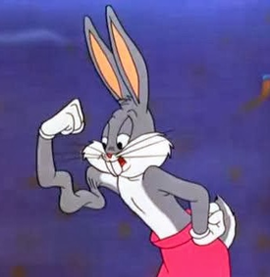
The decisions in the cases of McCulloch v. Maryland and Gibbons v. Ogden strengthened the feeling of national unity in the United States by…..?
Fed. Gov’t
Before McCulloch v. Maryland and Gibbons V. Ogden
Fed. Gov’t
After McCulloch v. Maryland and Gibbons V. Ogden
reinforcing the power of the federal government.

Slide 3
What is judicial review?
The power of the judiciary to declare an act of Congress unconstitutional

Slide 4
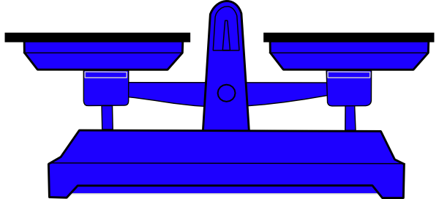
Which of the following was a consequence of the Missouri Compromise?
Free
States
Slave States
An equal balance between free and slave states was maintained.

Slide 5
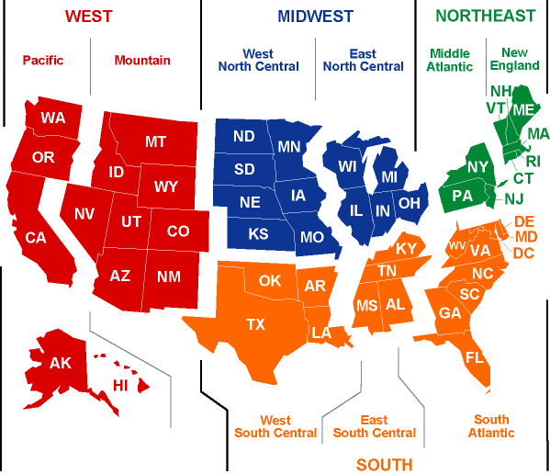
During the 1820s, sectionalism grew in the United States. Sectionalism is when….?
politicians disagree over the interests of different regions.

Slide 6
What caused the severe economic depression of
In which
President Harrison’s excessive investments in the military

Slide 7
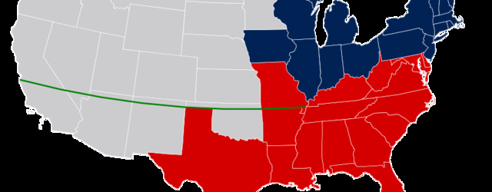
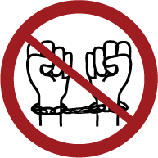
How did the Missouri Compromise contribute to the eventual abolition of slavery?
It prohibited slavery in states and territories north of Missouri’s southern border.

Slide 8
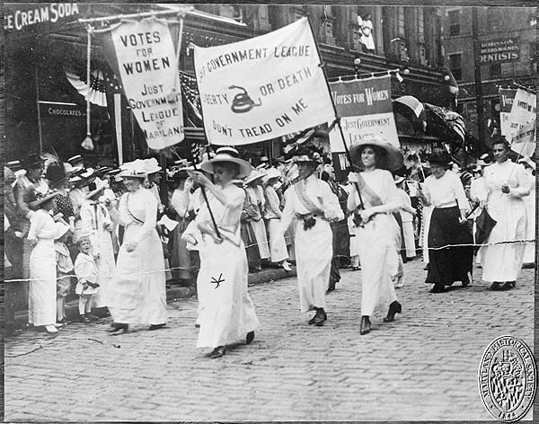
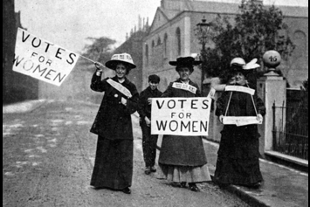
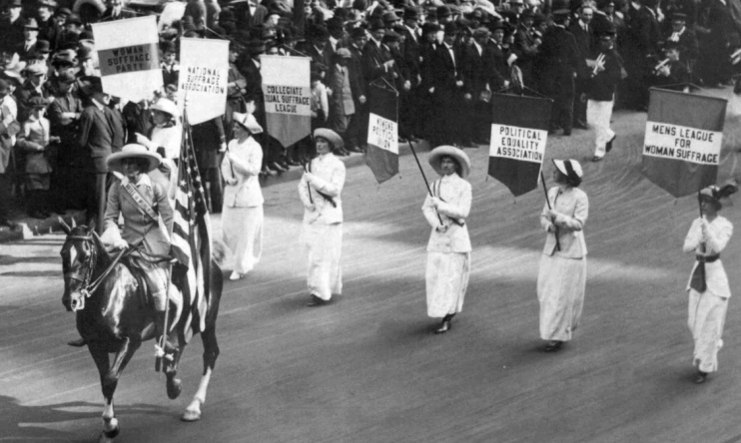
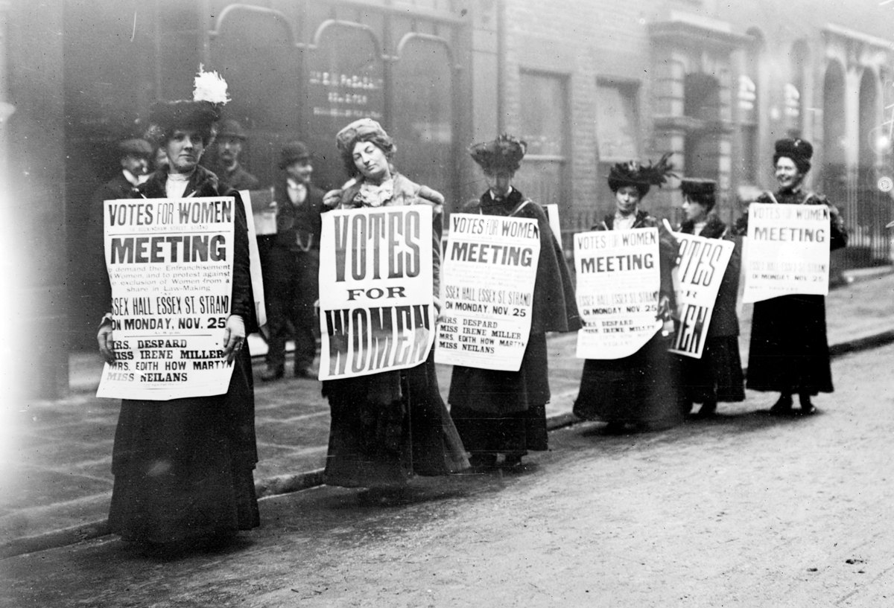
The women’s movement for equal rights was an offshoot of the….?
abolitionist movement.

Slide 9
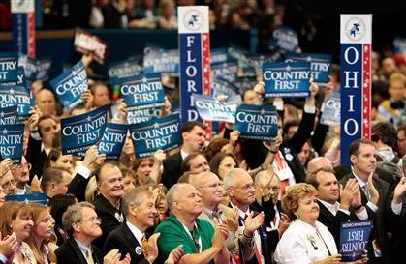
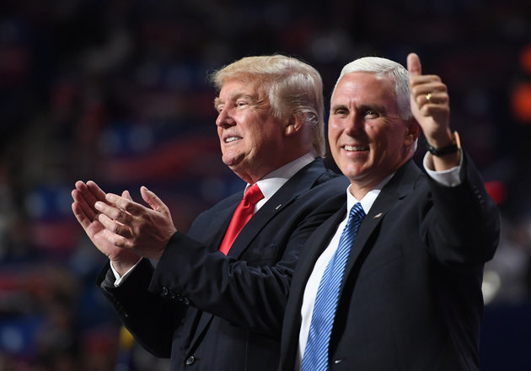
Nominating Conventions contributed to the expansion of democracy in the United States in the 1820s by
allowing people to become more active in politics..

Slide 10
The Nullification Crisis was a dispute over the power of the states to…?
Constitutional
Unconstitutional
reject unconstitutional federal laws.

Slide 11
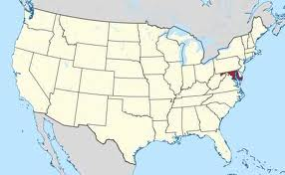
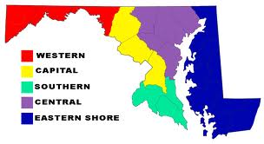
In what case did the Supreme Court rule that the national bank was constitutional??
Vs.
McCulloch vs Maryland

Slide 12
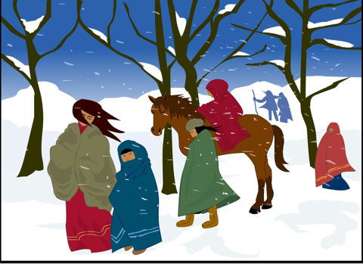
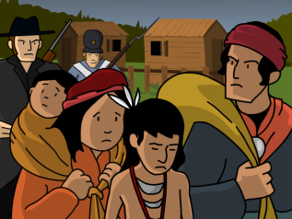
The Bureau of Indian Affairs was a…?
federal agency created to manage the removal of Native Americans to the West.

Slide 13
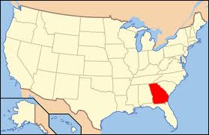
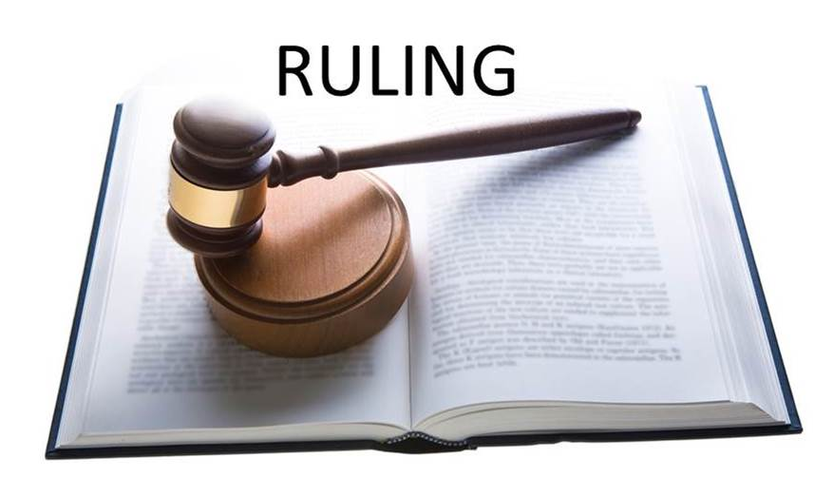
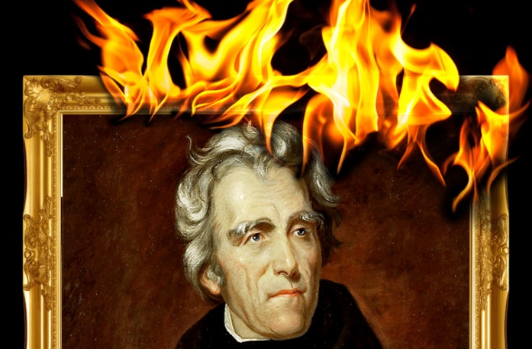
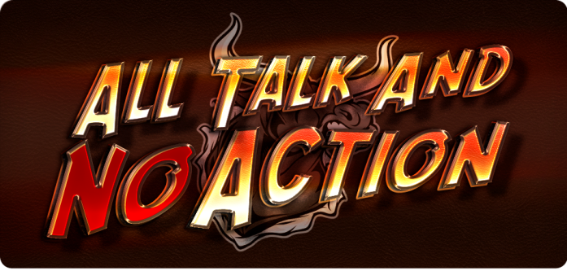
What was a consequence of the Worcester v. Georgia decision regarding the Cherokee Nation ?
Andrew Jackson
Georgia ignored the ruling and President Jackson took no action to enforce it.

Slide 14
What Supreme Court case established that only the federal government had authority over American Indians.
Worcester v. Georgia

