Slide 1
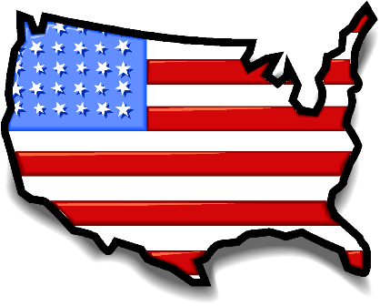
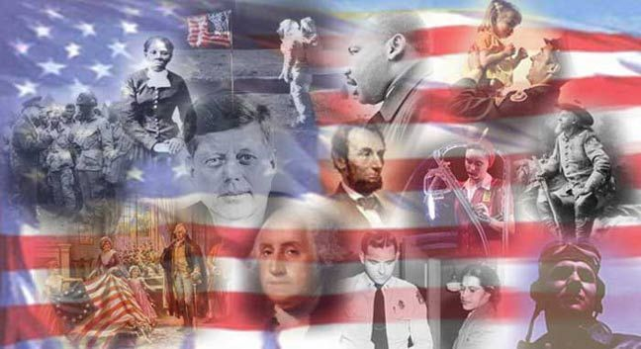
Trimester
2
Part 3

Slide 2
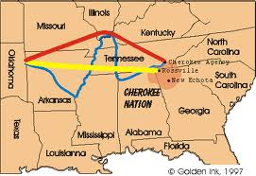
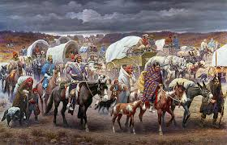
The forced 800-mile march the Cherokee Indians made in their removal from Georgia was called the…..?
The Trail of Tears

Slide 3
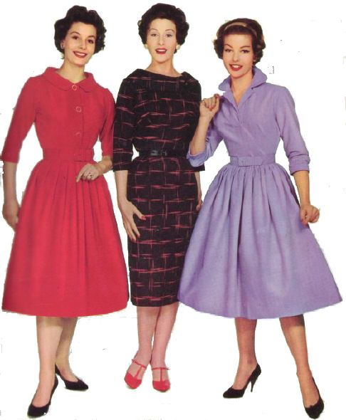
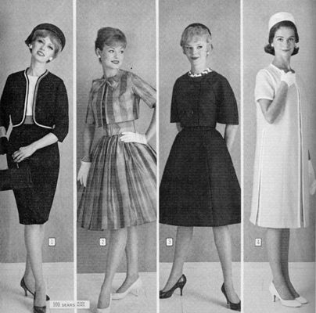
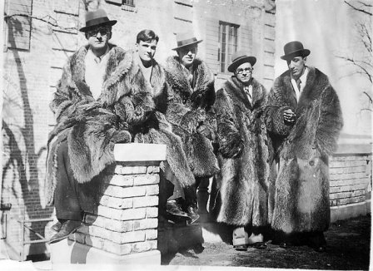
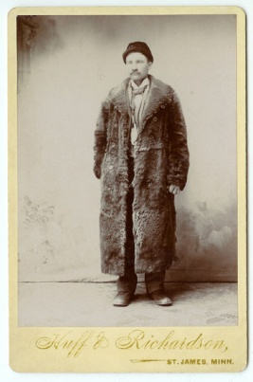
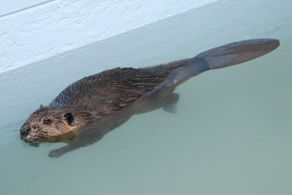
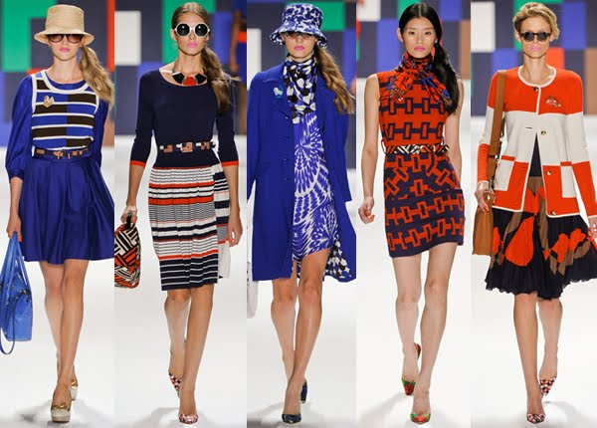
What put an end to American fur trading in the 1840s?
Then
Now
Beaver fur went out of fashion and demand fell.

Slide 4
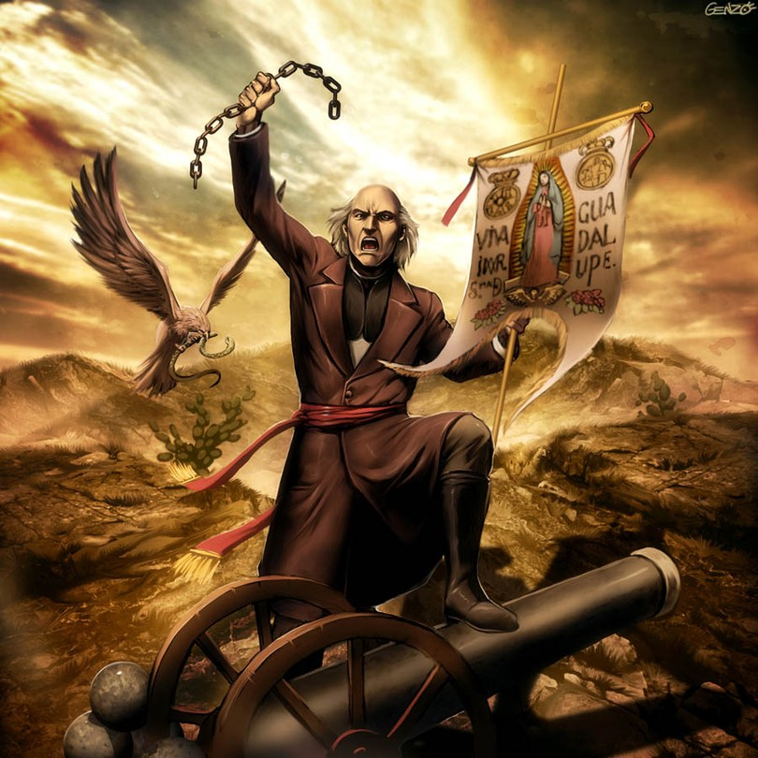
Father Hidalgo y Costilla’s rebellion in 1810 inspired …..?
the Mexican independence movement.

Slide 5
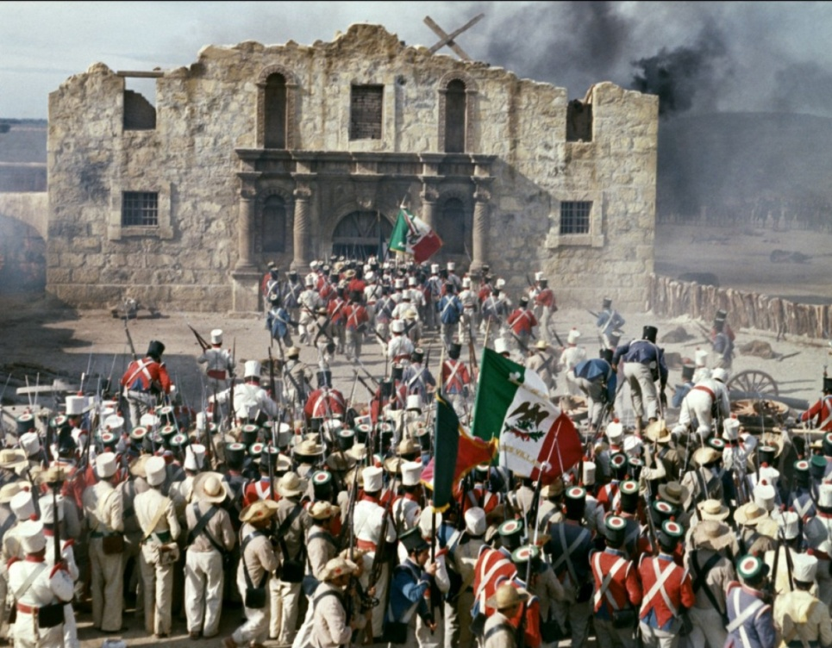
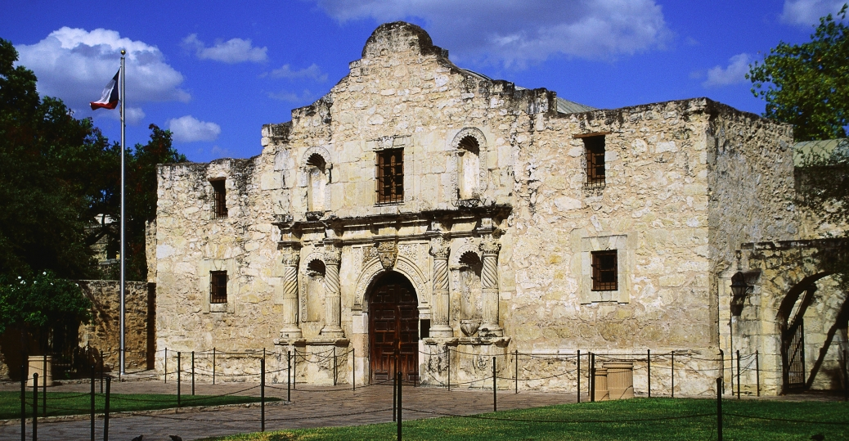
What is true about the men who fought in the battle at the Alamo in 1836?
All of the Alamo’s defenders were killed.

Slide 6
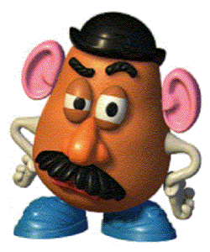
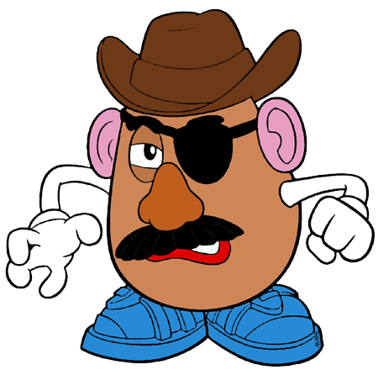
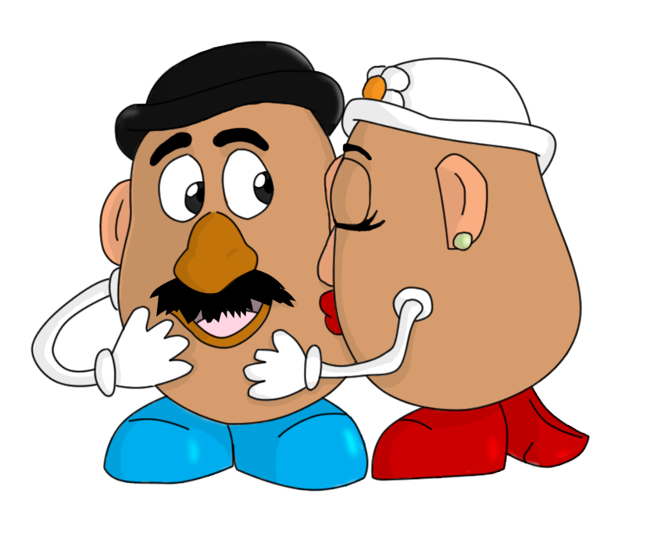
What led to the flood of Irish immigrants entering the United States in the mid 1840s
Potato fight...??
Potato Blight!

Slide 7
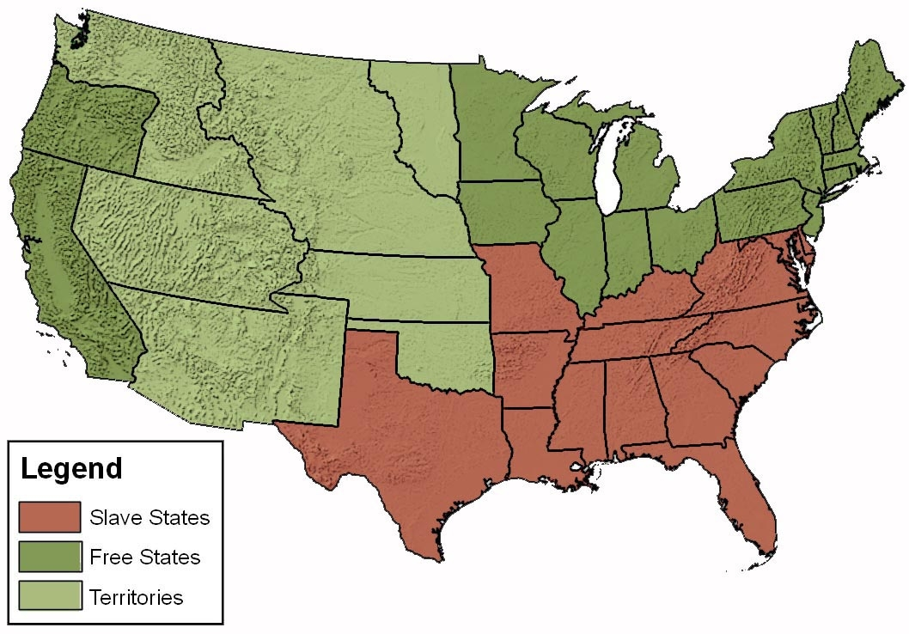
How did the slavery issue get tied up with the doctrine of manifest destiny in the 1840s and ’50s?
?
?
?
?
?
?
?
Americans did not know if the institution of slavery would be allowed in the new territories.

Slide 8
The Treaty of Guadalupe Hidalgo helped increase the size of the U.S. by…?
almost 25%?

Slide 9
How did the Gadsden Purchase benefit the United States?
It secured a southern route for a transcontinental railroad on American soil.

Slide 10
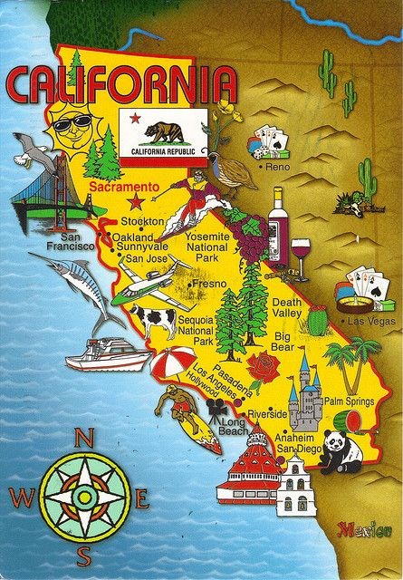
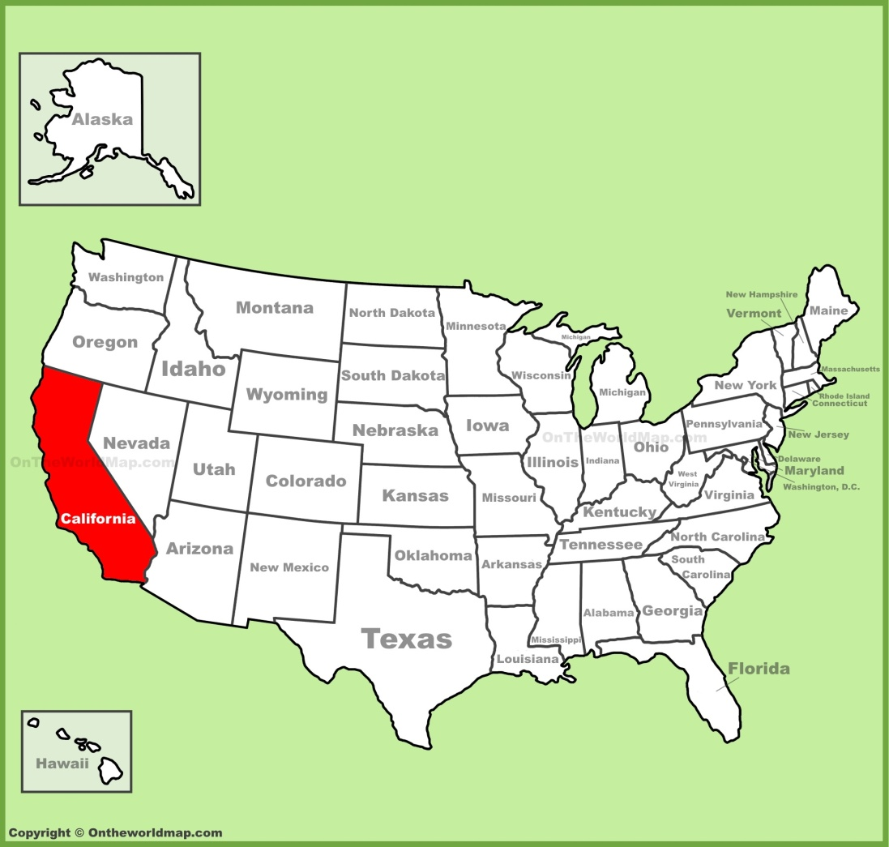
What happened to California’s population as a result of the Gold Rush?
Immigrants and Americans flocked to California to “get rich quick” and stayed to build a stable frontier society.

Slide 11
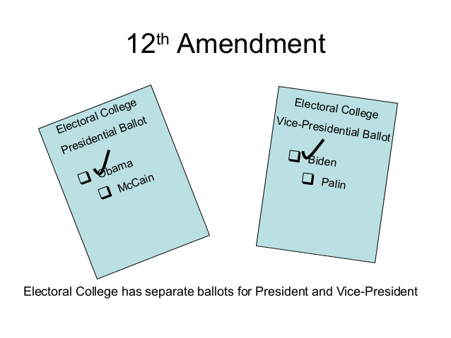
What did the 12th amendment accomplish?
It created a separate ballot for president and vice president.

Slide 12
What role did the transcontinental railroad play in California’s development?
It gave Cali’s economy the means to grow by connecting the state to the rest of the country.

Slide 13
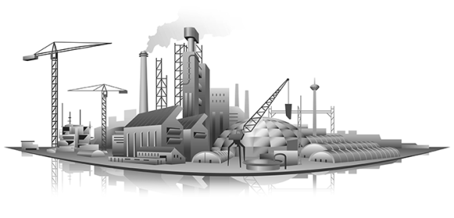
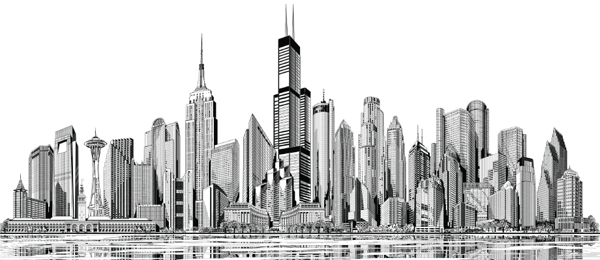
What led to the emergence of the middle class during the 1800s?
the growth of industry and cities

Slide 14
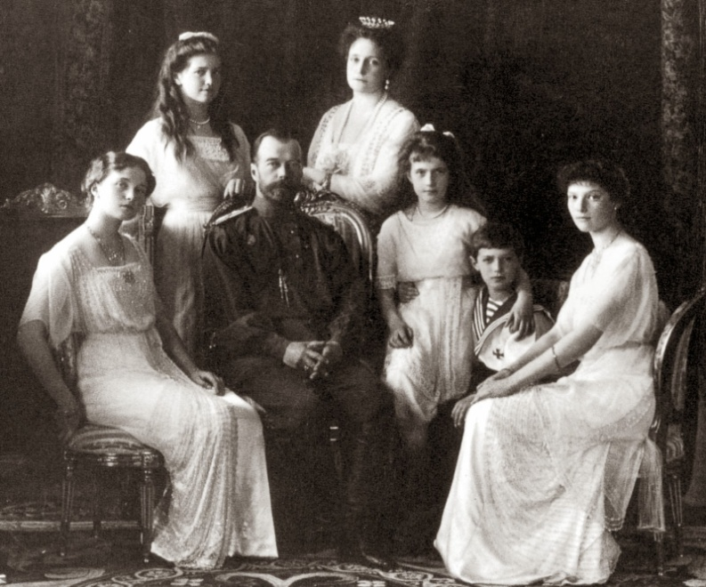
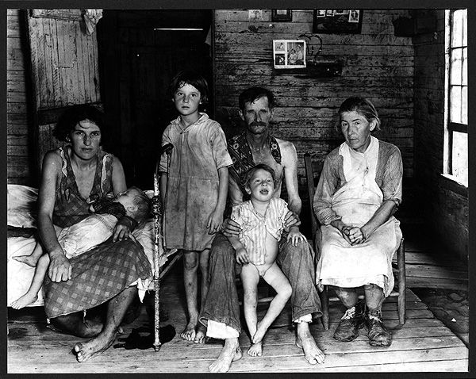
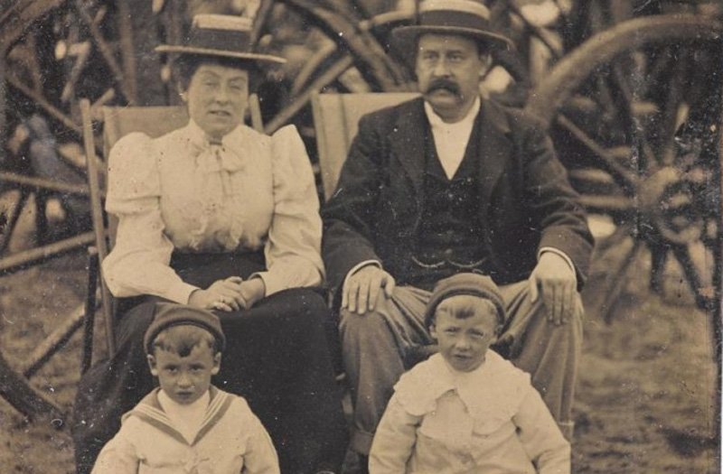
The term “middle class” refers to the…?
social and economic level between the wealthy and the poor.

Slide 15
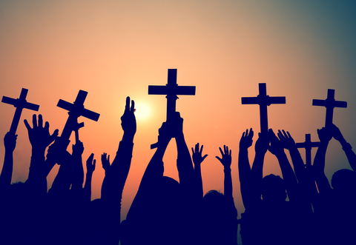
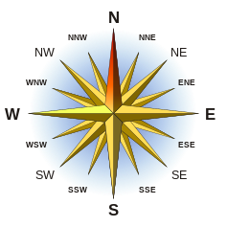
In late 18th century America, the Second Great Awakening was a period of..?
Christian renewal that began in the northeastern United States.

Slide 16
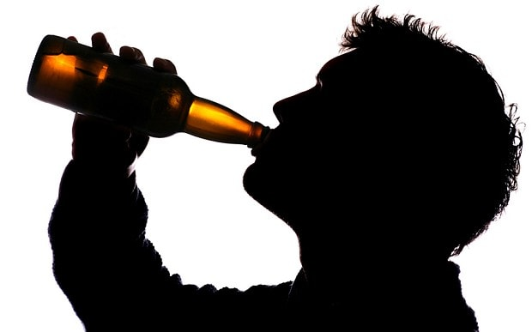
The temperance movement was a…?
reform effort to urge people to use self-discipline to stop drinking hard liquor.

Slide 17
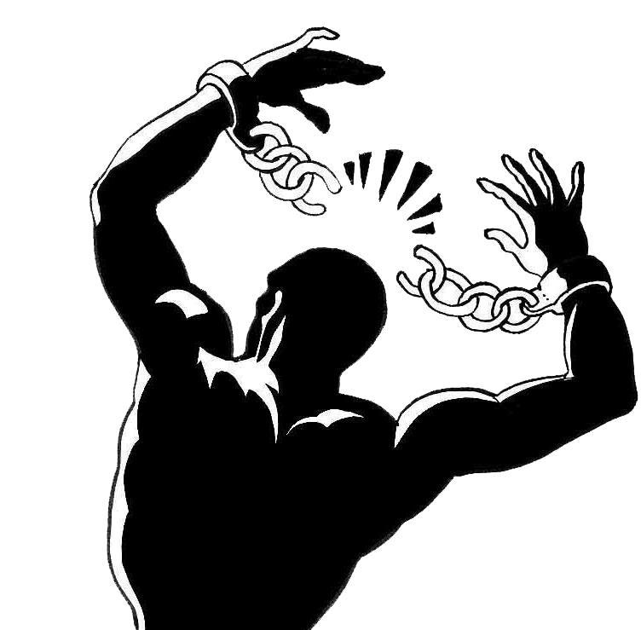
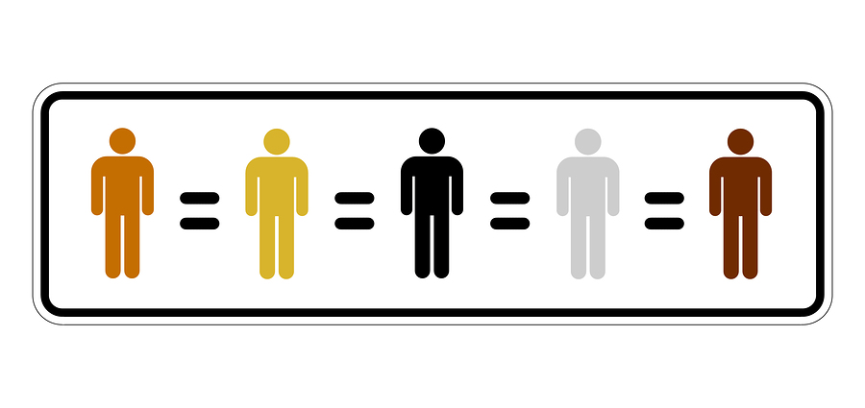
What was the goal of the American Anti-Slavery Society?
immediate emancipation and racial equality for African Americans

Slide 18
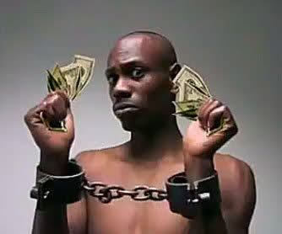
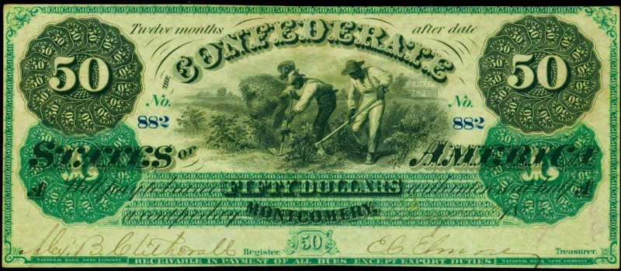
Which factor was largely responsible for making emancipation almost impossible in the South in the early 1800s?
the South’s economic dependence on slavery

Slide 19
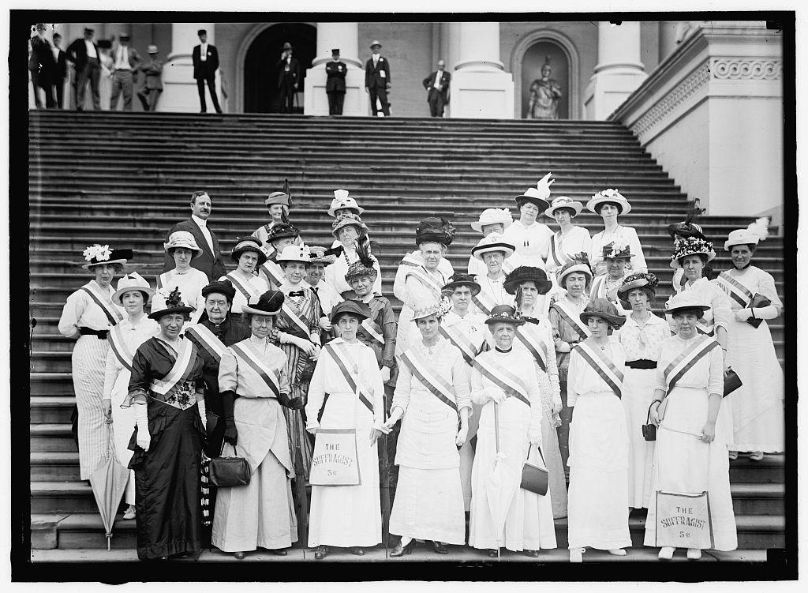
The Seneca Falls Convention in 1848 was significant because it….?
marked the start of the organized women’s rights movement.

